Slide 1
BASIC INTERVIEW QUESTIONS & ANSWERS

Slide 2
Tell me about yourself?
I am Suriya, currently working as a Business Analyst at Mindsprint with over 1 year and 5 months of experience specializing in ServiceNow strategy, & infrastructure consulting, Transition Management, & presales management. My role focuses on guiding customer business cases with strategic product & infrastructure solutions. My functional skills extends to product strategy development, program governance, resource allocation, and performance tracking, ensuring all my projects achieve measurable outcomes. And about my qualification, I hold an MBA in AI and Data Science with remarkable CPGA of 9.47 out of 10 and an MA in English Literature. My daily activities involves platform & product management activities, taking part in the Scrum calls to validate whether the right stories are being worked by my team, Transition management, presales support management to bridge all my customers technical and business problems perspectives with proactive solutions. Overall, I bring a strong blend of strategic insight, techno-functional acumen, and executive level experience to drive innovative solutions to my customers.
Why are you interested in our company?
I am highly interested in MiQ Digital because of its programmatic advertising and AI-driven media solutions, which is potentially the future of media and digital entertainment industry. The company’s commitment to continuous innovation, on a product called MiQ Sigma and advanced cross-channel campaign optimization, excites me as it offers tremendous opportunities to contribute to transformative product initiatives that drive real impact in digital media business. Moreover, MiQ’s culture of agility, collaboration, and data-centric decision-making interests me and my working style. I am eager to bring my skills in product management, strategic planning, and stakeholder engagement to a dynamic team at MiQ Digital, helping to build products that address evolving market needs and elevate customer experiences. Also, I think joining MiQ represents a chance to grow professionally while contributing to a forward-thinking organization that is shaping the future of advertising technology.
Why are you interested in this position?
I am very interested in the Associate Product Manager position at MiQ Digital because it presents an exciting opportunity to leverage my experience in strategic product solutions consulting, growth-focused digital environment. My background includes leading the designing of new features, defining functionalities, enhancing the existing product capabilities, managing cross-functional teams' collaboration for data informed solutions, and driving value through innovation and R&D, all of which closely align with MiQ’s commitment to data-driven transformation and advanced media technologies. The role matches my expertise in translating business requirements into actionable product roadmaps collaborating with stakeholders to deliver measurable results.
What are your strengths?
My key strengths include strategic consulting, product & platform management, and cross-functional collaboration. I excel at analyzing complex business challenges and designing solution-driven transformational roadmaps, leveraging my executive background as a Business Analyst. My experience in delivering high-impact, AI-enabled compliance solutions has honed my ability to translate customer needs into scalable, which I believe the same for data-driven products. I am skilled in stakeholder management and clear executive communication, ensuring alignment across business, technology, and vendor teams. My proficiency in Agile methodologies, product management, and program governance enables me to manage priorities, drive innovation, and deliver measurable outcomes. Overall, my blend of strategical expertise, techno-functional acumen, positions me to contribute effectively as an Associate Product Manager at MiQ Digital.

Slide 3
What are your weaknesses?
One area I am actively working to improve is delegating technical tasks within cross-functional teams. Because I have a strong interest in techno-functional strategical problem-solving, I sometimes take on complex issues myself rather than distributing them among available specialists. I’ve recognized that effective delegation not only increases team efficiency but also fosters development across the group. To address this, I have started using more structured project management tools and open communication strategies to better leverage team strengths, ensuring that responsibilities are shared appropriately. This approach has helped me enhance collaboration, empower team members, and focus more on strategic product leadership.
Why did you leave your last job?
I want to leave my last position because I am seeking new growth opportunities that align more closely with my passion for product management, advanced analytics, and innovative technology in the digital media space. While my role at Mindsprint provided valuable experience in strategic consulting and AI-driven product development, I am excited to take on greater challenges where I can work on cutting-edge solutions and contribute to a fast-paced, visionary organization like MiQ Digital. Making this move is a proactive step to further my career while adding value in an environment that matches my skills and aspirations. Also, I want to I leave my last job to take care of a family financial health matter. Now that’s behind me, because my father has lost his job because of the age factor, but I’m eager to to work in a role where I can help my customers because that brings me a lot of satisfaction.
What’s your preferred work environment/leadership style?
My preferred work environment is collaborative, dynamic, and driven by innovation. I thrive in teams that embrace open communication, experimentation, and shared accountability—settings where team members exchange ideas freely and work together toward common goals. I value environments that support continuous learning, encourage proactive problem-solving, and adapt quickly to change. In terms of leadership style, I work best under leaders who are approachable, clear in their vision, and supportive of individual growth. I appreciate management that empowers teams, sets clear expectations, and provides constructive feedback while encouraging autonomy and creativity. This style fosters both professional development and high-performance teamwork, which I believe are essential for building successful products at MiQ.
Why should we hire you over other qualified candidates?
You should hire me because I bring a unique blend of strategic business analysis skills, product & strategy management, program governance, project management, strong presales management skills with excellent vendor management skills, which I can convenience my customers to win the deal and cross-functional collaboration. My strong communication skills and stakeholder management experience ensure alignment across teams and leadership, facilitating efficient execution and timely delivery. My academic credentials in AI & Data Science combined with my passion for product management equip me to contribute fresh perspectives and data-driven decision-making to MiQ’s innovative product portfolio. I am deeply motivated to drive impactful results within a forward-thinking organization like MiQ Digital, and my proven track record of leading strategic initiatives and delivering high-quality products service and consultation positions me as a strong asset to MiQ.

Slide 4
What is Your Expected Salary Range?
In my previous role, I acquired significant skills and took on responsibilities that have enhanced my expertise in strategic product consulting. While my last salary was based on an entry-level package, it was offered at an F2 grade — a level typically reserved for candidates with a minimum of two years of experience.Given my current experience and double master’s qualifications, I believe my expected CTC accurately reflects both my skill set and prevailing market standards. My focus is not solely on compensation but also on growth opportunities and the value I can contribute to the organization.Based on my research into market benchmarks for Associate Product Managers with approximately 1.5 years of experience in AI-first product companies in the Bangalore area, the average compensation ranges between ₹18–25 LPA. Additionally, after reviewing information from Glassdoor, AmbitionBox, PayScale, and speaking with MiQ employees via Naukri, I understand the budgets and packages for similar roles and would expect a range of ₹16.5–20 LPA.I also noted that MiQ offers fresher packages of around ₹13–15 LPA. Considering my experience and qualifications, I believe a package between ₹16.5–20 LPA would be an appropriate fit and align with your allocated budget for this role. I remain open to negotiation within ±10% of this range and would be happy to learn more about the total compensation structure, including performance bonuses and annual increases over time.
You don't have experience in this role, why should we hire you?
You’re right — I may not have direct experience in the Associate Product Manager role specifically, but I bring a strong foundation in the core skills required, including strategic product management & consulting, presales management, transition and transformation management, AI-driven product innovation, and project management in various aspects such as Scrum, and software development methodologies. Throughout my career, I have demonstrated a proven ability to learn quickly and adapt by taking on responsibilities beyond my initial scope, such as leading AI-enabled ServiceNow modules and service optimization strategies. What I lack in direct product management experience, I compensate with dedication, curiosity, and a proactive mindset. I’m committed to asking the right questions, collaborating cross-functionally, and delivering results that align with business goals. I’m genuinely excited about the opportunity to bring a fresh perspective to MiQ Digital, grow within the product management discipline, and make meaningful contributions to your team. Given the chance, I’m confident that my blend of skills, adaptability, and commitment will prove values, and I politely believe you won’t regret choosing me.
Describe Your Long-Term Career Goals
My long-term career goal is to evolve into a senior product leadership role where I can drive the development of innovative, AI-powered digital solutions that transform how businesses leverage data and technology. I aim to deepen my expertise in product management, combining my foundation in AI, data science, and strategic consulting to build products that deliver measurable value and solve complex customer challenges. I also aspire to lead cross-functional teams, fostering a culture of collaboration, creativity, and continuous learning. Contributing to an organization like MiQ Digital, which is at the forefront of programmatic advertising and media innovation, aligns perfectly with my ambition to work on impactful, future-ready products. Ultimately, I want to be recognized as a product leader who not only delivers successful products but makes real impact in the global SaaS products business environment.

Slide 5
INTERVIEW QUESTIONS & ANSWERS
HIGH LEVEL PRODUCT MANAGEMENT

Slide 6
PRODUCT VISION AND STRATEGY
Your CEO asks you to define the long-term vision for a product, but the market is rapidly changing. How would you approach this?
I would start by analyzing market trends, customer needs, and competitor strategies. I would then define a flexible product vision focused on solving core user problems rather than locking into rigid features. I would present a high-level vision supported by short-term adaptable roadmaps to accommodate market shifts.
Your company wants to enter a new market where it has no prior experience. How would you define the product strategy?
I would conduct market research, competitor benchmarking, and customer discovery interviews. I would identify gaps in the market and evaluate whether our strengths align with customer pain points. I would propose a phased strategy—starting with an MVP to test demand—before scaling with full investment.
A competitor just launched a new feature that your customers are asking for. How would you handle this?
I would assess whether the feature aligns with our product vision and user needs. If it is critical, I would prioritize it in the roadmap with a clear differentiation angle. If not, I would communicate transparently with customers and focus on areas where our product provides greater value.
Leadership wants aggressive growth targets, but user research shows limited adoption potential. How would you respond?
I would present data from user research and adoption studies to highlight realistic growth potential. I would propose alternative strategies like targeting adjacent markets, improving retention, or diversifying monetization. My approach would balance ambition with data-driven feasibility.
You are asked to define KPIs for a new product. What would you do?
I would align KPIs with the product’s stage and goals. For an early-stage product, I would track adoption, activation, and engagement. For a mature product, I would measure retention, revenue growth, and customer satisfaction. I would ensure KPIs are specific, measurable, and linked to business outcomes.
Your product vision is unclear to stakeholders. How would you create alignment?
I would hold collaborative workshops to co-create vision statements, share customer insights, and use storytelling to articulate the “why” behind the product. I would reinforce alignment by documenting the vision and embedding it in roadmaps, Objectives & Key Results (OKRs), and team communication.
Your product is doing well in one segment but struggling in another. How would you adjust strategy?
I would analyze performance by customer segment and identify differences in needs, pricing sensitivity, and behavior. I would double down on the successful segment while re-evaluating positioning or feature sets for the weaker segment. If necessary, I would deprioritize the struggling segment to focus resources.
A stakeholder wants to expand the product into multiple directions at once. How would you decide where to focus?
I would evaluate each opportunity based on potential market size, customer demand, alignment with strategy, and resource availability. I would use frameworks like RICE or weighted scoring to prioritize. I would recommend focusing on fewer, high-impact initiatives rather than spreading too thin.
You’re asked to create a product vision that balances short-term revenue with long-term growth. How would you handle this?
I would build a two-track roadmap—short-term features that drive immediate revenue and long-term investments that ensure sustainable growth. I would communicate the importance of balancing both to stakeholders & align resources.
Your leadership team disagrees on the direction of the product. How would you build consensus?
I would gather data on customer needs, market opportunities, and financial impact. I would present multiple scenarios with pros and cons, then facilitate structured discussions to align leadership on a unified direction. Where consensus is not possible, I would escalate with a clear recommendation backed by evidence.

Slide 7
PRIORITIZATION AND ROADMAPPING
You have more feature requests than your team can handle. How would you prioritize?
I would gather input from stakeholders and customers, then use frameworks like RICE (Reach, Impact, Confidence, Effort) or MoSCoW (Must-have, Should-have, Could-have, Won’t-have). I would prioritize features that align with strategy, deliver the highest value, and fit within available resources.
Sales is pushing for a feature that doesn’t align with the roadmap. What would you do?
I would listen to their case and evaluate if the feature adds value for a critical customer segment. If not aligned, I would explain the roadmap priorities and offer alternatives. If the feature is critical, I would adjust priorities transparently and communicate trade-offs.
Your roadmap is criticized for being too vague. How would you make it more effective?
I would break down high-level themes into clear initiatives with timelines, owners, and success metrics. I would also communicate the roadmap visually using tools like Gantt charts or Kanban boards, showing both short-term deliverables and long-term goals.
Your engineering team says your roadmap is too ambitious. How would you respond?
I would collaborate with engineering to estimate effort, resource needs & adjust priorities based on feasibility, negotiate scope, if necessary, & communicate realistic timelines to stakeholders. The goal is to balance ambition with execution capacity.
A critical customer threatens to leave unless their requested feature is prioritized. What would you do?
I would assess the revenue and strategic importance of the customer against the broader roadmap. If the feature is justified, I would prioritize it while managing expectations with other stakeholders. If not, I would explore alternative solutions to retain the customer.
Your roadmap needs to be restructured due to budget cuts. How would you approach it?
I would revisit the roadmap, identify must-have initiatives tied to revenue or compliance, and cut lower-priority projects. I would communicate the rationale clearly to stakeholders and ensure that the reduced roadmap still aligns with long-term goals.
Different stakeholders have conflicting priorities for the roadmap. How would you resolve this?
I would organize a prioritization workshop, using objective scoring frameworks. I would bring data on market demand, ROI, and user research to guide decisions. If consensus cannot be reached, I would escalate with a recommendation to leadership.
Your roadmap is disrupted by an unexpected competitor launch. How would you adapt?
I would quickly analyze the competitor’s offering, gather customer feedback, and assess if the new threat requires an immediate response. If necessary, I would reprioritize the roadmap to include competitive features or improvements, while maintaining focus on differentiation.
You are asked to share the roadmap with customers. How would you manage expectations?
I would create an external version of the roadmap with high-level themes and value-driven initiatives, avoiding specific dates. I would highlight the vision and direction without overpromising features or timelines.
Your roadmap looks strong on features but lacks a long-term strategy. How would you fix it?
I would align roadmap to broader company goals, ensuring it includes strategic initiatives like scalability, infrastructure improvements, or new market exploration. I would add a mix of short-term deliverables and long-term bets that support the product vision.

Slide 8
USER EXPERIENCE AND CUSTOMER FOCUS
Customers complain that a key feature is difficult to use. How would you respond?
I would gather detailed user feedback through surveys, usability testing, and customer support logs. I would then work with design and engineering to simplify workflows, improve clarity, and release incremental improvements. I would also communicate transparently with users about the updates.
You receive conflicting feedback from different customer segments. How would you prioritize?
I would segment the feedback by customer type, revenue impact, and strategic importance. I would prioritize improvements that benefit the largest or most critical segments while exploring tailored solutions for niche groups if resources allow.
A customer requests a feature that is outside the product’s core vision. How would you handle it?
I would thank the customer for the feedback, evaluate if the request aligns with long-term goals, and analyze potential demand. If not aligned, I would politely decline but share alternative solutions. If aligned, I would add it to the roadmap based on priority.
Customers are abandoning the onboarding process. What would you do?
I would analyze funnel analytics to identify where drop-offs occur. I would simplify the onboarding flow, reduce unnecessary steps, and provide tooltips or guided tours. I would A/B test changes to measure improvements in activation rates.
A major customer is unhappy with product updates. How would you manage this relationship?
I would meet with the customer to understand concerns and provide context for the updates. I would share upcoming roadmap improvements relevant to them and ensure their feedback is considered. If possible, I would fast-track fixes that align with overall strategy.
A user group keeps requesting advanced features, but most of your customers are basic users. What would you do?
I would evaluate the business value of serving advanced users versus the broader customer base. I might create tiered product offerings—keeping the core simple while offering advanced features in a premium plan.
Customer feedback suggests your product is too complex compared to competitors. How would you address this?
I would conduct usability testing and competitor benchmarking. I would simplify navigation, improve documentation, and remove unnecessary steps. I would also prioritize features that provide the highest value while deprecating low-usage, high-complexity ones.
You are launching a new feature, but customers are unaware of it. How would you drive adoption?
I would collaborate with marketing and customer success to create in-app guides, email campaigns, and webinars. I would also track adoption metrics and gather feedback to refine the rollout.
Customers report frequent bugs in critical workflows. How would you prioritize fixes?
I would categorize issues based on severity and impact on revenue or user experience. Critical bugs would be prioritized over new features, and I would work with engineering to establish SLAs for bug resolution.
Customer satisfaction scores are dropping despite feature releases. How would you investigate?
I would analyze Net Promoter Score (NPS) and CSAT data alongside product usage metrics. I would identify gaps between what customers value and what we are delivering. I would then realign the roadmap to focus on improving core customer pain points rather than just adding new features.

Slide 9
STAKEHOLDER MANAGEMENT AND EXECUTION
Engineering says they cannot deliver a high-priority feature by the deadline. How would you handle it?
I would work with engineering to understand constraints and explore scope reduction or phased delivery. I would communicate trade-offs to stakeholders and reset expectations, ensuring that the most critical functionality is prioritized for release.
Sales wants you to commit to a feature for a big client, but engineering has not yet validated feasibility. What would you do?
I would avoid overpromising and explain that feasibility needs confirmation. I would work with engineering to conduct a quick technical assessment and provide Sales with a realistic timeline or alternatives that can be delivered with confidence.
Marketing and Engineering disagree on the launch date for a new feature. How would you resolve the conflict?
I would bring both teams together to align on dependencies. If engineering needs more time, I will explore phased rollouts or beta testing. I would then communicate a realistic launch date that balances product quality and market needs.
A senior executive demands a feature that is not on the roadmap. How would you handle this?
I would evaluate the request against customer demand, business impact, and resource availability. If justified, I would reprioritize transparently and communicate trade-offs. If not, I would provide data to explain why it should not be pursued immediately.
Your sprint review shows that multiple features are incomplete. How would you address this?
I would review the reasons—whether scope creep, poor estimation, or technical debt. I would work with the team to improve sprint planning, enforce better backlog grooming, and ensure clear acceptance criteria for future sprints.
The design team wants to spend extra time polishing UX, but leadership pushes for a quick release. How would you balance this?
I would assess the user impact of delaying polish versus launching early. If usability is significantly affected, I would argue for delaying release. Otherwise, I would suggest an MVP launch with iterative improvements in subsequent updates.
You discover mid-project that the scope has expanded significantly without approval. How would you handle it?
I would identify added items, assess their impact, and bring stakeholders together to re-prioritize. I would enforce change management processes and ensure that future scope changes are documented and approved before implementation.
Your engineering team is behind schedule, and stakeholders are frustrated. How would you manage expectations?
I would provide transparent updates with revised timelines and explain root causes. I would share mitigation strategies like scope reduction or parallel workstreams. Consistent communication helps rebuild stakeholder confidence.
You are asked to lead a product launch with very limited resources. How would you execute it?
I would focus on the critical success factors for launch—ensuring stability, targeting the right customer segment, and building awareness. I would cut non-essential scope and leverage low-cost marketing like targeted digital campaigns and customer advocacy.
Different stakeholders disagree on the product’s key priority. How would you align them?
I would organize a structured workshop using prioritization frameworks. I would present data on market opportunity, customer demand, and ROI to guide decisions. If conflict remains, I will escalate to leadership with clear recommendations.

Slide 10
MARKET STRATEGY AND ADVANCED SCENARIOS
A competitor suddenly drops prices and starts gaining your customers. How would you respond?
I would analyze whether the competitor’s pricing is sustainable and assess how much it impacts our core segments. Instead of immediately matching prices, I would highlight our product’s differentiators, explore bundling or loyalty programs, and consider targeted discounts only where needed.
Your product adoption is strong initially but user retention is weak. How would you address this?
I would analyze usage patterns to identify drop-off points, conduct customer interviews, and review onboarding experience. I would then improve activation flows, add engagement features like reminders or personalization, and strengthen customer support to boost retention.
A new regulation could impact your product’s compliance. How would you prepare?
I would work with legal and compliance teams to understand requirements and timelines. I would assess the product impact, prioritize compliance-related changes in the roadmap, and communicate updates to stakeholders and customers transparently to maintain trust.
You are launching in a new international market. What factors would you consider?
I would assess local user needs, language and cultural preferences, regulations, and pricing expectations. I would ensure product localization, adapt marketing strategies, and consider partnerships with local distributors or service providers for smoother entry.
A new disruptive technology is emerging that could make your product less relevant. How would you react?
I would evaluate the technology’s adoption curve and impact on our industry. I would explore integrating it into our product or pivoting our strategy to leverage it. If necessary, I would start R&D or partnerships to stay competitive.
Your product launch received negative customer feedback. What would you do?
I would analyze the feedback to identify common themes, address critical issues quickly, and release improvements in short cycles. I would communicate openly with customers about fixes and show responsiveness to rebuild trust.
You need to design a go-to-market strategy for a new feature. How would you approach it?
I would define the target customer segment, set positioning and messaging, and align with marketing on campaigns. I would enable sales with collateral and training, monitor adoption metrics post-launch, and adjust strategy based on feedback.
Your product has strong features, but market share is not growing. How would you investigate?
I would analyze brand awareness, pricing competitiveness, and distribution channels. I would gather customer insights to see if the value proposition is clear. Depending on findings, I would improve marketing, refine positioning, or adjust pricing models.
A key enterprise customer wants a custom feature, but it could derail your broader roadmap. How would you decide?
I would assess the revenue potential and strategic importance of the customer against roadmap priorities. If justified, I would negotiate cost-sharing or build it in a scalable way. If not, I would offer alternative solutions while maintaining focus on long-term strategy.
After months of investment, your product metrics show little improvement. How would you address this?
I would revisit assumptions, analyze whether the product solves a real user problem, and validate with customer feedback. I would pivot strategy if needed—focusing on high-impact features, changing positioning, or even rethinking the business model to align better with market demand.

Slide 11
TECHNICAL 1
1. Explain how a product goes from concept to launch.
A successful product journey begins with identifying a market problem or opportunity through user research, competitive analysis, and stakeholder conversations. For example, to enhance programmatic campaign optimisation, I’d first validate the problem and define personas by gathering input from traders, marketers, and sales. Next, I’d work collaboratively to develop a requirements document, clarifying the value proposition and success metrics (like improvement in optimisation efficacy or user adoption). Then, I would coordinate ideation sessions with cross-functional teams—engineering, data science, UX/UI—to refine solutions and ensure technical feasibility.​​ After agreeing on a feature set and roadmap based on impact and effort, I’d oversee the agile development process, holding regular sprint reviews and incorporating stakeholder feedback. Ensuring thorough QA and running A/B pilots are critical before a phased launch and full go-live. Post-launch, I’d rigorously monitor product analytics, track adoption/KPIs, and iterate rapidly using learnings for further enhancements.​​
2. How do you prioritize features for a new product or update?
I use a data-driven prioritization approach involving frameworks like RICE (Reach, Impact, Confidence, Effort) and MoSCoW (Must have, Should have, Could have, Won’t have). I start with stakeholder interviews (product leads, end users, sales), documenting each need and associating business value—for example, anticipated lift in campaign performance. Quantitative metrics such as user impact, revenue potential, resourcing needs, and technical complexity are assigned scores. Decisions are made transparently—features that reduce operational bottlenecks or enable significant optimisation improvements are prioritized. For example, if building an AI-driven bidding strategy promises the highest return, it moves forward, while minor UI tweaks are deprioritized. I iterate the roadmap monthly, ensuring alignment with business OKRs (Objectives and Key Results), and always communicate trade-offs with stakeholders.​​
3. How do you handle conflicting priorities between different teams?
When faced with conflicting priorities, such as engineering needing to address tech debt while sales pushes for new features, I first ensure open dialogue. I gather data to frame the trade-offs—quantifying lost revenue due to tech debt versus potential incremental sales from new features. Facilitating a workshop with both teams, I use data and business impact to mediate and reach consensus. If the conflict persists, I escalate strategically, presenting options and their business implications to leadership for a decision, always maintaining transparency. I document rationale for decisions to build trust, and ensure both teams feel heard and aligned to overall product goals. This approach balances short-term gains with long-term product health.​​
4. Describe your experience with analytics in product management.
Analytics is central to every product decision I make. In past projects, I used data to monitor key KPIs, such as CTR, ROAS, and feature adoption metrics, ensuring features directly tied to measurable outcomes. For example, when launching an optimisation automation tool, I defined baseline metrics, designed dashboard tracking with the data team, and set up weekly reviews to quickly pivot based on data insights. I am proficient with SQL, Excel, and BI tools for exploring user cohort behavior, running A/B tests, and generating actionable insights. In one instance, analytics revealed a drop in adoption post-update; deeper exploration attributed it to UX friction, leading to targeted redesigns that reversed the trend.​​

Slide 12
TECHNICAL 1
5. What is programmatic advertising? Describe the ecosystem.
Programmatic advertising refers to the automated buying and selling of digital ad inventory using real-time bidding and data-driven targeting. The ecosystem encompasses demand-side platforms (DSPs), supply-side platforms (SSPs), ad exchanges, data management platforms (DMPs), and various targeting/measurement tools. For example, an advertiser uses a DSP to bid on impression opportunities made available by publishers via SSPs on ad exchanges, enabling real-time targeting and campaign optimization. Programmatic systems leverage data and algorithms to optimize bids, improve targeting (audience segments, geos, devices), and maximize ROI, with significant roles played by trading specialists and optimisation AIs.​​
6. What are some key Excel skills you use for analytics in product management?
Advanced Excel skills are fundamental. I use pivot tables to segment campaign data, VLOOKUP/XLOOKUP to merge disparate datasets (e.g., campaign and user data), and data validation for error-free model inputs. I regularly employ statistical formulas for trend analysis, automate repetitive analysis with macros, and visualize key insights using charts—helping stakeholders interpret complex optimisation results rapidly. These skills accelerate root-cause analysis and support data-driven product development.​
7. How do you define success metrics for a product feature?
Success metrics are determined based on product goals—user engagement, business outcomes, and operational efficiency. Early in feature planning, I define north-star metrics (such as user adoption rate, uplift in optimisation score, or process automation time savings). I leverage baseline analysis, stakeholder input, and benchmarking with similar products where available. For example, when releasing a new auto-bidding feature, I’d select KPIs such as increase in campaign ROAS, reduction in manual intervention, and user retention. These are measured using analytics platforms and validated with both quantitative (usage stats) and qualitative (user feedback) data.​​
8. How would you determine a pricing strategy for a hotel chain?
I would start with a competitor analysis and customer segmentation to understand the market landscape. Then, I’d consider dynamic pricing models based on demand (seasonality, occupancy rates, local events), leveraging analytics to simulate various pricing scenarios. Working closely with marketing and finance, I would factor in cost structure, willingness to pay, and perceived value. I’d also consider incorporating digital ecosystem partnerships (e.g., loyalty programs, bundled offers), testing pricing using pilots, and iterating based on conversion data and guest feedback.​
9. Tell me about a time you had to deliver tough feedback to a team member.
In one instance, while leading a cross-functional sprint, a team member consistently missed deliverables. Recognizing the negative impact on team morale and project momentum, I scheduled a private, empathetic conversation. I started by acknowledging their strengths, then cited specific instances of delays, focusing on project impact and mutual goals. We discussed root causes and discovered over-allocation due to overlapping responsibilities. Together, we reassigned some tasks, set incremental check-ins, and as a result, the team member’s performance and engagement improved. This experience taught me the importance of direct, supportive communication and problem-solving.​​

Slide 13
PROGRAMMATIC ADVERTISEMENT

Slide 14
COMMON PROGRAMMATIC ADVERTISING INTERVIEW QUESTIONS (1/3)
1. Can you explain the difference between DSP, SSP, Ad Exchange, and DMP? How do they interact in programmatic advertising?
A DSP (Demand Side Platform) enables advertisers and agencies to buy digital ad inventory programmatically at scale, using algorithms and data to optimize delivery. SSPs (Supply Side Platforms) help publishers make their ad space available to multiple buyers, maximizing yield. Ad Exchanges are marketplaces where DSPs and SSPs transact, facilitating real-time bidding auctions. DMPs (Data Management Platforms) aggregate and analyze diverse user data sets to build granular audience segments, empowering both DSPs and SSPs with advanced targeting and analytics. For example, when a user visits a website, the SSP sends a request to an ad exchange, DSPs evaluate the impression using DMP data, bid on it in real time, and the winning creative is served, all in under a second.​
2. Walk me through what happens when a user loads a page with a programmatic ad. What is the real-time bidding (RTB) process?
When a user loads a web page, the site's SSP collects contextual and user data, packaging it into a bid request to send to an ad exchange. The exchange forwards this request to multiple DSPs, each of which analyzes the data against its active campaigns and audience profiles, often using DMP inputs. Each DSP places a bid based on campaign goals and predicted value. The highest bid wins the auction, and the winning ad is served instantly on the user’s screen. This entire RTB process typically takes about 100 milliseconds, ensuring relevant ads are delivered at scale and speed.​
3. What are the typical bidding strategies in DSPs? When would you use manual bidding versus automated or goal-based bidding?
DSPs commonly offer manual bidding, automated rule-based bidding, and goal-based (algorithmic) bidding:
Manual bidding lets the advertiser control exact bid prices—useful for low-budget campaigns or targeted A/B tests.
Automated bidding adjusts pricing based on set rules (e.g., raise bids for placements with higher conversion rates).
Goal-based bidding uses machine learning to optimize for business objectives like maximizing CTR, conversions, or ROAS, adapting in real time. Manual bidding is practical for precise tests or niche targeting, while algorithmic/goal-based is better for campaigns that require continuous optimization and scale.​
4. As a Product Manager, how would you measure and improve the win rate on your DSP?
I’d start by analyzing the bid landscape report to understand where bids are consistently falling short and which publishers or exchanges have the best opportunities. Improvement steps include optimizing bid price thresholds, leveraging bid shading strategies, and tightening audience targeting to reduce wasted impressions while increasing relevant reach. I would also A/B test new algorithms, and work with data science to enrich the DSP’s bidding logic—such as integrating real-time feedback loops. Success would be measured by monitoring win rate, CPM stability, and downstream impact like conversions or ROAS.​
5. How do supply path optimization (SPO) and header bidding impact publisher yield and advertiser efficiency?
Supply path optimization (SPO) helps advertisers cut out resellers and duplicative supply chains, resulting in greater transparency, lower fees, and better control over inventory quality. For publishers, this can mean more direct demand and fair pricing. Header bidding allows publishers to offer inventory to multiple demand sources simultaneously before calling their ad server, increasing competition and yield. Both strategies foster a more efficient, transparent, and win-win ecosystem for both sides.​

Slide 15
COMMON PROGRAMMATIC ADVERTISING INTERVIEW QUESTIONS (2/3)
6. What KPIs are most important to track for programmatic campaign optimization?
The most important KPIs include:
Win Rate: Proportion of impressions won vs. bid on.
CPM (Cost Per Mille): Efficiency of spend.
CTR (Click-Through Rate): Engagement.
CPA (Cost Per Acquisition): Conversion efficiency.
Viewability: Quality and viability of impression delivery.
Frequency: Controls for ad fatigue/frequency capping.
Incremental Reach: Unique users or new segments reached via a campaign.
These KPIs help assess performance from delivery to actual business impact, guiding real-time adjustments.​
7. How do you ensure brand safety and prevent ad fraud in programmatic campaigns?
I work with vendors offering pre-bid and post-bid brand safety and anti-fraud detection filters—blocking non-safe inventory, suspicious domains, and invalid traffic. I leverage private marketplaces, supply path optimization, and regularly audit campaign placements for anomalies. Integrating industry standards such as ads.txt and OpenRTB protocols is vital. Regular collaboration with both supply and compliance teams ensures risk is minimized and brand integrity maintained.​
8. What challenges do you see in moving to a cookieless advertising ecosystem, and what programmatic strategies can address them?
The loss of third-party cookies limits cross-site tracking and granular audience targeting, challenging historical attribution and personalization. To adapt, I would focus on building robust first-party data assets, developing contextual targeting capabilities, and leveraging privacy-safe ID solutions like Unified ID 2.0. I’d also pilot new measurement frameworks and foster strategic publisher partnerships to ensure addressability and effectiveness without compromising on privacy.​
9. How can a data management platform (DMP) improve targeting and performance in a programmatic setup?
A DMP unifies user, campaign, and third-party data, enabling advertisers to build detailed audience segments—be it retargeting website visitors or finding lookalike audiences. Integrating with DSPs, a DMP empowers precise targeting, creative personalization, and real-time adjustment. This drives higher conversion rates and ROAS, as campaigns are continuously optimized using ongoing data signals, not static assumptions.​
10. Provide an example of optimizing a live campaign mid-flight. What data would you monitor, and what changes might you make?
Suppose a campaign’s CPA is above target mid-flight. I would monitor the placement-level performance, bid landscapes, frequency, and conversion funnel analytics. If certain exchanges have low conversion rates or high fraud signals, I’d exclude them or adjust bids. I’d recommend A/B testing new creatives if CTR drops, retuning audience segments, or shifting spend to higher-performing time slots. Continuous monitoring ensures rapid identification and response to underperformance, maximizing outcomes.​

Slide 16
Programmatic Advertisement
1. Concepts
CONCEPT | MEANING | WHY IT MATTERS
Programmatic Advertising | Automated buying & selling of digital ad inventory in real time via software platforms rather than manual negotiations. | Reduces human error, speeds up transactions, scales easily.
DSP (Demand-Side Platform) | A platform advertisers use to buy ad space across multiple publishers automatically. | Central place to manage campaigns & bids.
SSP (Supply-Side Platform) | Platform publishers use to sell ad inventory programmatically to many buyers. | Maximizes publisher revenue & fill rates.
Ad Exchange | A marketplace where DSPs and SSPs transact. | The “stock exchange” of digital ads.
RTB (Real-Time Bidding) | The auction mechanism that decides which ad is shown to which user at the time of page load. | Enables precision targeting and price optimization.
PMP (Private Marketplace) | Invitation-only programmatic auctions between select publishers and advertisers. | Combines automation with premium inventory access.
Direct Programmatic / Programmatic Guaranteed | Pre-negotiated deals automated through programmatic platforms (no bidding). | Ensures guaranteed impressions with automation efficiency.

Slide 17
Programmatic Advertisement
2. Targeting & Data Concepts
CONCEPT | MEANING | WHY IT MATTERS
First-Party Data | Advertiser’s own user data (CRM, website visits, app data). | Highest quality for personalized ads.
Third-Party Data | Data aggregated from other sources/vendors. | Broader reach but lower accuracy post-cookies.
Contextual Targeting | Placing ads based on page content rather than user identity. | Important in privacy-first environments.
Audience Segmentation | Dividing users into groups by behavior, demographics, or interests. | Improves ad relevance & ROI.
3. Measurement & Optimization Concepts
CONCEPT | MEANING | WHY IT MATTERS
Viewability | Whether an ad was actually viewable on a user’s screen. | Non-viewable ads don’t generate value.
Attribution | Determining which ad interaction drove a conversion. | Helps allocate spend effectively.
Brand Safety & Suitability | Avoiding ads on harmful or irrelevant content. | Protects brand reputation.
Frequency Capping | Limiting how many times an ad is shown to the same user. | Prevents ad fatigue and waste.
Bid Shading | Algorithmic bidding that finds a middle ground between first- and second-price auctions. | Saves money in auctions.

Slide 18
Programmatic Advertisement
4. Advanced / Emerging Concepts
CONCEPT | MEANING | WHY IT MATTERS
Header Bidding | Publishers let multiple SSPs/DSPs bid simultaneously before calling the ad server. | Increases competition and yield.
Programmatic Audio / CTV / DOOH | Programmatic buying of ads in audio streaming, connected TV, and digital out-of-home screens. | Expands programmatic beyond display ads.
Identity Solutions / UID2.0 | Alternatives to third-party cookies to track & target users. | Crucial for the cookieless future.
Dynamic Creative Optimization (DCO) | Automatically customizes ad creatives based on user data/context. | Improves engagement & conversion.
Supply Path Optimization (SPO) | Advertisers choose the most efficient path to publisher inventory. | Reduces fees and fraud.

Slide 19
COMMON PROGRAMMATIC ADVERTISING INTERVIEW QUESTIONS (3/3)
Aspect | Demand-Side Platform (DSP) | Supply-Side Platform (SSP)
Purpose | Used by advertisers/agencies to buy ad inventory programmatically | Used by publishers to sell and manage their available ad inventory
User Base | Advertisers and media buyers | Publishers and digital media owners
Functionality | Automates media buying, targeting, bidding across multiple sources | Automates inventory sales, manages auctions across multiple demand sources
Key Objective | Optimize ad spend, targeting, and campaign performance for buyers | Maximize revenue, fill inventory efficiently for publishers
Role in Ad Ecosystem | Places bids on ad impressions, selects which ads to show based on data | Runs auctions, sets price floors, controls inventory supply to demand

Slide 20
MiQ Competitor Products & Companies
COMPETITOR PRODUCT | COMPETITOR COMPANY | DESCRIPTION/NOTES
BigSpy | BigSpy | A spying tool for Facebook, Google ads, Shopify ads, used for competitive intelligence and ad insights.
wetracked.io | Wetracked | Platform simplifies tracking Shopify orders and ad performance across platforms like META, TikTok, Pinterest.
Amazon Sponsored Ads | Amazon | Amazon’s sponsored ads platform, including Sponsored Products and Sponsored Brands for product discovery ads.
Kartapult | Kartapult | Advertising campaign management and optimization tool, used for digital marketing.
Lucid | Lucid | Platform for digital advertising performance insights and analytics.
Google Display & Video 360 (DV360) | Google | Data-driven programmatic advertising platform with tools for ad buying, audience management, and analytics.
The Trade Desk | The Trade Desk | Transparent, self-serve DSP with deep data analysis, AI automation, cross-device audience targeting.
MediaMath | MediaMath | Programmatic buying technology with attention-grabbing video, first-party data use, cross-device targeting.
Xandr | Xandr (Microsoft Advertising) | Scalable end-to-end advertising platform with advanced identity solutions for targeting CTV, display, native ads.
Outbrain | Outbrain | Content discovery and targeted advertising platform with programmatic buying options via DSPs.
PubMatic | PubMatic | Comprehensive programmatic solutions for publishers and marketers.
Criteo | Criteo | Retargeting platform with AI-driven audience targeting and performance measurement.
Adobe Advertising Cloud DSP | Adobe | Programmatic DSP with integration for creative, audience management, and campaign optimization.

Slide 21
MiQ Competitor Products Differentiators
COMPETITOR PRODUCT | COMPETITOR COMPANY | KEY DIFFERENTIATORS
MiQ Sigma | MiQ | Unifies 300+ data feeds, 700 trillion consumer signals; AI-powered Trading Agent using LLMs; Gen AI Personas for instant audience creation; agnostic platform connecting multiple DSPs/SSPs; proven 132% higher conversion, 57% lower CPA in tests .
BigSpy | BigSpy | Focuses on ad spying and competitive intelligence; limited to Facebook, Google, Shopify ads; no advanced AI or unified ecosystem .
wetracked.io | Wetracked | Tracks Shopify orders and ad performance; simple analytics; lacks deep AI or cross-platform campaign automation .
Amazon Sponsored Ads | Amazon | Sponsored Products and Brands for Amazon marketplace; limited to Amazon ecosystem; no multi-platform campaign orchestration .
Kartapult | Kartapult | Campaign management and optimization; focused on digital marketing; lacks AI-driven persona creation or unified data .
Lucid | Lucid | Digital ad performance analytics; no AI-powered campaign automation or persona generation .
Google Display & Video 360 (DV360) | Google | Data-driven programmatic buying; strong analytics; lacks unified AI agent for persona creation and multi-platform orchestration .
The Trade Desk | The Trade Desk | Transparent DSP with deep data analysis; strong cross-device targeting; lacks unified AI persona creation and agnostic multi-platform orchestration .
MediaMath | MediaMath | Programmatic buying with video and first-party data; lacks Gen AI persona creation and unified ecosystem .
Xandr | Xandr (Microsoft Advertising) | End-to-end advertising platform; advanced identity solutions; lacks unified AI persona creation and agnostic multi-platform orchestration .
Outbrain | Outbrain | Content discovery and programmatic buying; lacks unified AI persona creation and deep data integration .
PubMatic | PubMatic | Programmatic solutions for publishers; lacks unified AI persona creation and agnostic multi-platform orchestration .
Criteo | Criteo | Retargeting with AI-driven audience targeting; lacks unified ecosystem and persona creation .
Adobe Advertising Cloud DSP | Adobe | Programmatic DSP with creative and audience management; lacks unified AI persona creation and agnostic multi-platform orchestration .

Slide 22
Product Roadmap Example
PHASE | DESCRIPTION
Discovery & Foundation (0-3 months) | Problem Validation & Stakeholder Interviews: Engage with trading teams, data scientists, and client stakeholders to map pain points around current data access, analysis, and decision bottlenecks. Validate the need for simplification of DSP/SSP/RTB data flows and optimization controls. Define Success Metrics: Adoption rate of Trading Agent features, reduction in time spent on manual data extraction and analysis, improvement in campaign KPIs (CTR, ROAS, Win Rate). Technical Feasibility & Data Integration Mapping: Audit current data sources such as DSP bid logs, SSP inventory, Ad Exchange auction data, DMP audience segments. Architect ETL pipelines to unify these dispersed datasets into a single Trading Agent data layer.
MVP Development (4-6 months) | Core Functionalities: Build intuitive dashboards with key programmatic metrics (win rate, bid landscapes, CPM). Implement rule-based automation for bid adjustment and inventory prioritization. Enable granular audience segment integration from DMPs for targeting refinement. Simplified Data Access Interface: Design API and UI layers that abstract away raw data complexity; provide pre-built reports and alerting on performance anomalies. Real-time Analytics Engine: Create a near real-time data ingestion pipeline to power instantaneous bidding insights and optimization signals.
Advanced Automation & AI Enhancements (7-12 months) | AI-powered Bidding Models: Integrate ML models that dynamically adjust bidding strategies based on historical and contextual data. Support goal-based bidding such as CPA or ROAS optimization. Predictive Analytics & Recommendations: Surface proactive recommendations for campaign adjustments. Include forecast models estimating incremental lift and bid floor sensitivity. Experimentation Framework: Deploy A/B testing capabilities for new feature rollout and optimization policy validation.
Global Scale & Ecosystem Integration (12-18 months) | Multi-market Scalability: Adapt Trading Agent for diverse international markets with localization of data sources and campaign objectives. Partner and Ecosystem Connectivity: Increase integration with SSPs, Ad Exchanges, and new DMPs. Support header bidding environment optimization and supply path transparency. Self-serve & Collaborative Features: Develop granular user permissioning, shared dashboards, and collaboration features for cross-functional teams.
Continuous Learning & Innovation (18+ months) | Learning System and Feedback Loops: Enable automated learning from campaign outcomes to refine bidding and targeting algorithms. Establish feedback channels for traders to report insights and enhance Trading Agent features. Privacy-first Enhancements: Build cookieless targeting and measurement capabilities aligned with evolving privacy standards. Expand Beyond Ads: Explore adjacent use cases such as Connected TV and Cross-device attribution within the Trading Agent framework.

Slide 23
INTERVIEW QUESTIONS & ANSWERS
MiQ DIGITAL CORE PRODUCT MANAGEMENT

Slide 24
MEDIA PLATFORM | SUBSCRIBERS | AD-SUPPORTED/REACH | AVG. TIME SPENT | AD CLICKS/CONVERSION RATE (APPROX.)
Netflix | 301.6 million+ | 94 million | 41 hrs/month | Strong sales lift; specific rate not public
Amazon Prime | 240 million+ | Ad-supported user base not large | N/A | N/A (Prime: mainly ad-free, limited ad engagement)
Apple TV | 45.9 million+ | Limited/free tier (ad MAU <10M est) | N/A | N/A (Apple TV+ mostly ad-free; few direct ads)
Spotify | 696 million | ~404 million ad-supported | 25 hrs/month+ | ~1–2% CTR, typical music ad conversion
Apple Music | 110 million+ | Ad-supported MAU negligible | N/A | No direct ads (music only)
YouTube Music | ~95 million+ | Ad reach: ~80 million | N/A | ~1.5–2% CTR across music campaigns
YouTube | 2.74 billion | 2.53 billion ad reach | >30 hrs/month | CTR: 2–2.6% (video campaigns), conversion varies
Hulu | 53.6 million+ | ~33 million ad-supported (62%) | 53 min/day | Highest attention rate; est. 3–5% CTR
Disney Plus | ~154 million+ | Ad MAU ~30 million (est.) | N/A | Not public; CTV avg. 2% CTR
HBO Max | ~97 million+ | Ad MAU ~20 million (est.) | N/A | Not public; CTV avg. 2% CTR
Peacock | 37 million+ | ~20 million ad-supported (est.) | N/A | Not public; CTV avg. 2% CTR
Paramount+ | ~63 million+ | Ad MAU ~20 million (est.) | N/A | Not public; CTV avg. 2% CTR
JioSaavn | ~25 million+ | ~18 million ad MAU (est.) | N/A | Not public; India music avg. 1–2% CTR
Gaana | 185 million+ | ~166 million ad MAU (90%) | N/A | Not public; India music avg. 1–2% CTR
Amazon Music | 82 million+ | ~40 million ad-supported (est.) | N/A | Not public; music avg. 1–2% CTR
Pandora | 47.6 million+ | ~35 million ad-supported (est.) | N/A | Not public; music avg. 1–2% CTR
Deezer | 16 million+ | ~8 million ad MAU (est.) | N/A | Not public; music avg. 1–2% CTR
Rank | 1 | 2 | 3 | 4 | 5 | 6 | 7 | 8 | 9 | 10 | 11 | 12 | 13 | 14 | 15
Country | USA | China | Germany | India | Japan | UK | France | Italy | Canada | Brazil | South Korea | Australia | Russia | Spain | Mexico
Population | 347.3 | 1416.1 | 83.1 | 1463.9 | 124.7 | 68.2 | 65.9 | 59.0 | 39.8 | 212.8 | 51.4 | 26.0 | 144.0 | 46.7 | 130.0

Slide 25
Should MiQ prioritize expanding its Connected TV advertising capabilities or focus on enhancing its existing display and video ad offerings?
MiQ Digital should prioritize expanding its Connected TV (CTV) advertising capabilities given the rapid market growth and shifting advertiser budgets toward CTV, while still maintaining strength in display and video ad offerings to ensure full-funnel effectiveness.
Connected TV Market Trends
The global CTV market is expected to grow at a 13.5% CAGR from 2025 to 2035, with a projected value increase from $16.98 billion in 2025 to over $60 billion by 2035.
In 2025, CTV ad investments are forecasted to be 43% higher than online video, reaching $26.6 billion in the US alone.
More than 68% of marketers identify CTV as a “must-have” in their media mix for 2025, with many reallocating budget from linear TV and social media into CTV advertising.
MiQ Digital’s Current Capabilities
MiQ has developed an advanced, agnostic platform (MiQ Sigma) that connects programmatic advertising across TV, display, and video, using data from over 700 trillion consumer signals.
Their Advanced TV solution enables unified campaigns across linear, digital, and CTV, with sophisticated audience targeting and measurement tools.
MiQ’s AI-powered Performance Engine is optimized to drive third-party verified marketing outcomes with efficient reach and frequency.
Strategic Considerations
Advertisers are shifting budgets into CTV for better targeting, measurement, and cross-device reach, making CTV a key growth area.
Maintaining and enhancing display and online video remains vital for full-funnel marketing and retargeting strategies, as omni-channel approaches deliver stronger results.
MiQ’s capabilities to integrate behavioral insights, creative solutions, and TV retargeting allow clients to maximize reach across platforms.
Real-Time Recommendation
Expand CTV capabilities to address new audience habits, advanced targeting, and higher advertiser demand.
Continue to enhance display and video ad offerings in tandem to deliver holistic, cross-channel performance.
Use unified platforms and AI-driven analytics to help brands navigate fragmentation and achieve optimal outcomes.
MiQ Digital should leverage its strong technology foundation to lead in CTV, while using display and video enhancements as complementary strengths in a unified, programmatic media strategy.

Slide 26
How can MiQ Digital improve its programmatic advertising platform to better target niche audiences?
MiQ Digital can significantly improve its programmatic advertising platform to better target niche audiences by leveraging AI-driven segmenting, unified data sources, contextual strategies, and privacy-safe identity matching.
Advanced Data and AI Integration
Use the MiQ Sigma platform’s AI to analyze 700 trillion consumer signals from over 300 data feeds, enabling creation of hyper-specific audience personas based on live behavioral triggers, interests, geographic context, and device usage.
Deploy natural language prompts to build audience segments such as “pet owners in Mumbai who stream documentaries on weekends,” allowing planners to rapidly refine targeting criteria for specialized campaigns.
Contextual and Exploratory Targeting
Combine niche contextual targeting (keywords, domains, device types, private marketplace deals, curated seller whitelists) with broad exploratory campaigns to identify new pockets of high-value, specialized audience segments.
Utilize machine learning models for predictive analytics on placement and creative effectiveness, continuously optimizing for actions most likely performed by niche audiences.
Identity Spine and Privacy-Safe Solutions
Integrate comprehensive identity graphs (e.g., Experian’s Digital Graph) to connect multiple identifiers—cookies, MAIDs, hashed emails, CTV IDs—creating a complete picture of a niche target audience even as third-party cookies phase out.
Ensure all targeting and retargeting is privacy-compliant, maintaining scale and precision without sacrificing regulatory requirements.
Creative Personalization and Campaign Flexibility
Enable custom dynamic creative optimization (DCO) to tailor messaging at scale to micro-audiences, driving engagement for niche interests.
Use feedback loops between strategy and execution (broad vs. niche targeting), pulling insights from new data sources and campaign performance to continually refine approach.
MiQ Digital should prioritize continual innovation in AI, data integration, contextual targeting, and privacy-safe identity solutions to precisely target and convert niche audiences across fragmented digital environments.

Slide 27
In what ways can MiQ Digital enhance its cross-device tracking capabilities to create a more seamless user experience?
MiQ Digital can enhance its cross-device tracking capabilities and deliver a more seamless user experience by adopting advanced identity graph technology, server-side architecture, hybrid matching methodologies, and robust consent frameworks.
Advanced Identity Graphs & Real-Time Resolution
Integrate leading cross-device identity solutions such as Experian’s Digital Graph with MiQ’s proprietary Identity Spine, connecting over 60 cookieless data feeds and 25 ID solutions to unify disparate digital identifiers across devices (cookies, mobile IDs, hashed emails, CTV IDs, IP addresses).
Enable real-time, privacy-safe resolution of identifiers, improving reach and measurement accuracy even as traditional tracking methods decline. MiQ achieved a measurable 51% increase in cross-device reach and a 70% match rate using this approach.
Hybrid Deterministic & Probabilistic Matching
Use a hybrid model that combines deterministic identifiers (e.g., hashed emails, persistent logins) and probabilistic signals (e.g., device attributes, IP matching) for optimal tracking accuracy and scale.
This allows for 6.5 devices matched per IP address, creating a deeper understanding of user journeys while adapting to privacy changes and regulation.
Flexible Server-Side Architecture
Shift to robust server-side measurement tools rather than relying solely on browser-based tracking, which is increasingly restricted by privacy regulations and browser updates.
Modular, adaptable infrastructure ensures MiQ can respond rapidly to future regulatory or technological changes without major rebuilds.
Consent Management & Privacy Compliance
Implement transparent, user-friendly opt-in/opt-out options and a dedicated privacy dashboard to allow users easy control of cross-device tracking choices.
Maintain compliance through ongoing education of marketing and IT teams, regular audits, and clear privacy disclosures in all platforms and apps.
Creative, Omnichannel Storytelling
Deliver a cohesive customer experience with sequential messaging and unified campaign management across CTV, display, mobile, and social—connecting touchpoints without repetition or fragmented reporting.
Use AI models for advanced attribution, measuring customer journeys to allocate campaign value accurately and improve spend efficiency.
By focusing on unified identity graphs, hybrid matching, flexible architecture, and transparent privacy controls, MiQ Digital can provide seamless, future-proof cross-device tracking for marketers and an improved user experience across every connected screen.

Slide 28
For MiQ Digital analytics tools, how do we weigh providing more detailed campaign performance data against the risk of overwhelming clients with excessive information?
MiQ Digital should balance providing detailed campaign performance data with the risk of overwhelming clients by implementing tiered reporting, customized dashboards, and narrative-driven analytics solutions that match each client's needs and decision-making style.
Tiered & Customizable Reporting
Use multi-level analytics dashboards (e.g., MiQ’s Intelligence Hub) to present high-level KPIs first, with drill-down options for more detailed, granular data when required.
Allow clients to choose the depth of information displayed—executive stakeholders may prefer summaries and impact metrics, while technical teams can access deeper, platform-specific details.
Client-Specific Presentation Formats
Customize the structure and presentation of data for each client by considering their roles, knowledge level, and preferences.
Visual learners benefit from charts and graphs.
Analytical decision-makers prefer detailed tables.
Narrative processors need cohesive stories with causal analysis.
Incorporate recommendations and action steps to guide clients through the data, ensuring they can turn insights into strategic initiatives.
Simplification and Context
Highlight key comparisons (over time, vs. benchmarks, across channels) to give data context and meaning, rather than presenting isolated metrics.
Use clear, non-technical explanations for complex analytics, ensuring accessibility for all client types.
Real-World Application
MiQ provides custom measurement frameworks and predictive models, but always tailors the data presentation to the brand’s specific challenges and ambitions, reducing information overload while maximizing relevance.
Case studies show that personalized campaign analytics (e.g., viewer data tied to first-party audiences, moment data for predictive bidding) help brands focus on the insights most valuable to their objectives without unnecessary complexity.
MiQ should emphasize flexibility and personalization in its analytics tools, ensuring clients receive actionable insights at a detail level suited to their business needs—empowering smarter decisions without overwhelming information.

Slide 29
What features could MiQ add to its data analytics tools to provide more actionable insights for marketers?
MiQ Digital could enhance its data analytics tools to provide more actionable insights for marketers by adding features such as AI-driven predictive analytics, custom measurement frameworks, integration of offline data sources, real-time optimization recommendations, and natural language query capabilities.
Key Feature Enhancements:
Predictive Analytics and Custom Algorithms: Leveraging AI to predict user behavior and conversion likelihood allows marketers to target potential customers more effectively and optimize bidding strategies dynamically before and during campaigns.
Incrementality Measurement: Offering solutions like MiQ Measure’s Incremental Lift, which uses advanced methodologies (including non-viewable ads for control groups) to measure real campaign impact helps marketers understand true ROI beyond just clicks or views.
Unified Data Integrations: Bringing together data from CRM, sales, online browsing, and offline sources (such as in-store shopper behavior via partners like Lifesight) creates a holistic view of audience journeys and enables cross-channel attribution and more precise segmentation.
Real-Time Actionable Recommendations: Embedding AI that continuously assesses campaign performance and suggests actionable changes—such as shifting budgets, altering creative or targeting parameters—enables marketers to respond quickly to maximize outcomes.
Natural Language Query and Automation: Incorporating natural language processing lets marketers ask complex questions about their campaigns in plain language and receive immediate insights or automated actions, reducing manual effort and accelerating decision-making.
Summary
MiQ can empower marketers with deeper, actionable insights by enhancing analytics tools with AI-powered prediction, incremental measurement, comprehensive data integration, real-time optimization advice, and user-friendly interfaces driven by natural language and automation. These features will enhance campaign effectiveness, strategic planning, and ROI measurement while simplifying complexity.

Slide 30
How can MiQ balance increasing the granularity of audience segments in its programmatic advertising platform against potential privacy concerns?
MiQ Digital balances increasing the granularity of audience segments in its programmatic advertising platform against privacy concerns through several key practices focused on data minimization, aggregated targeting, strong consent frameworks, and privacy-first technology.
Aggregated and Large Population Segments
MiQ targets population groups rather than individuals, ensuring segments generally include no fewer than 1,500 users, often hundreds of thousands, to avoid identifying single users. This aggregated approach protects individual privacy while allowing precise segmentation.
Privacy-First Identity Framework
Uses the MiQ Identity Spine, which connects data from multiple privacy-compliant identifier sources (authenticated IDs, contextual data, clean rooms, anonymous cohorts) without ingesting personally identifiable information directly. This architecture prioritizes privacy and meets cookieless and regulatory requirements.
Explicit Consent and Transparency
Partners adhere strictly to industry consent frameworks such as the IAB Transparency & Consent Framework. Users must explicitly opt in to cookie/data usage, and preferences are managed transparently via consent pop-ups and privacy dashboards.
MiQ does not process personal data without verified consent from publishers and advertisers, supporting responsible data use and compliance.
Data Minimization and Ethical Use
Collects only essential data, minimizes retention (user-level data held no longer than 180 days), and applies hashing and anonymization techniques.
Prohibits targeting sensitive groups such as children or vulnerable adults and restricts ads linked to sensitive topics like gambling and politics.
Balancing Personalization and Compliance
Employs machine learning models that focus on population-level predictions rather than individual characteristics, reducing privacy risks while enabling relevant ad personalization.
Encourages using first-party data and privacy-safe cohort models over third-party cookies, future-proofing audience segmentation as privacy regulations tighten.
This privacy-conscious approach allows MiQ Digital to enhance audience granularity responsibly, maintaining trust while delivering targeted programmatic advertising that respects individual privacy rights and regulatory standards.

Slide 31
What factors are contributing to the sudden 30% decrease in new client acquisitions for MiQ's Connected TV advertising solutions this quarter?
The 30% decrease in new client acquisitions for MiQ Digital Connected TV (CTV) advertising solutions this quarter can be attributed to a combination of market, competitive, and operational factors:
Market Saturation & Scale Challenges
CTV user bases, especially in regions like India, remain smaller than linear TV audiences (e.g., CTV users about a quarter of linear TV users), limiting scale for some advertisers seeking broad reach.
Fragmentation across platforms, supply paths, and different publisher ecosystems complicates campaign management and makes it harder for some brands to achieve consistent scale and frequency across CTV.
Pricing and ROI Concerns
Surge in Cost Per Mille during peak demand periods and major events such as political campaigns or sports (e.g., IPL) can make CTV appear less cost-effective compared to other digital channels, leading advertisers to hesitate or reduce spending.
Some advertisers perceive CTV as a premium but expensive channel with unclear ROI compared to traditional digital video or social advertising.
Buyer Education & Strategic Fit
Many marketers are still learning how to effectively use CTV, and some may over-prioritize it as a shiny new channel without fully aligning it to their business objectives, resulting in misaligned expectations and delays in acquisition decisions.
MiQ advocates that CTV be part of a broader omni-channel strategy with clear goals rather than a standalone solution, which may slow adoption during client strategy reassessments.
Operational and Competitive Factors
Increased competition from other platforms and agencies also offering CTV solutions raises the bar for client acquisition efforts.
Supply and data fragmentation create challenges around measurement and attribution, causing hesitation among cautious advertisers awaiting more transparency and confidence in performance metrics.
Summary
The decline in new clients is influenced by CTVs smaller audience scale versus linear TV, fragmented inventory and supply paths, higher pricing during peak times, ongoing industry learning curves around CTV use, and competitive marketplace pressures. Addressing these with education, flexible pricing, unified measurement, and clearer omni-channel value messaging may help MiQ reverse this trend.

Slide 32
Why has MiQ's programmatic advertising platform seen a 15% drop in click-through rates over the past month?
MiQ Digital’s programmatic advertising platform has likely experienced a 15% drop in click-through rates (CTR) over the past month due to several contributing factors:
Increased Competition and Ad Fatigue
Higher competition in the programmatic ecosystem can dilute ad impressions and clicks, as more advertisers vie for limited high-intent audiences.
Users may experience ad fatigue from frequently seeing similar ads, reducing engagement and CTR.
Changes in Consumer Behavior and Privacy Impact
Growing privacy constraints and cookie-phase out reduce accurate user tracking, leading to less precise targeting and well-matched ads, impacting CTR negatively.
More cookieless and consent-based traffic results in less session data, increasing friction in attribution and reducing click engagement.
Landing Page and Ad Quality Issues
Poorly optimized or slow-loading landing pages can discourage clicks converting into sessions, decreasing CTR metrics.
Declining ad relevance or weak creative messaging can result in fewer clicks if ads don’t match search intent or user interests closely enough.
Seasonal and External Market Forces
Seasonal shifts, inflation, and economic factors influence consumer buying power, reducing overall ad engagement as users become more cost-conscious.
Changes in auction dynamics and increased CPC due to demand spikes can reduce cost-efficiency and dilute click performance.
Technological and Execution Factors
Issues with data quality, delayed updates to targeting parameters, or campaign execution glitches can disrupt audience reach and responsiveness.
Deployment of new AI-driven bidding or campaign optimization algorithms might initially cause temporary CTR fluctuations before stabilizing.
Summary
The click-through rates (CTR) drop likely arises from a mix of heightened market competition, privacy-driven targeting limitations, ad fatigue, landing page challenges, economic factors, and possible technical changes in campaign execution. Addressing these requires continual creative refreshes, optimizing landing pages, leveraging privacy-safe data strategies, and careful performance monitoring.

Slide 33
How can we explain the unexpected 20% increase in data processing costs for MiQ's audience targeting system in the last two weeks?
The unexpected 20% increase in data processing costs for MiQ Digital’s audience targeting system over the last two weeks can be attributed to several key factors:
Increased Data Volume and Complexity
MiQ’s platform, powered by MiQ Sigma, ingests and processes over 700 trillion consumer signals across 300+ data feeds including browsing, viewing, and purchase behavior. A recent surge in data volume or adding new, richer data sources (e.g., first-party integrations, device signals) can significantly raise processing costs.
Complex AI models and large-scale graph databases used for identity resolution, real-time audience stitching, and predictive analytics require high compute resources, which may spike operational expenses suddenly if traffic or query complexity grows.
Platform Enhancements and Feature Rollouts
Recent updates or new features rolled out on MiQ Sigma involving deeper multi-modal data fusion, advanced natural language processing, or expanded integrations with partner datasets could increase backend processing needs.
Automated, real-time campaign optimization engines running more extensive simulations or modeling to improve conversion rates might consume more compute power compared to static models.
Market Demand and Campaign Volume Shifts
A rise in active campaigns, especially during peak advertising periods or events, leads to more ad impressions and audience calculations, driving higher data processing loads.
Increased use of advanced targeting and personalization features (e.g., niche audience segments, dynamic creative optimization) also raises data and compute requirements.
Infrastructure and Cloud Costs
Higher cloud service usage or changes in cloud pricing (AWS, Google Cloud, etc.) for data storage, processing, and streaming infrastructure can impact total costs.
Scaling challenges for real-time data ingestion and querying under tight latency constraints may necessitate use of more expensive resources temporarily.
Summary
The 20% increase in data processing costs is likely driven by a combination of growing data volumes and complexity, new AI-powered feature deployments, higher campaign activity, and associated cloud infrastructure expenses. This aligns with MiQ’s investment in advanced, AI-driven programmatic capabilities aiming to maximize performance and client value, albeit at a rising operational cost.

Slide 34
How would you define the success of MiQ Digital cross-channel campaign optimization feature?
The success of MiQ Digital’s cross-channel campaign optimization feature can be defined by its ability to unify and enhance campaign performance across multiple advertising channels—such as Connected TV, display, video, mobile, and social—through intelligent, data-driven coordination and real-time optimization. Key success criteria include:
Measurable Performance Improvements
Achieving higher ROI by optimizing budget allocation dynamically across channels based on predicted and observed conversion efficiencies.
Demonstrating increased key engagement metrics such as click-through rates, view-through rates, conversions, and reduced cost-per-acquisition across the campaign.
Unified Audience Targeting and Reach
Successfully integrating audience data from diverse sources and devices to reach targeted users consistently and cohesively across multiple touchpoints without overlap or redundancy.
Delivering seamless user experiences that engage audiences with relevant messaging adapted to context and channel.
Advanced Analytics and Attribution
Providing marketers with accurate, cross-channel attribution and insights that reveal the incremental impact of each channel and guide strategic decisions.
Using AI-powered algorithms to constantly learn from campaign data and optimize delivery to drive improved outcomes over time.
Operational Efficiency and Automation
Reducing manual campaign management effort through automated bid adjustments, creative optimizations, and real-time reallocation of media spend across channels.
Enabling faster campaign launches and adaptations through integrated workflows and transparent reporting, increasing agility in dynamic markets.
Client Satisfaction and Brand Impact
Positive feedback from clients citing improved campaign results, simpler management experience, and stronger alignment with business objectives.
Enhanced brand awareness and customer engagement demonstrated by uplifted reach and frequency metrics powered by cross-channel synergy.
In summary, MiQ Digital’s cross-channel optimization succeeds by maximizing campaign effectiveness and efficiency through intelligent, unified targeting and real-time adjustments, delivering measurable business and marketing value across all media touchpoints.

Slide 35
How would you measure the success of MiQ Digital programmatic advertising platform?
The success of MiQ Digital’s programmatic advertising platform can be measured through a combination of performance, efficiency, scalability, and client-centric metrics that demonstrate its impact on business outcomes and user experience.
Key Success Metrics
Return on Ad Spend (ROAS) and Conversion Rates: Measure how effectively the platform drives conversions and revenue relative to ad spend, reflecting financial impact and campaign efficiency.
Audience Reach and Precision: Track the ability to reach targeted, relevant audiences at scale using advanced segmentation, identity resolution, and cross-device tracking, ensuring precise targeting that reduces wasted impressions.
Click-Through Rate (CTR) and Engagement: Monitor user interaction levels with ads as a proxy for relevance and creative effectiveness, while considering context and channel differences.
Cost Efficiency and CPM/CPC Trends: Analyze media costs to ensure competitive pricing alongside quality inventory and strong auction performance, optimizing cost-efficiency for marketers.
Cross-Channel and Omni-Channel Impact: Assess the platform’s capability to integrate campaigns across multiple channels (CTV, display, video, mobile) for unified measurement and optimization that drives incremental lift.
Platform Stability and Automation: Evaluate uptime, latency, and automation effectiveness in campaign management, targeting, and optimization workflows that reduce manual intervention.
Client Satisfaction and Retention: Gather qualitative feedback and retention statistics to confirm strong partnerships, product usability, and alignment with client business goals.
Compliance and Privacy Adherence: Ensure data handling meets regulatory standards and privacy frameworks to maintain trust and enable sustainable data usage.
Summary
Measuring MiQ Digital’s programmatic advertising platform success involves comprehensive evaluation of business outcomes, audience targeting quality, operational efficiency, and client experience—combined to drive superior marketing performance in a privacy-compliant ecosystem.

Slide 36
What metrics would you use to evaluate MiQ Digital audience targeting capabilities?
To evaluate MiQ Digital’s audience targeting capabilities, the following metrics are essential to gauge precision, reach, engagement, and business impact effectively:
Key Evaluation Metrics
Audience Match Rate: The percentage of targeted users correctly identified and matched across identifiers (cookies, device IDs, emails) indicating targeting accuracy and reach.
Segment Size and Granularity: The balance between segment scale (large enough for sufficient reach) and detail (niche targeting), ensuring effective but privacy-compliant audience definitions.
Engagement Rates (CTR, View-Through Rate): Measures of how well the targeted audience responds to ads, indicating relevance and targeting precision.
Conversion and Incrementality Rates: Tracking the percentage of targeted users who take desired actions and the incremental lift attributable specifically to targeting efforts.
Cross-Device Reach and Frequency: Ability to recognize and engage the same user across multiple devices, maintaining appropriate frequency without overexposure.
Data Freshness and Latency: The timeliness of the audience data in reflecting current user behavior and the system’s ability to update segments in near real-time for responsiveness.
Privacy Compliance and Consent Rate: Ensuring targeting respects user privacy, collecting data with proper consent, and operating within regulatory frameworks to sustain long-term audience validity.
Cost per Targeted User: Efficiency in reaching each qualified audience member relative to spend, balancing budget with targeting quality.
Summary
Evaluating MiQ Digital’s audience targeting capabilities revolves around accuracy, engagement, business outcomes, cross-device consistency, freshness, privacy compliance, and cost-efficiency—ensuring precise, scalable, and ethical targeting that drives campaign success.

Slide 37
ABOUT MiQ DIGITAL

Slide 38
OVERVIEW OF MIQ DIGITAL
Founded in 2010, headquartered in the UK, MiQ has grown to ~1,100+ employees globally.
An independent marketing intelligence / programmatic media partner—for brands & agencies.
MiQ’s core lies at the intersection of data science / analytics / AI + programmatic trading.
Global presence: multiple offices across APAC, Europe, North America etc., with a large “Centre of Excellence” (CoE) in Bengaluru, India.
FOUNDERS / FOUNDING
Gurman Hundal — Co-Founder & Global Executive Chairman (also sometimes written as Global CEO & Co-Founder).
Lee Puri — Co-Founder & Global Chief Growth Officer.

Slide 39
KEY PRODUCTS & TECHNOLOGY
PRODUCT / CAPABILITY | WHAT IT IS & KEY FEATURES | WHAT PROBLEMS IT SOLVES / WHY IT MATTERS
MiQ Sigma | Their newest AI-powered platform. Integrates 300+ diverse data feeds, processes 700+ trillion consumer signals (watching, browsing, buying) globally. Components include: Sigma Intelligence – dashboards & visualizations connecting audience profiles (~1.7B globally) across behaviour. Trading Agent – uses generative / large language models (LLMs) like Claude, Gemini, ChatGPT, trained on MiQ’s historical trading data, to help execute & optimize across multiple Demand Side Platform (DSPs). Natural-language commands etc. Gen-AI Personas – generate audience profiles automatically via prompts. Faster activation & reporting – actions that earlier took hours are greatly compressed. Eg, activating audiences across diverse channels or DSPs, time reduced from ~6 hours to ~30 seconds.
Measure product suite (Analytics / Measurement) | A set of analytics and measurement tools, including "Incremental Lift" for in-flight measurement. It aims to define metrics that matter, measure the incremental value of different channels / investments, reduce bias / inefficiency. | Helps marketers see what actually adds value, not just last-click or simple attribution. Also key in privacy-sensitive / cookieless environments.
Identity Spine / Cookieless Identity Graph | MiQ has built its Identity Spine, a multi-ID, cookieless audience graph. It connects many identifiers (over 20 from 8 partners), using device IDs, authenticated IDs, geo-cohorts, contextual signals, clean room analytics etc. They process several TBs of data daily into identity resolution. | Because cookies are getting phased out, cross-device / cross-channel identity is a big challenge. This helps maintain addressability, measurement, frequency control, etc.

Slide 40
KEY PRODUCTS & TECHNOLOGY
PRODUCT / CAPABILITY | WHAT IT IS & KEY FEATURES | WHAT PROBLEMS IT SOLVES / WHY IT MATTERS
Advanced TV / Connected TV (CTV) + TV Intelligence | Advanced TV solution offers: Access to large TV-viewing data footprint (linear + streaming + panel + partners) – e.g. 6.4 trillion video consumption signals + panel households in major markets. Ability to link TV exposure data to digital channels, manage reach & frequency, use cross-device attribution etc. Creative capabilities, including flexible TV ad formats.
Dynamic Creative Optimization (DCO) | In campaigns like OTT awareness etc., MiQ uses DCO to tailor creative messaging for different audience segments & interests. | Makes creatives more relevant, improves engagement, enables faster testing of which creatives have better impact.
Partnerships & Data Augmentation | MiQ works with external data providers & platforms to enhance its targeting & measurement. Examples: Partnership with Lifesight (customer intelligence / location / footfall data) in India to measure impact of digital on store visits. Uses Amazon Marketing Cloud & AWS to build clean room / data pipelines for cross-channel measurement. Partnership with holding companies — e.g. Dentsu has selected MiQ Sigma.

Slide 41
STRENGTHS & DIFFERENTIATORS
WHAT MIQ SEEMS TO DO WELL, WHERE IT APPEARS TO HAVE AN EDGE:
Unification / Fragmentation handling: Because digital media is spread across many DSPs, SSPs, platforms, device types, channels, geographies — MiQ’s “Sigma” strategy is to bring many of these together under one roof (or one unified platform). This reduces overhead, speed loss, mis-alignment etc.
AI / Automation: The Trading Agent, Gen-AI Personas, automation of reporting / activation — all help reduce manual work, speed up decision making, make experiments / pivots easier.
Rich data sources: They are integrating a lot of behavioural signals — watching, browsing, buying — plus non-cookie identity, clean-room measurement, footfall, geo etc. This helps in better targeting & more accurate measurement.
Global + Local: They have global scale + local execution (e.g. India CoE, regional data, regional media behavior) which is important especially in markets that are fragmented (multiple languages, varying device usages, etc.).
Transparent measurement / incrementality: Their “Measure” tools seem built to give advertisers a clearer view of what parts of their media spends actually deliver incremental value. This is increasingly demanded by clients.
Advanced TV + cross-channel integration: The ability to bring TV (linear + digital/streaming) together with digital media, both for targeting and measurement, gives them a holistic offering. In many markets, TV is still big, so connecting those channels is a strength.

Slide 42
STRENGTHS & DIFFERENTIATORS
WHAT MIQ SEEMS TO DO WELL, WHERE IT APPEARS TO HAVE AN EDGE:
CLIENT / CAMPAIGN | OBJECTIVE | WHAT MIQ DID | OUTCOME / RESULTS
Bajaj Finserv (India) | Increase app installs, reduce cost per install (CPI) | Data-driven programmatic display across apps & mobile web; targeting new high-intent users + existing users; creative refreshes; custom algorithm for optimizing installs; geographic / creative testing. | 5× increase in installs in 3 months; ~35% reduction in CPI; ~1.5× increase in CTR.
Boost Mobile (Australia) | Connect TV + digital strategies to drive online conversions | Use Advanced TV + data to measure exposure to TV + retarget via digital, cross-device etc. | Found that TV + Digital delivered 1.35× more site visits vs digital only; 1.3× more engagement; improved quality of site traffic.
MX Player (India, awareness) | OTT show awareness | Used Dynamic Creative Optimization (DCO) to vary messaging per audience segment (matching interests) etc. | Outcome: Increased awareness with more personalized creatives; more impactful message delivery (exact % increases not detailed in the source).
RECENT ANNOUNCEMENTS / STRATEGY MOVES
Launch of MiQ Sigma in India : That’s a major release, positioning them as a unified AI platform that tries to bring together media data activation in 1 tool.
The emphasis is on speed & localization in India: because the digital market is diverse (many languages, varying devices, strong mobile usage, fragmented media) — a fast platform + strong local insights helps.
Strategic partnership with Dentsu: Dentsu has selected MiQ Sigma to integrate into its media practice. This is a big validation and likely gives MiQ scale via holding company / agency networks.

Slide 43
POTENTIAL WEAKNESSES & THINGS TO WATCH
NO COMPANY IS PERFECT. HERE ARE POSSIBLE CHALLENGES OR AREAS TO WATCH FOR:
Complexity & dependency: With many data sources, many channels, automations, identities etc., ensuring consistency, data quality, and compliance (especially across geographies with different privacy laws) can be hard.
Transparency & trust: As with many ad tech providers, clients will demand transparency around how models / algorithms work, how audience data is sourced, how identity graphs are built, etc. Any perceived opacity can become a risk.
Latency of insights vs real-time: Promising “decision in seconds” or “activation quickly” is good, but real performance depends on how fast data is ingested / processed / cleaned. Delays, data drift, or integration lags can reduce the value.
Competition: Other big players (The Trade Desk, Google DV360, MediaMath, etc.) are also building AI / unified platforms, identity solutions, cross-channel (TV + digital) integrations. MiQ will need to keep innovating and differentiating.
Privacy / Regulations: Cookieless future, data protection laws, data localisation requirements in many countries — these pose risks and need continuous adaptation. MiQ is working in these areas (e.g. identity spine, clean room etc.), but it’s a challenging domain.
WHAT “AGNOSTIC” MEANS FOR MIQ
One recurring theme is MiQ’s claim to be partner-agnostic, platform-agnostic, data-agnostic. It means:
They don’t force a client to use a particular DSP / SSP / data provider. They integrate with many, so that the choice can be based on performance / appropriateness rather than vendor lock-in. (This helps especially for clients with global operations or multiple legacy ad tech stacks.)
They try to avoid internal bias: E.g. choosing a platform because it’s “ours” rather than because it gives better reach or cost efficiencies. The promise is more objective optimization.
It also implies a lot of internal engineering to support many integrations, ensure data compatibility, keep pipelines robust etc.

Slide 44
RECENT METRIC / PERFORMANCE HIGHLIGHTS
Some of the numbers mentioned in their public materials:
MiQ Sigma uses 700+ trillion consumer signals from “watching, browsing, buying” across >300 data feeds.
Early tests / trials in India: 132% increase in conversion rates, 57% drop in cost per action (CPA) when using Sigma vs previous workflows.
Audience profile database: over 1.7 billion global profiles for visualisation & audience building in Sigma.
HOW MIQ “DOES THINGS” — WORKFLOW & PROCESSES
From public sources, here’s roughly how a campaign / product flow looks, and what tooling / process MiQ tends to use:
1. Discovery / Planning
Use first-party data + external data feeds to understand existing customer segments.
Use visualisation tools (Sigma Intelligence or older equivalents) to map audience behaviours.
Use identity graphs to resolve cross-device / cookieless identity.
2. Audience Creation
Use Gen-AI personas or manually constructed segments, based on behavior, location, device, etc.
Potentially use location / footfall data or offline behaviours where available.
3. Setting up Campaigns / Activation
Choose DSPs / channels (mobile display, video, OTT/CTV, TV, etc.).
Use dynamic creative Optimization (DCO) to tailor creatives per segment.
Use scheduling / frequency / day/time targeting etc.

Slide 45
4. Optimization & Automation
The Trading Agent assists in multi-DSP optimizations, responding to natural language commands (e.g. “increase reach in Segment X”, “reduce spend where, Cost Per Action (CPA) > threshold”, etc.).
Custom bidding algorithms and diagnostic health metrics inform what works.
5. Measurement / Attribution
Use MiQ Measure suite — incremental lift testing, clean-room / privacy-safe measurement.
Use data pipelines (e.g. via AWS, Amazon Marketing Cloud etc.) to pull together campaign performance data, audience data, identity data etc.
Report transparently to clients; use the insights to feed back into future campaigns.
OUTLOOK & TRENDS
Based on what MiQ is doing, here are likely areas they’re focusing on / moving toward, and general trends in which they seem well-positioned:
Cookieless / identity stable targeting will remain critical. MiQ’s Identity Spine & clean room work suggest they expect this to be a core part of how advertisers operate.
AI / Generative tools in campaign planning, audience profiling, faster decisioning, automation of media buying. Sigma’s use of LLMs for the Trading Agent & personas is exactly aligned with that.
Cross-channel / cross-device / TV + digital convergence: As streaming grows, linear TV loses some share (but still relevant), advertisers want to see synergies between TV & digital. MiQ’s Advanced TV offerings will likely expand.
Sustainability, brand safety, ethical measurement: clients are asking not just for performance but also for responsible practices, data safety, transparent supply paths etc. MiQ is doing some work around these.
Regional/local customization while maintaining global scale. For example, India has diverse regional languages, platforms, device usage. MiQ building CoE and local data feeds etc shows they are adapting for that.

Slide 46
PRODUCT MANAGEMENT

Slide 47
PRODUCT MANAGER RESPONSIBILITIES
USER RESEARCH FUNNEL
Get to know the user
Analyze the user experience
Improve the user experience
TYPES OF PRODUCT USERS
MARKET RESEARCH & USER DATA
Consumer Product Users
Build a product for general population
Users outside of your organization
Internal Product Users
Build a product for the business
Common user type for AI & Data Product Managers
Example:
Enhance the inventory management systems
Improve Data management systems
Identify customer segments
Predict turnover
3. Software as a Service (SaaS) Users
Build a product for other business
Customize the product for each business clients
EXPLORATORY INTERVIEWS
SURVEYS
47

Slide 48
1
2
3
MARKET RESEARCH & USER DATA
EXPLORATORY INTERVIEWS
SURVEYS
Census Data
User Research Reports
Government Data
Aggregate Data
Relevant interview questions
Who are the users?
What are the user’s likes?
What excites users?
How do I create effective surveys?
Identify the users
Determine user pain points
QUESTIONS
KEY CONSIDERATIONS
MAJOR CHALLENGES
What are the common user activities
Who are all the most active users
What is the most active user’s age
User open-ended questions
Observe whether users pinpoint at any problems
The possibility of unintentionally collecting data to support a pre-existing solution
IMPORTANT QUANTITATIVE DATA
User Persona: A representation of commonly observed user business.
How can I create a user persona?
Take commonly observed data from user records?
Develop a character description of a typical user
User Base Size
Demographics (Gender, Race, Ethnicity, Language, Age, Nationality)
Key User Activities
48

Slide 49
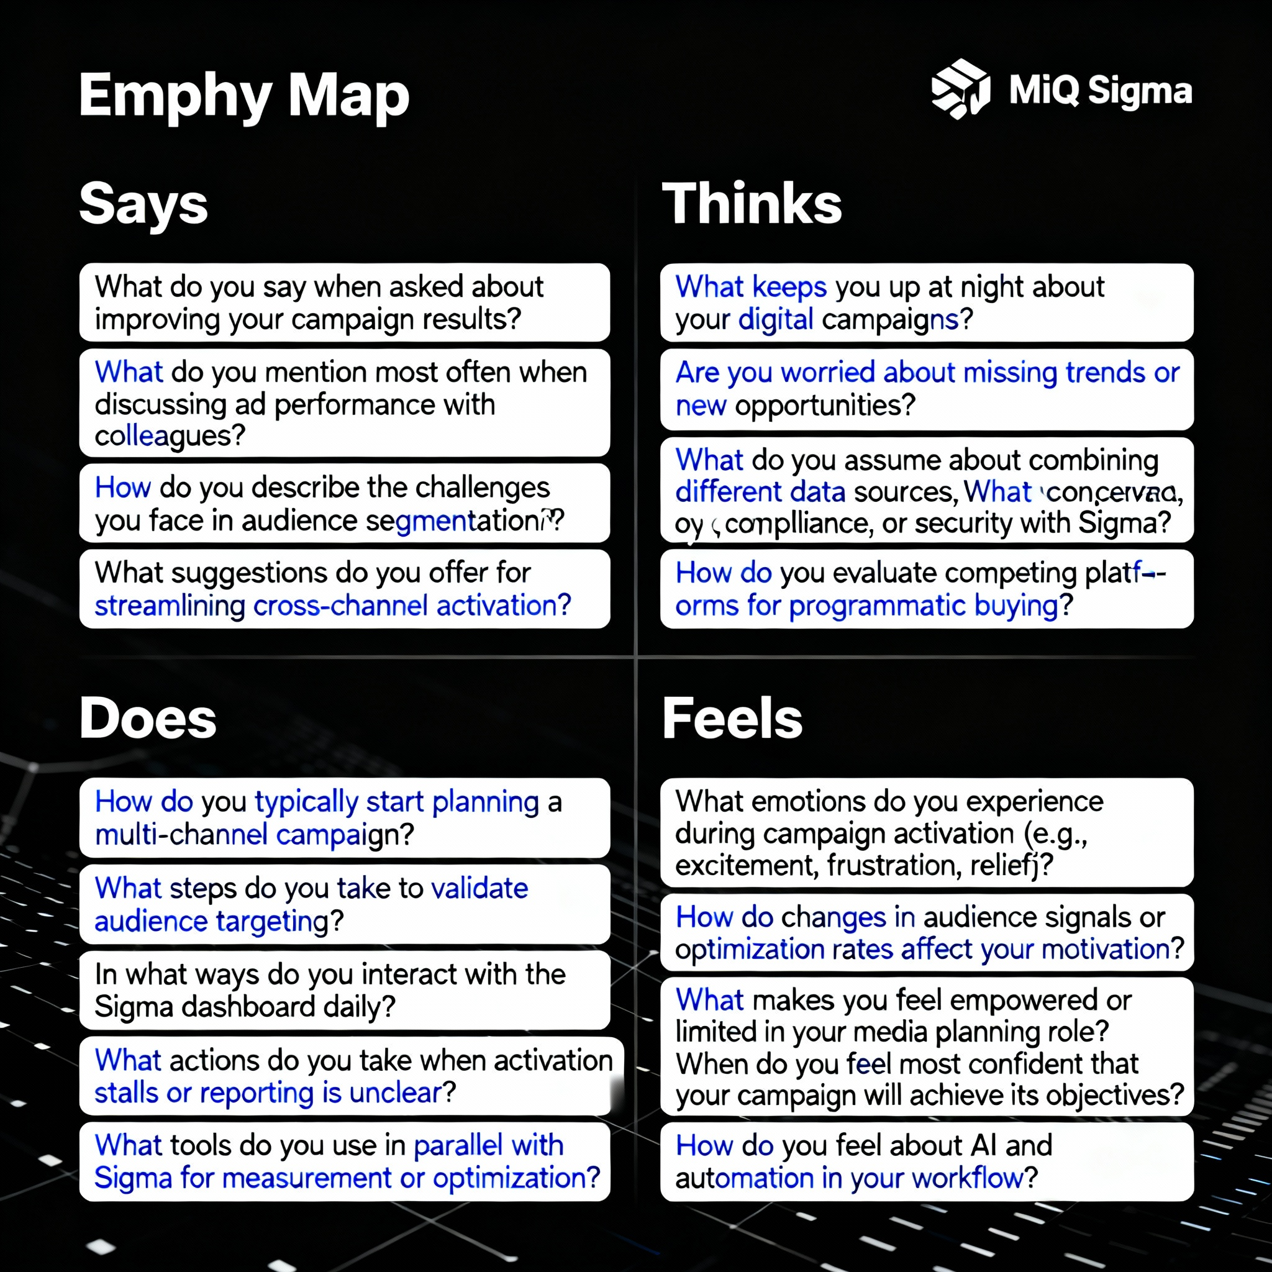
THE EMPATHY MAP
AI & DATA PRODUCT MANAGER’S TIME
Training Data Availability
Product Life Cycle Management
MAIN TASKS & RESPONSIBILITIES:
Negotiate Contracts
Work on the new product features
Write instructions
Contribute to the team’s data strategy
Leverage data to gain a competitive edge
Process Optimization
Run the business
Insight’s Innovation
DATA STRATEGY
Data Leads
Grow the business
Product Managers
49

Slide 50
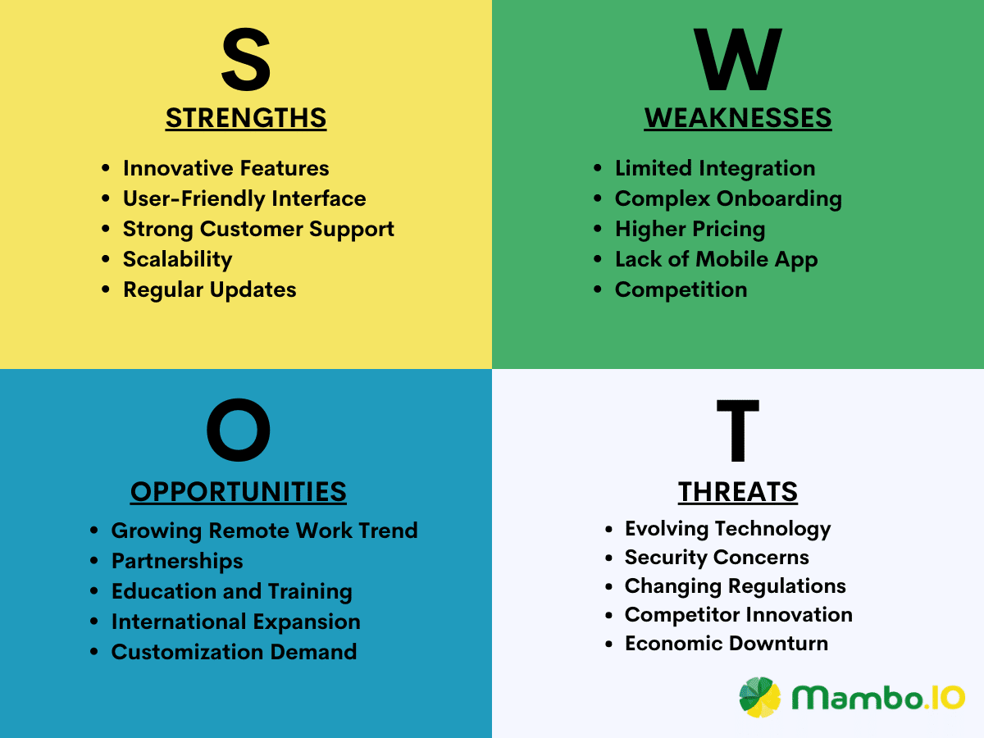
SWOT Analysis
PRODUCT MANAGEMENT ACTIVITIES
Data Annotation: The process of labelling data to make it usable for supervised machine learning
Data Warehouse: A system that collects historical data from multiple sources in organization for purpose of analyzing.
Users of Data Warehouse:
Business Forecasting
User Growth Analysis
Data Lake: A pool for raw data collected from multiple sources in the organization.
50

Slide 51
SETTING A MODEL PERFORMANCE METRIC
1. Human Level Performance Metric: Considering the average human level performance for a task.
How accurate would the average groups of people be at doing this task?
Your team’s goal or performance metric would be 5% error rate or something close to that.
2. Base Model Metrics: It produces realistic goals than getting as close to human-level performance as possible.
3. Satisfaction & Optimizing Metrics: Outlining both the metric that you want your model to do as best as possible in (this would be optimizing metrics), while also meeting a minimum set if standards (that is your satisfying metrics).
MODEL | ERROR RATE | PROCESSING TIME
A | 5% | 1300 ms
B | 11% | 50 ms
C | 7% | 90 ms
Dividing Test Data
Training Data
Validation Data (Development Data)
Testing Data
Training Data will allow your ML model to learn from (Largest Chunk – 80%)
Validation Data will fine tune the model’s performance. This data will never be added to the training set. (10% of available data)
Testing Data will be tested on the finished model. (10% of remaining data)
“Dissimilar data types among the test data will introduce data errors. It’s called bias and variance.”
High Bias: Model is too simple and won’t capture the complexity of data.
High Variance: The model has only learned the pattern at hand.
“Low Bias & Low Variance is the best suit model for the Product Management.”
51

Slide 52
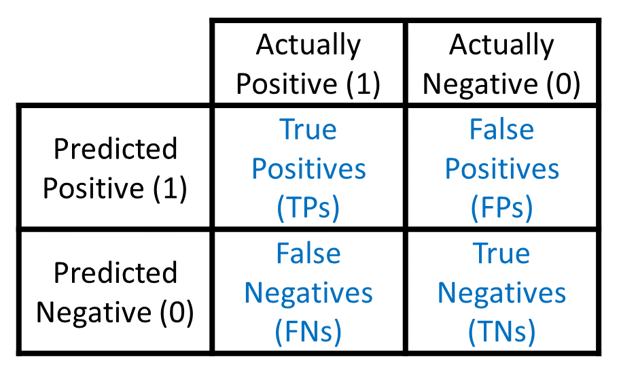
THE CONFUSION MATRIX
Confusion matrix is a simple table used to measure how well a classification model is performing. It compares the predictions made by the model with the actual results and shows where the model was right or wrong. This helps you understand where the model is making mistakes so you can improve it.
Total = 15 images of cats & dogs
Dogs = 10
Cat = 5
Accuracy: An accuracy percentage tells us only so much about an AI Model’s performance
Precision & Recall are preferred metrics to calculate the accuracy of a model.
Accuracy: How may times the model identifies dogs correctly out of all images. (9 out of 15)
Precision: Out of all identifies, how many images were correctly identified as dogs correctly. (9 out of 15)
Recall: The total is the actual images of dogs (9 out of 10)
Precision = TP / (TP + FP) = 9 / (9+2) = 9 / 11 = 81.81%
Recall = TP / (TP + FN) = 9 / (9+1) = 9 / 10 = 90%
The F1 Score – Harmonic mean of Precision & Recall:
F1 = [Precision x Recall / (Precision + Recall)] * 2 = 7362.9 / 171.81 = 42.85 x 2 = 85.70
DOG CLASSIFIER MODELS | PRECISION | RECALL | F1 SCORE
Model 1 | 82% | 90% | 86%
Model 2 | 75% | 80% | 77%
Model 3 | 87% | 70% | 78%
52

Slide 53

THE CONFUSION MATRIX – AD-TECH EXAMPLE
Predicting “High Intent” Users for an Ad Campaign.
Your product has a machine learning model that predicts which users are likely to click (or convert) on an ad. The goal is to show ads only to “High Intent” users to maximize ROI. You want to evaluate your model’s performance with a confusion matrix.
INTENT | ACTUAL CLASS | FORMULA | COUNT
20000 | High-Intent | TP + FN | 7,500 + 2,500 = 10,000 users
 | Low-Intent | FP + TN | 1,200 + 8,800 = 10,000 users
How to Interpret (PM View)
AdTech Model Performance (Predicting High-Intent Users)
Precision: Out of all the users we predicted as high intent, how many actually clicked. $$\text{Precision}=\frac{TP}{TP+FP}=\frac{7,500}{7,500+1,200}=\frac{7,500}{8,700}≈86\%$$ “When we predict high intent, we’re right 86% of the time.” → Good for ROI.
Recall: Out of all the actual high-intent users, how many we correctly predicted. $$\text{Recall}=\frac{TP}{TP+FN}=\frac{7,500}{7,500+2,500}=\frac{7,500}{10,000}=75\%$$ “We catch 75% of actual high-intent users.” → We’re missing 25% of potential converters.
F1 Score – Harmonic mean of Precision & Recall: $$F1=2×\frac{\text{Precision}×\text{Recall}}{\text{Precision}+\text{Recall}} \\ F1=2×\frac{0.86×0.75}{0.86+0.75}=2×\frac{0.645}{1.61}=2×0.400=0.80 \\ F1≈80\%$$
METRIC | COUNT | WHAT IT MEANS (PM VIEW)
True Positives (TP) | 7,500 | ✅ Good targeting: Ad spend was effective; these are users you wanted.
False Negatives (FN) | 2,500 | ⚠️ Missed opportunities: High-value users were excluded by the model.
False Positives (FP) | 1,200 | 💸 Wasted spend: Ads shown to people who didn’t convert.
True Negatives (TN) | 8,800 | 🛡️ Efficient filtering: Budget saved by excluding low-intent users.
 | PREDICTED: HIGH INTENT (WILL CLICK) | PREDICTED: LOW INTENT (WON’T CLICK)
ACTUAL: HIGH INTENT (CLICKED) | True Positives (TP) = 7,500 users who actually clicked and were predicted as high intent. | False Negatives (FN) = 2,500 users who clicked but were predicted as low intent.
ACTUAL: LOW INTENT (DIDN’T CLICK) | False Positives (FP) = 1,200 users predicted as high intent but didn’t click. | True Negatives (TN) = 8,800 users predicted as low intent and didn’t click.
Business Decision (PM View):
If Recall matters more (catching more high-intent users): accept more False Positives (higher spend) to reduce False Negatives.
If Precision matters more (reducing wasted spend): accept missing some high-value users to reduce False Positives.
53

Slide 54
DEPLOYING A MODEL BASED ON ENGINEERING EFFORTS
DEPLOYMENT TYPE | DESCRIPTION | ENGINEERING EFFORT | TYPICAL USE CASE / EXAMPLE
Ad-Hoc Predictions via SQL | The model outputs (or scoring logic) are stored in a database, and predictions are pulled on-demand by analysts or dashboards using SQL queries. No live serving. | Low – model is run offline, and results are just queried. | Marketing team pulls churn scores for a campaign; risk scoring via SQL before approvals.
Batch Predictions | Model runs on a schedule (e.g., nightly or hourly) and writes predictions back to a data store or file. Downstream systems consume these precomputed scores. | Medium – need pipelines for scheduled scoring and storage. | Credit risk scoring for all users once per day; ad audience segmentation updated nightly.
Real-Time Predictions | Model is deployed as an API / microservice to score each event or user request instantly. Predictions are returned within milliseconds. | High – need APIs, scalable infra, monitoring, low-latency serving. | Fraud detection at checkout, Auto Car Pilot system making split-second decisions, real-time ad bidding.
MONITORING MODELS: Performance needs to be sampled and tested on a continuous basis to avoid model staleness.
MODEL STALENESS: The predictive power of an AI model decreasing over a time as trends or tastes changes.
PROACTIVE MONITORING: Identifies general outlier patterns in the real world compared to the test or training patterns.
REACTIVE MONITORING: Identifies bad model performance and the cause of it.
FEEDBACK METRICS: A feedback metric whether its Ad Recommendations algorithm in performing well or not.
SHADOW DEPLOYMENT: Shadow deployment is a software deployment strategy that allows testing new software versions or updates in a production-like environment without impacting live users. In this approach, a replica of the live system, called the shadow environment, is created. Real-time production traffic is mirrored to this environment, enabling the new version to process the same requests as the live system. However, the responses from the shadow environment are not returned to users, ensuring no disruption to the live system. This strategy is particularly useful for identifying issues, validating performance, and ensuring compatibility under real-world conditions before rolling out the new version to production.
54

Slide 55
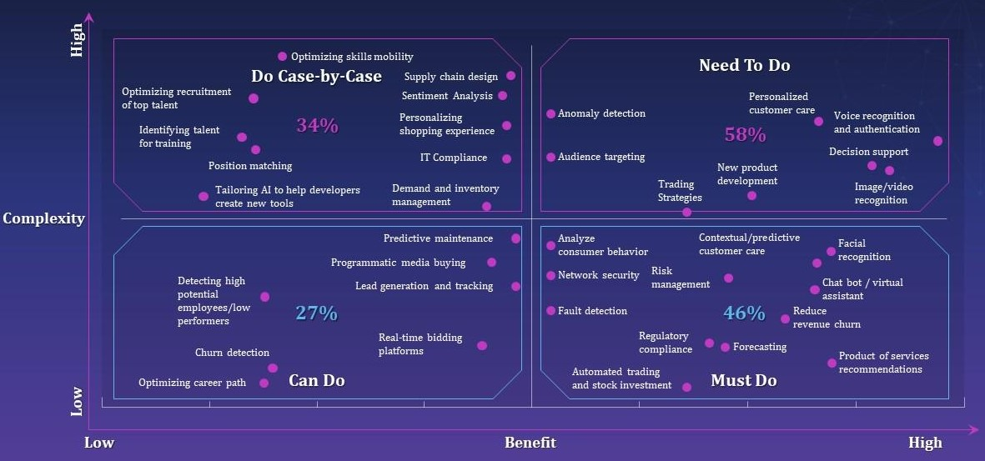
AI HEIRARCHY OF NEEDS
AI COMPLEXITY BENEFIT MATRIX
AI
Advanced AI Products
Data Science
Ability to craft models
Data Analysis
Customer Product Insights
Cleaning & Preparing data
A/B testing and experimentation
Data Infrastructure
Data Pipelines
ETL
Data Story
Data Collection
A large data is needed for developing AI products
55

Slide 56
TYPES OF TRADITIONAL DATA ANALYSIS

Slide 57
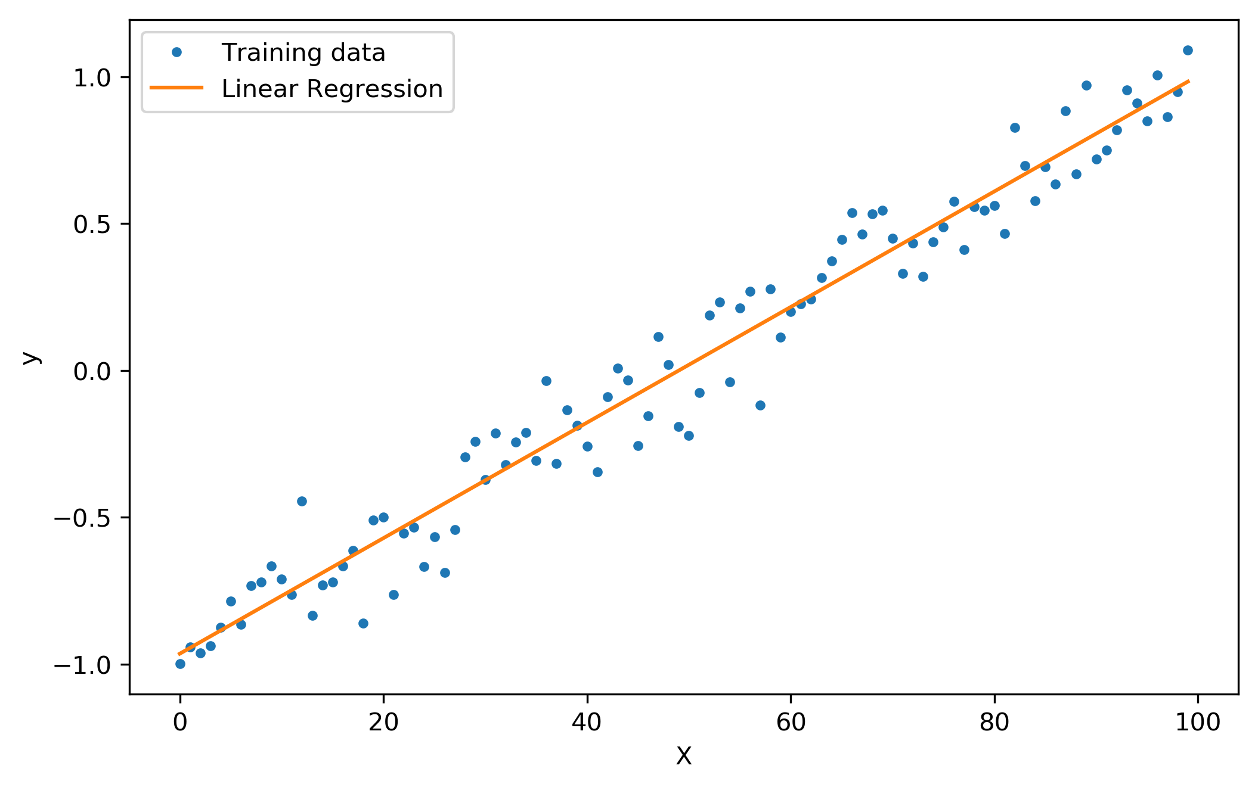
TRADITIONAL METHODS OF DATA ANALYSIS – REGRESSION ANALYSIS
Regression is a statistical approach used to analyze the relationship between a dependent variable (target variable) and one or more independent variables (predictor variables). The primary goal is to determine the most suitable function that characterizes the connection between these variables, enabling predictions or drawing conclusions.
SIMPLE LINEAR REGRESSION involves one dependent and one independent variable, forming a linear relationship. Its equation is y = ax + b, where a is the slope and b is the intercept. It is commonly used in weather forecasting and financial analysis.
MULTIPLE LINEAR REGRESSION extends simple regression by incorporating multiple independent variables. Its equation is y = a0x1 + a1x2 + ... + b. This method is used in fields like real estate and public healthcare.
POLYNOMIAL REGRESSION fits a non-linear relationship by introducing polynomial terms. For example, a second-degree polynomial regression has the form y = a0 + a1x + a2x^2. It is useful for flexible curve fitting in datasets.
SUPPORT VECTOR REGRESSION (SVR): Based on the support vector machine algorithm, it finds a hyperplane that minimizes the sum of the squared residuals between the predicted and actual values.
DECISION TREE REGRESSION: Builds a decision tree to predict the target value, where each node represents a decision, and each branch represents the outcome.
RANDOM FOREST REGRESSION: An ensemble method that combines multiple decision trees to predict the target value.
APPLICATIONS:
Regression analysis is used in stock price prediction, product sales forecasting, real estate valuation, weather forecasting, crop yield prediction, and sports performance analysis. It helps businesses and researchers understand relationships and make data-driven decisions.
ADVANTAGES:
Regression analysis provides insights into how variables are related, aids in forecasting, and identifies key predictors. It also helps assess the model's goodness of fit and diagnose potential issues.
LIMITATIONS:
It is sensitive to outliers and relies on assumptions like linearity and normality of residuals. Poor data quality can lead to unreliable results, and it struggles with highly complex relationships or multicollinearity among variables.
Regression analysis is a powerful tool for understanding and predicting data trends, but its effectiveness depends on the quality of data and adherence to its assumptions.

Slide 58
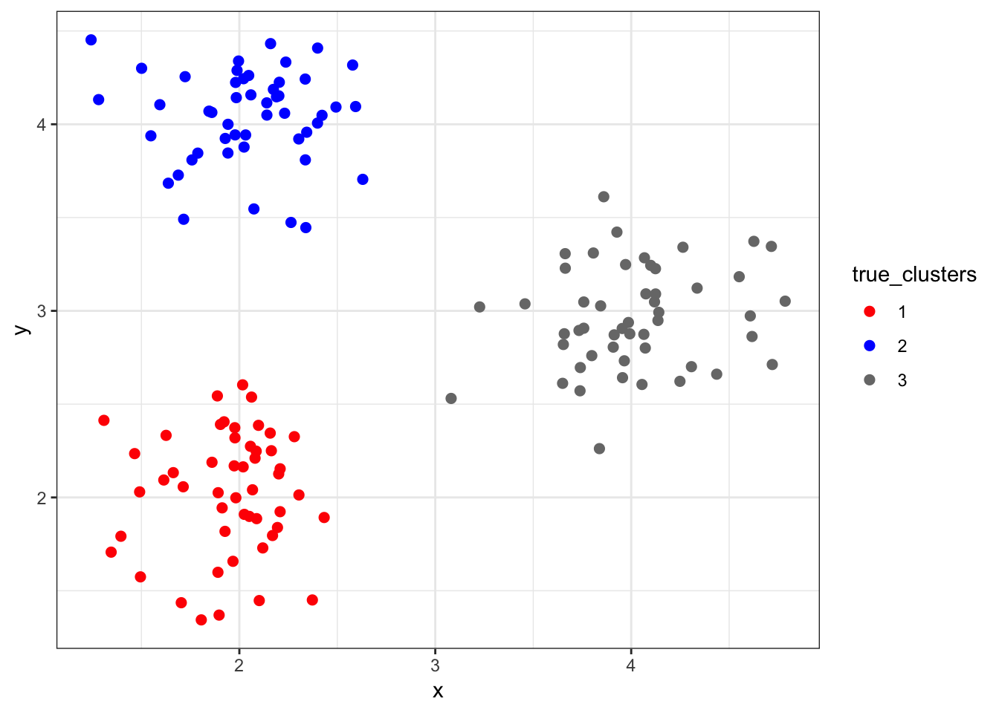
TRADITIONAL METHODS OF DATA ANALYSIS – CLUSTER ANALYSIS
Cluster analysis, also known as clustering, is a method of data analysis that groups similar data points together. The primary goal is to divide a dataset into clusters such that the data points within each group are more similar to each other than to those in other groups. This process is often used for exploratory data analysis and can help identify patterns or relationships within the data that may not be immediately obvious.
PARTITIONING METHODS: Divide data into predefined groups, such as K-means clustering.
HIERARCHICAL METHODS: Build a tree-like structure of clusters, either merging smaller clusters (agglomerative) or splitting larger ones (divisive).
DENSITY-BASED METHODS: Group densely packed data points while treating sparse regions as noise, useful for irregularly shaped clusters.
GRID-BASED METHODS: Divide the data space into grids for faster clustering, often used in geographical or climate data analysis.
MODEL-BASED METHODS: Assume data is generated from a mixture of distributions, such as Gaussian Mixture Models (GMM).
CONSTRAINT-BASED METHODS: Use user-defined constraints to guide the clustering process
APPLICATIONS OF CLUSTERING
Market Segmentation: Group customers based on purchasing behavior for targeted marketing.
Image Segmentation: Identify objects in images by grouping pixels.
Biological Classification: Group genes with similar behaviors for disease research.
Document Classification: Categorize web pages for better search engine results.
Anomaly Detection: Identify outliers or unusual patterns, such as fraud detection
CHALLENGES IN CLUSTERING
Determining the optimal number of clusters can be difficult.
Some algorithms, like hierarchical clustering, struggle with scalability for large datasets.
Many methods assume clusters are evenly shaped, which may not align with real-world data.
Sensitivity to noise and outliers can affect clustering accuracy

Slide 59
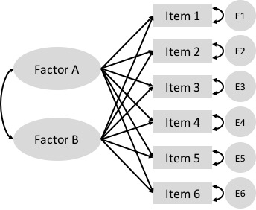
TRADITIONAL METHODS OF DATA ANALYSIS – FACTOR ANALYSIS
EXPLORATORY FACTOR ANALYSIS (EFA):
It is used when researchers don’t have preconceived ideas about the underlying structure of the data. It’s like exploring uncharted territory, letting the data reveal its own patterns and relationships.
Key characteristics of EFA include:
No predetermined structure or hypothesis
Data-driven approach that reveals underlying patterns
Helps identify how many factors exist in the data
Useful in the early stages of research or instrument development
CONFIRMATORY FACTOR ANALYSIS (CFA):
Unlike EFA, confirmatory factor analysis starts with a hypothesis about how variables relate to underlying factors. Researchers use CFA to test and validate existing theories or models.
Key characteristics of CFA include:
Tests a predetermined factor structure
Evaluates how well the data fits the theoretical model
Provides statistical measures of model fit
Often used after EFA to confirm and refine findings
PRINCIPAL COMPONENT ANALYSIS (PCA):
Principal Component Analysis is sometimes classified as a type of factor analysis, though statistically it’s slightly different. It emphasizes variance to identify patterns in the data and is beneficial when variables have high correlations.
Key characteristics of PCA include:
Focuses on explaining the maximum amount of variance
Creates components that are completely uncorrelated with each other
Often used for data reduction and simplification
Particularly useful with highly correlated variables
Factorial analysis is invaluable when dealing with multiple variables that may interact and influence each other. It is particularly useful in the following scenarios:
Market Research: Understanding customer preferences and behaviors by analyzing multiple factors influencing purchasing decisions.
Psychological Studies: Exploring various factors affecting human behavior and emotions, providing insights into psychological patterns.
Product Planning and Development: Evaluating the impact of multiple variables on product features and customer satisfaction, guiding product enhancement strategies.

Slide 60
PROBABILITY

Slide 61
WHAT IS PROBABILITY?
Chance of something happening, which is the likelihood of an event occurring
A = Event p(A) = Probability p(A) = Preferred (Favourable) / All (Sample space)
---------------------------------------------------------------------------------------------------------------------------------------------------------------------------------------------
EXPERIMENTAL PROBABILITIES:
P(A) = Successful Trails / All Trails
E(A) – The outcome we expect to occur when we run an experiment
---------------------------------------------------------------------------------------------------------------------------------------------------------------------------------------------
COMBINATORICS:
Permutations
Variations No. of favourable outcomes (OR) No. of all elements in a sample space
Combinations
`Formula: Combinations = Variations / Permutations
---------------------------------------------------------------------------------------------------------------------------------------------------------------------------------------------
BAYER’S RULE:
Bayer’s rule allows us to find a relationship between the different conditional probabilities of two events.
P(A|B) = p(A∩B)/p(B) → Conditional Probability Formula
P(B∩A) = p(B|A)/p(A) → Multiplication Rule Formula

Slide 62
TYPES OF DISTRIBUTIONS
DISCRETE DISTRIBUTIONS
All outcomes are equally likely, which is equiprobable.
Events with only two possible outcomes (True or False).
Bernoulli Distribution: Any event with two outcomes can be transformed into a Bernoulli event.
---------------------------------------------------------------------------------------------------------------------------------------------------------------------------------------------
B. BINOMIAL DISTRIBUTION
Carrying out a similar experiment several times in a row.
Two outcomes per interactions
Many iterations
---------------------------------------------------------------------------------------------------------------------------------------------------------------------------------------------
POISON DISTRIBUTION
Test how unusual an event frequently is given for interval
---------------------------------------------------------------------------------------------------------------------------------------------------------------------------------------------
D. CHI-SQUARED:
Asymmetric
Only consists of non-negative values
Uses: It is used in Hypothesis testing to help with the goodness of fit.

Slide 63
E. BERNOULLI DISTRIBUTION
Option pricing: An agreement between two parties for the price of a stock or item at a future point in time.
---------------------------------------------------------------------------------------------------------------------------------------------------------------------------------------------

Slide 64
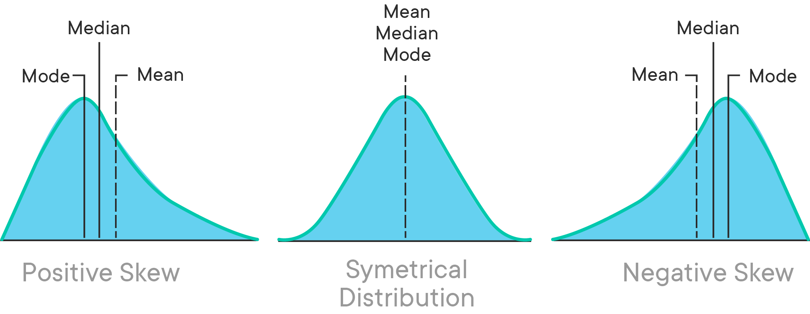
MEASURE OF CENTRAL TENDENCY
Mean: Simple Average. Denoted by μ
Median: Middle value if the values are in the odd range; if its even, the median is (n+1/2)
Mode: Highest frequency term, and mode is noy sensitive to the outliers
Skewness: Indicates whether the data is concentrated on one side
Positive Skew: Where the Mean is greater than Median
Zero Skew: Where the Mean = Median = Mode
Negative Skew: Mean is lesser than Median
---------------------------------------------------------------------------------------------------------------------------------------------------------------------------------------------
CENTRAL LIMIT THEOREM: The distribution of sample mean of a large number of independent and identically distributed random variables will approximate a normal distribution, regardless of original distribution of the values.
STANDARD ERROR: Standard error is used in most statistical tests. Because of it shows how well you approximated the true mean. Standard error decreases, when sample size increases.
ESTIMATES: Specific values are called estimates.
ESTIMATOR: An estimator is a statistical method or formula that provides a way to calculate an estimate of a population parameter based on sample data. For example, the sample mean is an estimator for the population mean.
---------------------------------------------------------------------------------------------------------------------------------------------------------------------------------------------

Slide 65
TYPES OF CHARTS

Slide 66
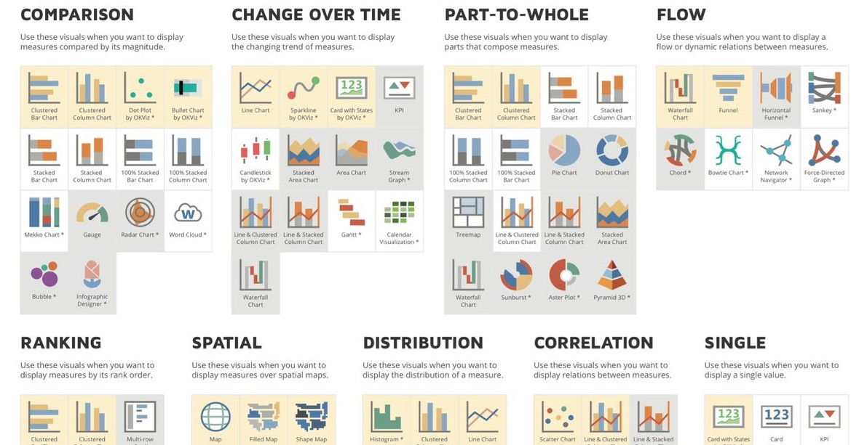

Slide 67
TYPES OF CHARTS
Pie Chart: Relative frequency is the percentage of total frequency of each category.
Bar Chart/Column Chart: Vertical axis shows the frequency and each bar represents the category (Horizontal).
Pareto Diagram: It’s a subset pf a bar chart and it has a curve on the same graph showing the cumulative frequency.
Pareto principal: 80% of the effect comes from 20% of cause
The Histogram: It helps to visualize the frequency distribution and frequency occurrence per each distribution.
Cross Tables: A method to quantitatively analyze the relationship between multiple variable.
Side-by-side bar chart: It is a variation of the bar chart to visualize the relationship between multiple variables.
Scatter Plots: The graphs that represent the relationship between 2 variables in a data-set.
Heat Maps: A heatmap is a graphical representation of data where values are depicted by color to display complex information in a way you can quickly comprehend. Product and website heatmaps visualize the most popular (hot) and unpopular (cold) elements of your content using colors on a scale from red to blue.
---------------------------------------------------------------------------------------------------------------------------------------------------------------------------------------------

Slide 68
CHARTS (1/4)
CHART NAME | DESCRIPTION | TYPICAL POWER BI USE CASE
Clustereda Bar Chart | Horizontal bars to compare discrete categories. | Performance by region, team, product.
Clustered Column Chart | Vertical bars for quickly comparing data categories. | Financial performance, survey responses.
Dot Plot | Plots dots for categorical frequency/distribution. | Distribution or frequency across groups.
Bullet Chart | Shows performance against targets and thresholds. | KPI tracking, performance benchmarks.
Stacked Bar Chart | Compares breakdowns stacked horizontally. | Sales by region and segment.
Stacked Column Chart | Stacks values vertically for part-to-whole comparisons. | Budget breakdown, category totals.
100% Stacked Bar/Column Chart | Proportional breakdown (all same length, percent focus). | Percent market share, proportion analysis.
Mekko Chart | Variable segment chart for complex category visualization. | Market share across multiple dimensions.
Gauge | Shows current value vs. target in a semicircular meter. | KPI, progress tracking.
Radar Chart | Compares multiple variables, displaying performance profiles. | Multimetric performance comparison.
Word Cloud | Text visualization displaying frequency of words. | High-frequency keywords, survey results.

Slide 69
CHARTS (2/4)
CHART NAME | DESCRIPTION | TYPICAL POWER BI USE CASE
Infographic Designer | Custom visual representations for storytelling. | Marketing presentations, executive summaries.
Line Chart | Time series trend or continuous data measure. | Sales growth, website traffic.
Candlestick Chart | Shows open, close, high, low values over time (finance). | Stock/fund analysis, price movement.
Stacked Area Chart | Emphasizes cumulative totals with area shading. | Revenue by category over time.
Area Chart | Highlights change and differences between series. | Website visits, usage statistics.
Stream Graph | Evolution of multiple data streams (stacked flows). | Traffic sources, resource allocation.
Sparkline | Miniature line chart in tables/cards for trend context. | Inline performance trend in dashboards.
Card with States | Shows value with trend indications and conditional formatting. | KPIs with status indicators.
KPI | Key performance indicator—main value with trend. | Instant metric check (revenue, costs).
Line & Clustered Column Chart | Combines line and column for dual-axis analysis. | Revenue and growth rate together.
Waterfall Chart | Shows sequential changes & cumulative effects. | Profit/loss steps, variance analysis.

Slide 70
CHARTS (3/4)
CHART NAME | DESCRIPTION | TYPICAL POWER BI USE CASE
Gantt | Project timeline chart showing tasks and milestones. | Project management, schedule tracking.
Calendar Visualization | Chronological date-based data patterns. | Attendance, daily sales, event tracking.
Pie Chart | Proportional division of a whole. | Product share, portfolio allocation.
Donut Chart | Pie chart variant with center cut-out. | Emphasizing parts of a whole.
Treemap | Part-to-whole with nested rectangles by category. | Spend by department, content analysis.
Sunburst | Hierarchical part-to-whole, shown in concentric rings. | Multi-level category breakdown.
Aster Plot | Radial part-to-whole chart with variable arm length. | Complex composition visualizations.
Pyramid 3D | Hierarchical visual for populations or funnels. | Sales funnel stages, age demographics.
Funnel Chart | Stage-based flow reducing as it progresses. | Sales pipeline, conversion rates.
Horizontal Funnel | Funnel chart laid out horizontally. | Alternative stage‐flow layouts.
Sankey Chart | Flow relationships between categories. | Supply chain, user journey mapping.

Slide 71
CHARTS (4/4)
CHART NAME | DESCRIPTION | TYPICAL POWER BI USE CASE
Chord Chart | Inter-category relationship via arcs. | Network flows, relationship mapping.
Bowtie Chart | Diverging/converging processes. | Process crossroad analytics.
Network Navigator | Network relationships and dependencies. | Social network analysis, organizational links.
Force-Directed Graph | Node-link chart showing dynamic relationships. | System/component interdependencies.
Map/Filled Map/Shape Map | Geospatial visualization for regions and territories. | Regional sales/demographics mapping.
Histogram | Distribution of values in buckets. | Exam scores, age distribution.
Scatter Chart | Shows relationships between two quantitative variables. | Correlation analysis, outlier detection.
Card | Displays a single value as a visual metric. | Key metrics, single KPIs.
Multi-row Card | Multiple single values displayed together. | Multiple KPIs in compact format.

Slide 72
HYPOTHESIS TESTING

Slide 73
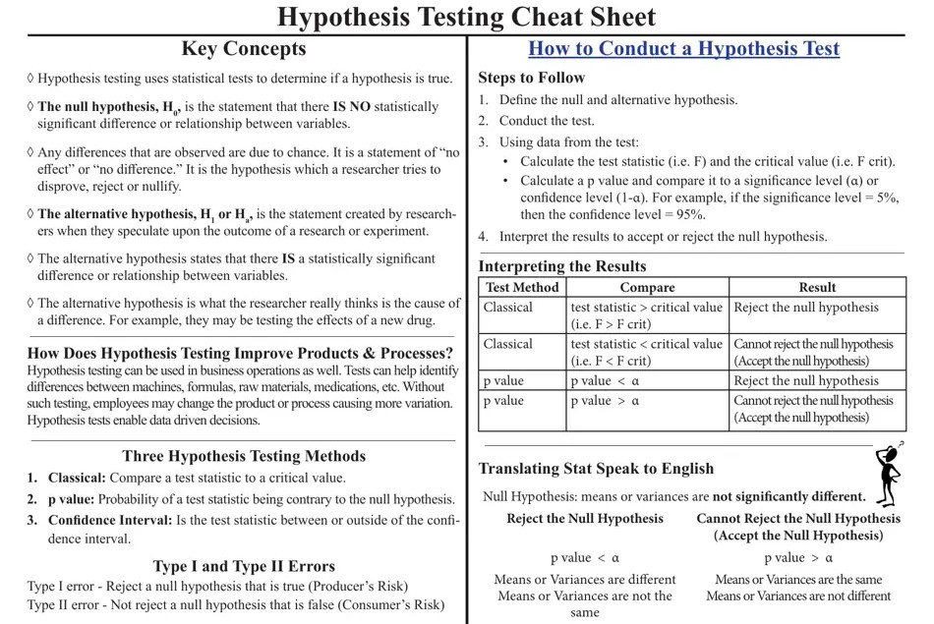

Slide 74
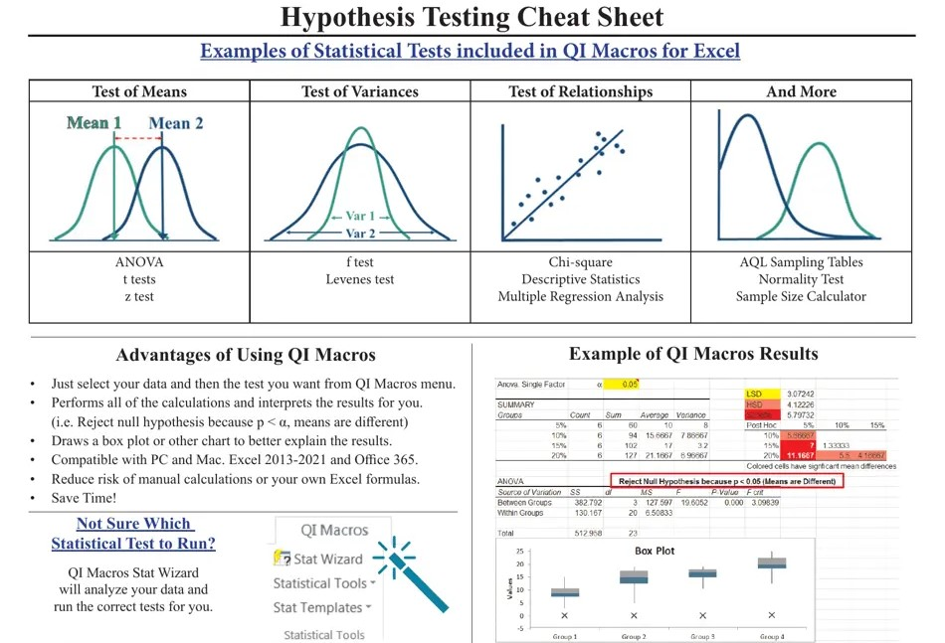

Slide 75
HYPOTHESIS TESTING
Hypothesis-driven practices are ideal for building new features. Since the goal is to test the validity of each hypothesis, the uncertainty around the product development process is significantly reduced. In a way, hypothesis testing helps product managers make better decisions about the product lifecycle management.
---------------------------------------------------------------------------------------------------------------------------------------------------------------------------------------------
PRODUCT HYPOTHESIS:
A product hypothesis is an assumption made within a limited understanding of a specific product-related situation. It further needs validation to determine if the assumption would actually deliver the predicted results or add little to no value to the product. The crucial factors required to build a clear hypothesis statement are —
Assumption: An assumption made based on observations (Either to fix a problem or to update the product feature).
Condition: The condition is the reason why the assumption was made (Example — lack of user interaction with the product or dip in page traffic).
Prediction (Impact): Prediction is the success or failure rate of the hypothesis.
---------------------------------------------------------------------------------------------------------------------------------------------------------------------------------------------
THE NEED FOR HYPOTHESIS-DRIVEN FEATURE DEVELOPMENT:
Hypothesis-driven practices provide a space to brainstorm based on users & customers behaviors, build a hypothesis, and convert them into a significant feature. The process also gives us a thorough understanding of what, how, and why to prioritize the product’s features. It is a cost-effective approach as the experimentation and testing is done before production. It requires minimal effort and fosters the product team’s confidence. Overall, the impact of hypothesis testing has a direct effect on the business goals and revenue streams.

Slide 76
THE STEPS INVOLVED IN THE PRODUCT DESIGN HYPOTHESIS
STEP 1 - JOT DOWN THE UNCERTAINTIES OR CHALLENGES OF THE PRODUCT AND BRAINSTORM QUESTIONS
Whether you're adding a new feature or improving an existing one, there will always be uncertainties associated with the product. Jot them down and come up with the possible assumptions that can solve the uncertainties of the product.
For example: Your application is not gaining users on the Google play store. The possible questions could be:
How to increase the reach of your app?
How to utilize current users to market your app?
Would the right marketing strategy suffice?
Would a user survey form help?
So, brainstorming different questions to improve the product feature is the foundation of defining an effective hypothesis statement.
---------------------------------------------------------------------------------------------------------------------------------------------------------------------------------------------
STEP 2 - HOW TO BUILD A HYPOTHESIS STATEMENT?
Now that we now have ideas or questions handy, pick the ones that you firmly think add value to the process. Eliminate the least impactful questions. The possible assumptions or solutions to the shortlisted questions are the real hypothesis for our product. The solutions should not only reflect a product manager’s thoughts. It should support the group decision structure where all the stakeholders are involved in defining a hypothesis. There are multiple templates available to build hypothesis statements. Choosing the template that correlates well with your product development team and is most comfortable with is a good practice.

Slide 77
We believe that undefined for undefined, addresses their undefined and help us achieve undefined
So, it’s crucial to work on the four factors required to frame the hypothesis statement — Problem, Solution or Feature, Users or Target Audience, Impact or outcome.
---------------------------------------------------------------------------------------------------------------------------------------------------------------------------------------------
STEP 3 - SEGREGATE THE GOOD HYPOTHESIS FROM BAD HYPOTHESIS
Practically speaking, testing and validating all the hypotheses would be challenging. We should bifurcate the hypothesis statements based on the hypothesis's duration, research method, and outcome. We can bucketize the statements into Good and Bad hypotheses. An effective hypothesis is accompanied by specific and measurable outcomes. In the other hand, a lousy hypothesis provides neither clear nor quantifiable outcomes.
For example,
If we have a statement like, Introducing a new literature review feature will increase the user engagement rate, it is a bad hypothesis as it is not specific or a definite outcome in the statement.
An example of a good hypothesis would be, Introducing a new literature review feature that simplifies reader workflow will increase the average time a researcher spends on our site.
To be more efficient, draft strong hypothesis statements that deliver impactful outcomes with minimal effort. In addition, you can employ supportive tools like the Discovery effort worthiness (DEW) index, which helps you analyze the steps required for product development and design thinking approaches.
---------------------------------------------------------------------------------------------------------------------------------------------------------------------------------------------

Slide 78
STEP 4 - TEST
Testing is vital to product lifecycle management as it decides whether the hypothesis is true or false. It gives us a conclusion on whether to accept the hypothesis and push it to the production stage or reject it and revise or tweak the assumptions.
What are the different types of hypothesis testing?
A/B Testing: The experiment is aimed at two different user sets. Let’s say Set A and Set B, where only Set A users are introduced to the new hypothesis design feature while keeping the Set B users exposed to older features. Run the experiment for a specific period of time, analyze the data, and draw conclusions. If the result shows a spike in the new feature, then it is clear that the hypothesis functioned well and vice versa.
Multivariate Testing: The experiment is aimed at multiple variants or user sets. It is mainly performed to track the multiple variations associated with the same product development. You can set or define variants based on your user or business outcome.
---------------------------------------------------------------------------------------------------------------------------------------------------------------------------------------------
STEP 5 - EVALUATE THE TEST RESULTS AND DEFINE THE NEXT STEPS
The next step is to analyze the results of your hypothesis and create a roadmap for the new feature rollout. The assessment can include both qualitative and quantitative approaches. Quantitative analysis includes several combinations:
High impact + High efforts
Low impact + Low efforts
High impact + Low efforts
Low impact + High efforts

Slide 79
While qualitative analysis majorly includes user feedback, survey records, stakeholders' feedback, and more. By correlating all the possible conclusions drawn from the tests, you can define the next action steps.
---------------------------------------------------------------------------------------------------------------------------------------------------------------------------------------------
STEP 6 - CONCLUDE THE EXPERIMENTS (CLOSING THE LOOP)
So, here comes the final verdict of the hypothesis testing. If the experiments favored the expected hypothesis, product manager can inform the stakeholders and prepare the team for the feature rollout process. Release the feature to a wider set of audience (100% users). However, feature testing should keep continuing even after the product release. It helps you gain a deeper understanding of your product under different scenarios.
If the hypothesis is false, do not move it to the production stage and reconsider how to solve the problem. Accumulate the data or insights from the experiments, finetune the hypothesis with specific and measurable goals and build a new hypothesis.
Ensure to stay up-to-date with the latest trends, user behavior or demands, and other factors, and update your product on a timely basis to increase customer retention.
To continuously deliver value to users via products, product manager need to continue running experiments for various hypotheses.
---------------------------------------------------------------------------------------------------------------------------------------------------------------------------------------------
NULL HYPOTHESIS AND ALTERNATIVE HYPOTHESIS:
The null hypothesis (H0) states that there is no effect or relationship between the variables being studied, while the alternative hypothesis (Ha or H1) posits that there is an effect or relationship. These two hypotheses are used in statistical testing to determine if there is enough evidence to reject the null hypothesis in favor of the alternative hypothesis. They are mutually exclusive, meaning that if one is true, the other must be false.

Slide 80
RESEARCH QUESTION | NULL HYPOTHESIS (H₀)
 | GENERAL | TEST-SPECIFIC
Does tooth flossing affect the number of cavities? | Tooth flossing has no effect on the number of cavities. | t test: The mean number of cavities per person does not differ between the flossing group (µ₁) and the non-flossing group (µ₂) in the population; µ₁ = µ₂.
Does the amount of text highlighted in the textbook affect exam scores? | The amount of text highlighted in the textbook has no effect on exam scores. | Linear regression: There is no relationship between the amount of text highlighted and exam scores in the population; β₁ = 0.
Does daily meditation decrease the incidence of depression? | Daily meditation does not decrease the incidence of depression.* | Two-proportions z test: The proportion of people with depression in the daily-meditation group (p₁) is greater than or equal to the no-meditation group (p₂) in the population; p₁ ≥ p₂.
RESEARCH QUESTION | ALTERNATIVE HYPOTHESIS (H_{A})
 | GENERAL | TEST-SPECIFIC
Does tooth flossing affect the number of cavities? | Tooth flossing has an effect on the number of cavities. | t test: The mean number of cavities per person differs between the flossing group (µ₁) and the non-flossing group (µ₂) in the population; µ₁ ≠ µ₂.
Does the amount of text highlighted in a textbook affect exam scores? | The amount of text highlighted in the textbook has an effect on exam scores. | Linear regression: There is a relationship between the amount of text highlighted and exam scores in the population; β₁ ≠ 0.
Does daily meditation decrease the incidence of depression? | Daily meditation decreases the incidence of depression. | Two-proportions z test: The proportion of people with depression in the daily-meditation group (p₁) is less than the no-meditation group (p₂) in the population; p₁ < p₂.

Slide 81
STATISTICAL TEST | NULL HYPOTHESIS (H₀) | ALTERNATIVE HYPOTHESIS (H_{A})
Two-sample t test Or One-way ANOVA with two groups | The mean dependent variable does not differ between group 1 (µ₁) and group 2 (µ₂) in the population; µ₁ = µ₂. | The mean dependent variable differs between group 1 (µ₁) and group 2 (µ₂) in the population; µ₁ ≠ µ₂.
One-way ANOVA with three groups | The mean dependent variable does not differ between group 1 (µ₁), group 2 (µ₂), and group 3 (µ₃) in the population; µ₁ = µ₂ = µ₃. | The mean dependent variable of group 1 (µ₁), group 2 (µ₂), and group 3 (µ₃) are not all equal in the population.
Pearson correlation | There is no correlation between independent variable and dependent variable in the population; ρ = 0. | There is a correlation between independent variable and dependent variable in the population; ρ ≠ 0.
Simple linear regression | There is no relationship between independent variable and dependent variable in the population; β₁ = 0. | There is a relationship between independent variable and dependent variable in the population; β₁ ≠ 0.
Two-proportions z test | The dependent variable expressed as a proportion does not differ between group 1 (p₁) and group 2 (p₂) in the population; p₁ = p₂. | The dependent variable expressed as a proportion differs between group 1 (p₁) and group 2 (p₂) in the population; p₁ ≠ p₂.

Slide 82
Null Hypothesis (H₀) | DECISION
 | Accept (H0) | Reject (H0)
H0 = True | Correct Decision | Type 1 Error (α)
H0 = False | Type 2 Error (β) | Correct Decision
Type 1 Error: Reject a true null hypothesis – False Positive
Type 2 Error: Accept a false null hypothesis – False Negative

Slide 83
PRODUCT MANAGEMENT &
SOFTWARE DEVELOPMENT METHODOLOGIES

Slide 84
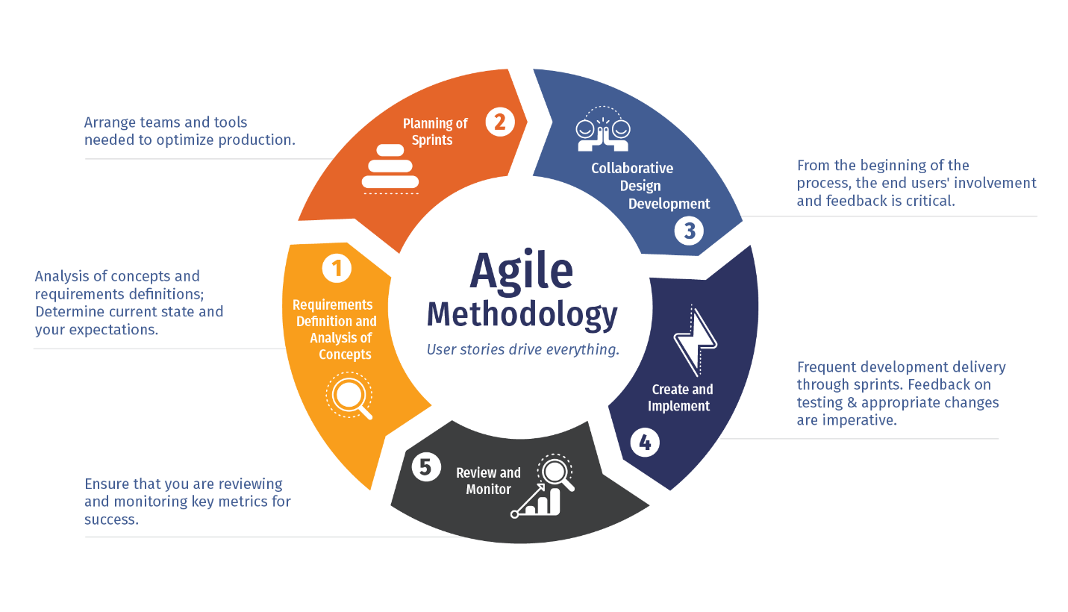

Slide 85
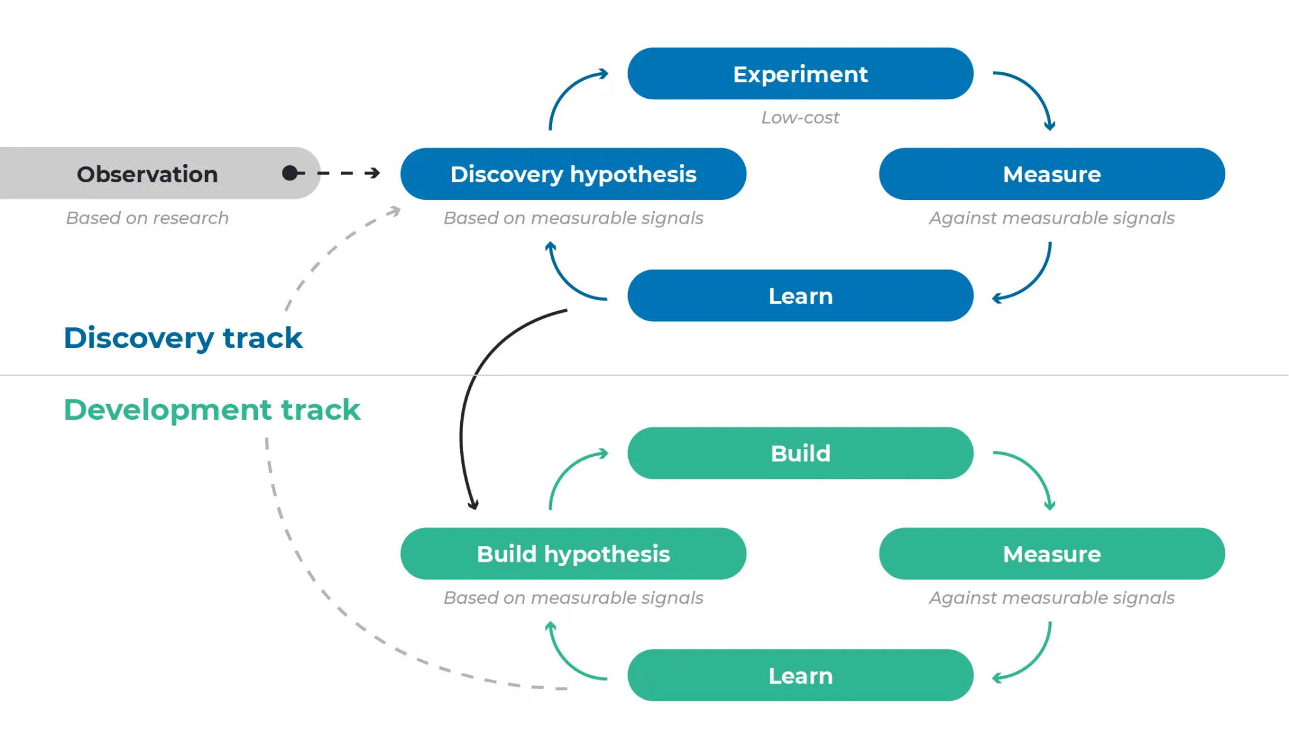
DUAL-TRACK AGILE is a framework that integrates two essential workflows in product development: discovery (determining what to build) and delivery (building it). This approach fosters collaboration among product managers, designers, and engineers to ensure that teams deliver valuable outcomes to both the business and customers. The concept emerged as a response to traditional waterfall-like processes, where design and planning were done upfront and handed off to engineering. Dual-track agile emphasizes continuous collaboration and iterative progress, breaking down silos between teams.
Key Principles of Dual-Track Agile
Discovery and Delivery Integration: Discovery focuses on understanding customer needs, validating ideas, and defining what to build. Delivery ensures those ideas are implemented effectively. These tracks run in parallel, feeding into each other continuously.
Unified Teams: Contrary to misconceptions, dual-track agile does not involve separate teams for discovery and delivery. Instead, the same team collaborates across both tracks, ensuring alignment and shared ownership.
Customer-Centric Approach: While traditional dual-track agile emphasized team collaboration, modern adaptations, like continuous discovery, place a stronger focus on customer interviews and data-driven insights to guide decision-making.
Evolution into Continuous Discovery
Over time, dual-track agile has evolved into continuous discovery, a more integrated approach where discovery and delivery are inseparable. Continuous discovery emphasizes:
Customer Engagement: Regular customer interviews and feedback loops to identify opportunities and validate assumptions.
Intertwined Workflows: Discovery and delivery are no longer distinct phases but part of a unified process. For example, live production tests during delivery can inform ongoing discovery efforts.
Product Trio: A core team of product managers, designers, and engineers (often called the "product trio") works collaboratively to explore opportunities and deliver solutions.
Differences Between Dual-Track Agile and Continuous Discovery
Customer Focus: Continuous discovery prioritizes customer insights as the primary driver of product decisions, whereas dual-track agile initially focused more on team collaboration.
Workflow Integration: Continuous discovery eliminates the distinction between discovery and delivery, treating them as a single, iterative process.
Team Structure: Continuous discovery formalizes the "product trio" model, ensuring close collaboration among design, product, and engineering.

Slide 86
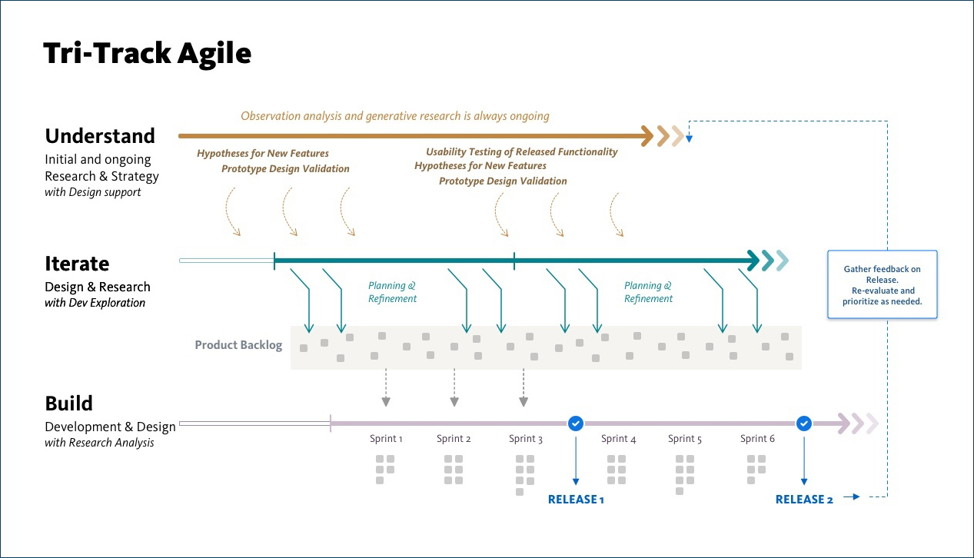

Slide 87
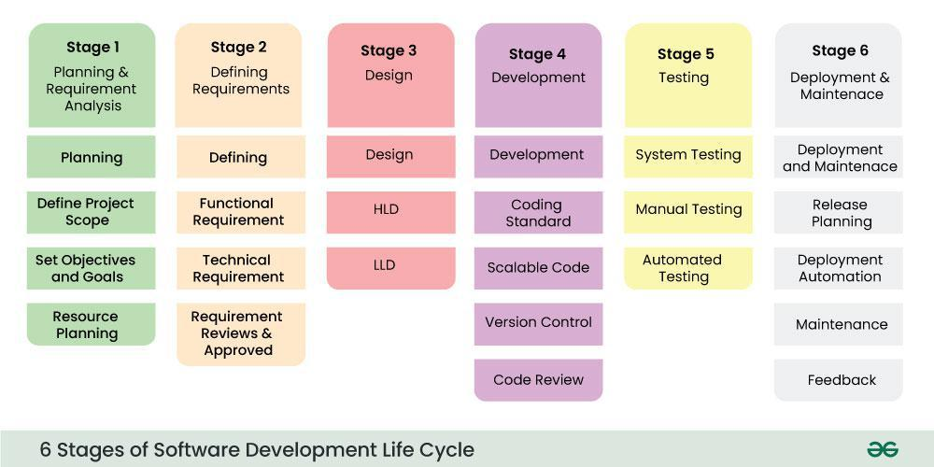
SOFTWARE DEVELOPMENT LIFECYCLE
(Dev)
(UAT)
(Production)
HLD – High Level design
LLD – Low Level design

Slide 88
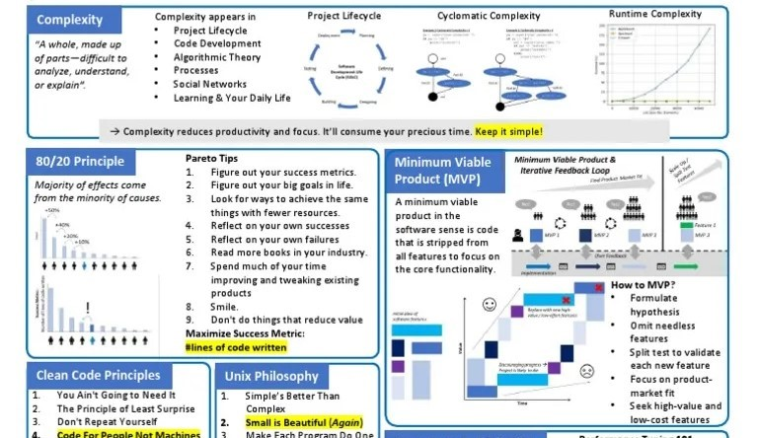
SOFTWARE DEVELOPMENT LIFECYCLE

Slide 89
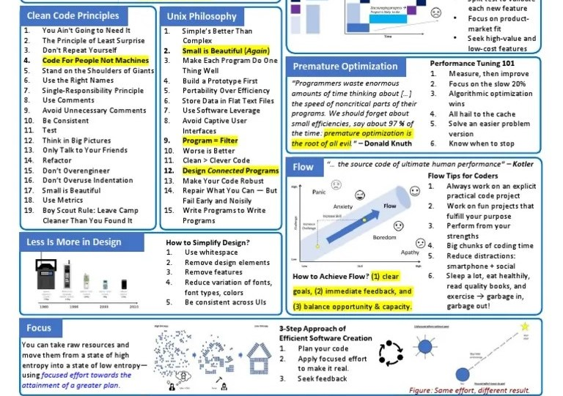
SOFTWARE DEVELOPMENT LIFECYCLE

Slide 90
OWN THE IDEATION, TECHNICAL DEVELOPMENT, LAUNCH AND ADOPTION OF THE PRODUCTS YOU BUILD
how to do it:
Gather inputs from clients, account teams, and internal users.
Run brainstorming or design thinking sessions to generate solutions.
Partner with engineering & data science early to validate feasibility.
Define MVP → phased rollouts → adoption campaigns.
Pro-tip: Anchor ideation in measurable advertiser outcomes (e.g., “increase audience targeting accuracy” or “faster reporting turnaround”), not just new features.
---------------------------------------------------------------------------------------------------------------------------------------------------------------------------------------------
2. DRIVE PRODUCT DEVELOPMENT WITH CROSS-FUNCTIONAL TEAMS INCLUDING ENGINEERING, DATA SCIENCE, ANALYTICS
How to do it:
Be the bridge between business and technical teams: translate problems into actionable stories.
Maintain a prioritized backlog and host sprint planning/grooming sessions.
Encourage shared ownership: highlight how each team’s work contributes to client success.
Pro-tip: Engineers/data scientists at MiQ care about scale and precision — always communicate requirements with clarity on data sources, accuracy needs, and performance expectations.
---------------------------------------------------------------------------------------------------------------------------------------------------------------------------------------------
3. BUILD AND MAINTAIN SHORT-TERM AND LONG-TERM PRODUCT ROADMAP
How to do it:
Align roadmap to MiQ’s strategy (e.g., omnichannel programmatic, measurement, data integration).
Define short-term wins (quick adoption features) vs. long-term bets (AI-based optimization, new attribution models).
Update quarterly, sharing with leadership and GTM teams.
Pro-tip: In ad-tech, client expectations shift fast. Keep your roadmap flexible with “tentative” and “committed” buckets.

Slide 91
4. ENSURE FEATURES MEET DEMANDS VIA EXTENSIVE TESTING AND CUSTOMER FEEDBACK
How to do it:
Collaborate with QA to define acceptance criteria.
Run UAT with internal traders/account teams before client pilots.
Collect structured feedback (surveys, interviews, usage data) and iterate.
Pro-tip: Use real campaign data wherever possible for testing — it’s more convincing for clients than dummy use cases.
---------------------------------------------------------------------------------------------------------------------------------------------------------------------------------------------
5. DEFINE PRODUCT KPIS AND METRICS TO TRACK SUCCESS OF THE PRODUCT
How to do it:
Tie KPIs to business impact (e.g., adoption rate, time saved in reporting, campaign ROI uplift).
Track both leading indicators (feature usage, engagement) and lagging indicators (revenue contribution, renewal rates).
Automate reporting dashboards for visibility.
Pro-tip: At MiQ, emphasize KPIs that showcase client performance improvements (click-through rates, attribution accuracy) rather than just internal usage stats.
---------------------------------------------------------------------------------------------------------------------------------------------------------------------------------------------
6. CREATE DOCUMENTATION AND COLLATERAL THAT DESCRIBE FEATURE SETS FOR INTERNAL AND EXTERNAL AUDIENCES
How to do it:
Internal: write product briefs, training decks, FAQs, and release notes for account managers and traders.
External: collaborate with marketing to produce one-pagers, client decks, and demo scripts.
Pro-tip: Frame docs around “what problem this solves for clients” → not just “what the feature does.”

Slide 92
7. SUPPORT SALES VIA TRAINING, ONBOARDING AND ONGOING SUPPORT OF CUSTOMER INITIATIVES USING NEW PRODUCTS
How to do it:
Run enablement sessions with sales & client service teams.
Provide playbooks with value props, demo flows, and objection-handling tips.
Join client pitches or onboarding calls to hear firsthand feedback.
Pro-tip: Position yourself as the product translator → sales doesn’t need technical jargon; they need clear value stories that resonate with clients.

Slide 93
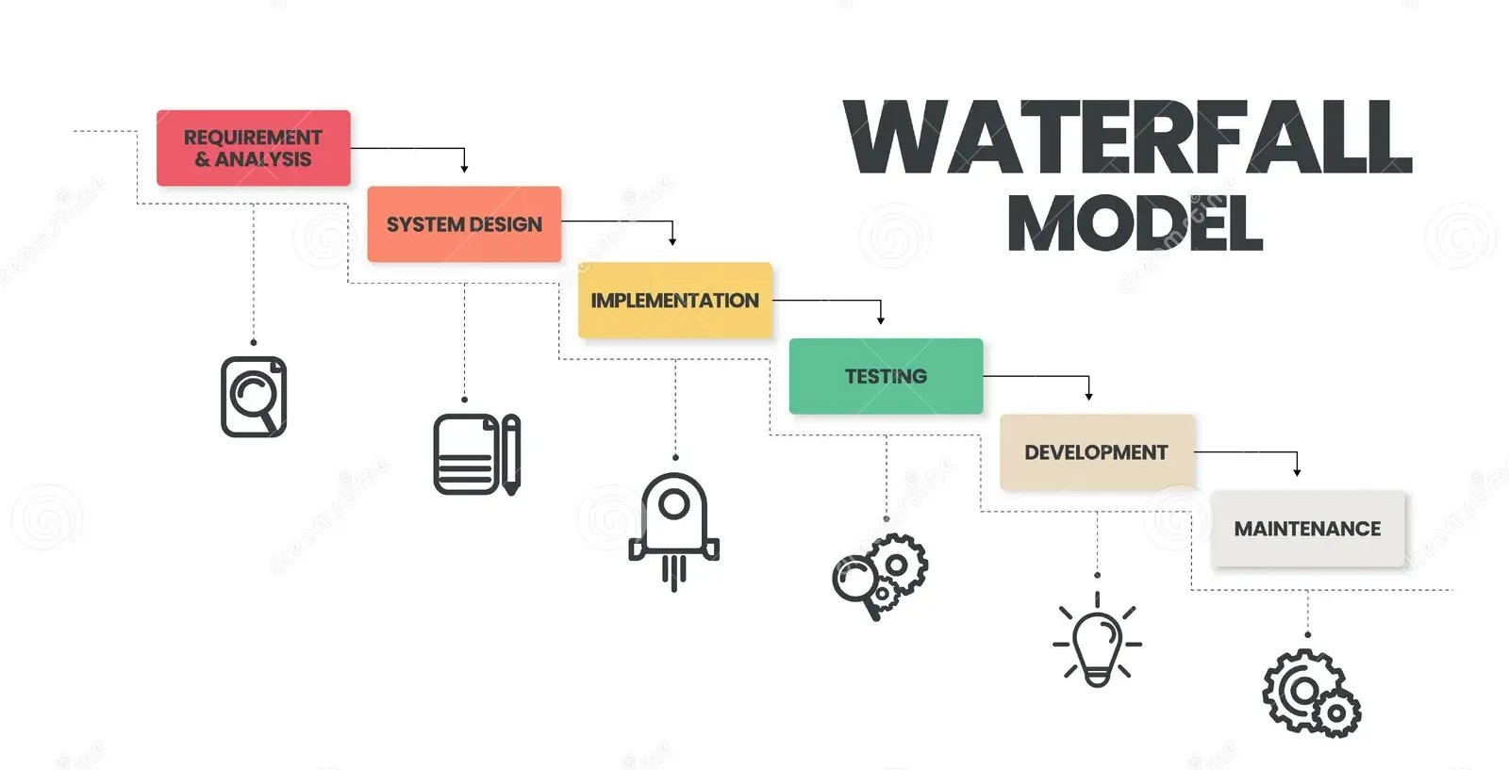
SOFTWARE DEVELOPMENT LIFECYCLE

Slide 94
ASPECT | WATERFALL METHODOLOGY | AGILE METHODOLOGY
Development Approach | Follows a linear, sequential process: requirements → design → development → testing → deployment, with each phase finished before the next starts. This is typical of highly regulated or fixed-scope work such as a government e-services portal or a banking core-system upgrade. | Uses an iterative, incremental approach in short sprints where planning, coding and testing happen in parallel. Common in mobile-app start-ups or SaaS firms rolling out new features every 2–3 weeks.
Flexibility with Requirements | Requirements are defined and frozen upfront; any change requires a formal change request and can cause rework. For example, an aircraft control system or a hospital building project cannot change specs mid-way. | Requirements are expected to evolve; product owners can reprioritise features at the end of each sprint. This is typical of an e-commerce site adding new payment options or a fintech app responding to new regulations.
Project Size & Suitability | Best for large, predictable projects with stable deliverables – e.g. constructing a data centre or implementing a packaged ERP suite. | Best for complex or uncertain projects where outcomes aren’t fully known – e.g. developing a cloud analytics platform or a social-media feature set driven by user feedback.
Customer/Stakeholder Involvement | Stakeholders are involved heavily at the start and at final acceptance, with minimal touchpoints in between – like a multi-year defence IT upgrade delivered at the end. | Stakeholders are engaged continuously, reviewing and steering each sprint – like a SaaS company demoing new dashboards to clients every fortnight.
Delivery of Output | The final product is delivered only at the end of the project; no usable software until late in the lifecycle. Typical for packaged enterprise software releases after 12–18 months. | Working software or product increments are delivered at the end of each sprint, allowing early use – e.g. a streaming service rolling out a new UI module every sprint to beta users.

Slide 95
ASPECT | WATERFALL METHODOLOGY | AGILE METHODOLOGY
Testing Approach | Testing is a separate phase performed after the build, so defects surface late and cost more to fix – like medical-device firmware tested after all coding is done. | Testing is continuous and integrated into each sprint with automation and immediate fixes – like a social network running automated tests on every feature branch.
Documentation | Emphasises comprehensive documentation (requirements, design, test plans, manuals) which serves as the main reference – as seen in defence or aerospace projects with strict audits. | Emphasises “working software over comprehensive documentation,” maintaining only essential artefacts – as seen in start-ups building chat or collaboration apps with user stories in Jira instead of thick specs.
Team Structure | Teams are role-based and siloed, handing work off sequentially – typical of large IT vendors where analysts, developers and testers sit in separate departments. | Teams are cross-functional, sharing responsibility and working side by side – like a Scrum squad at Spotify with developers, QA, designers and a product owner in one pod.
Risk Management | Risk is higher because issues emerge late and changes are expensive – as happened with national census software built over years without interim releases. | Risk is lower because the work is broken into small increments with early feedback – like an online-learning platform adding new modules gradually and adjusting based on usage.
Time & Cost Estimation | Budget and schedule are fixed upfront for the whole project, suiting fixed-price contracts – e.g. building a new data centre facility with a strict deadline. | Estimates are done per sprint or feature, allowing ongoing adjustment of scope and resources – e.g. a fintech app where scope shifts with new regulator guidance.

Slide 96
THE SCRUM FRAMEWORK

Slide 97
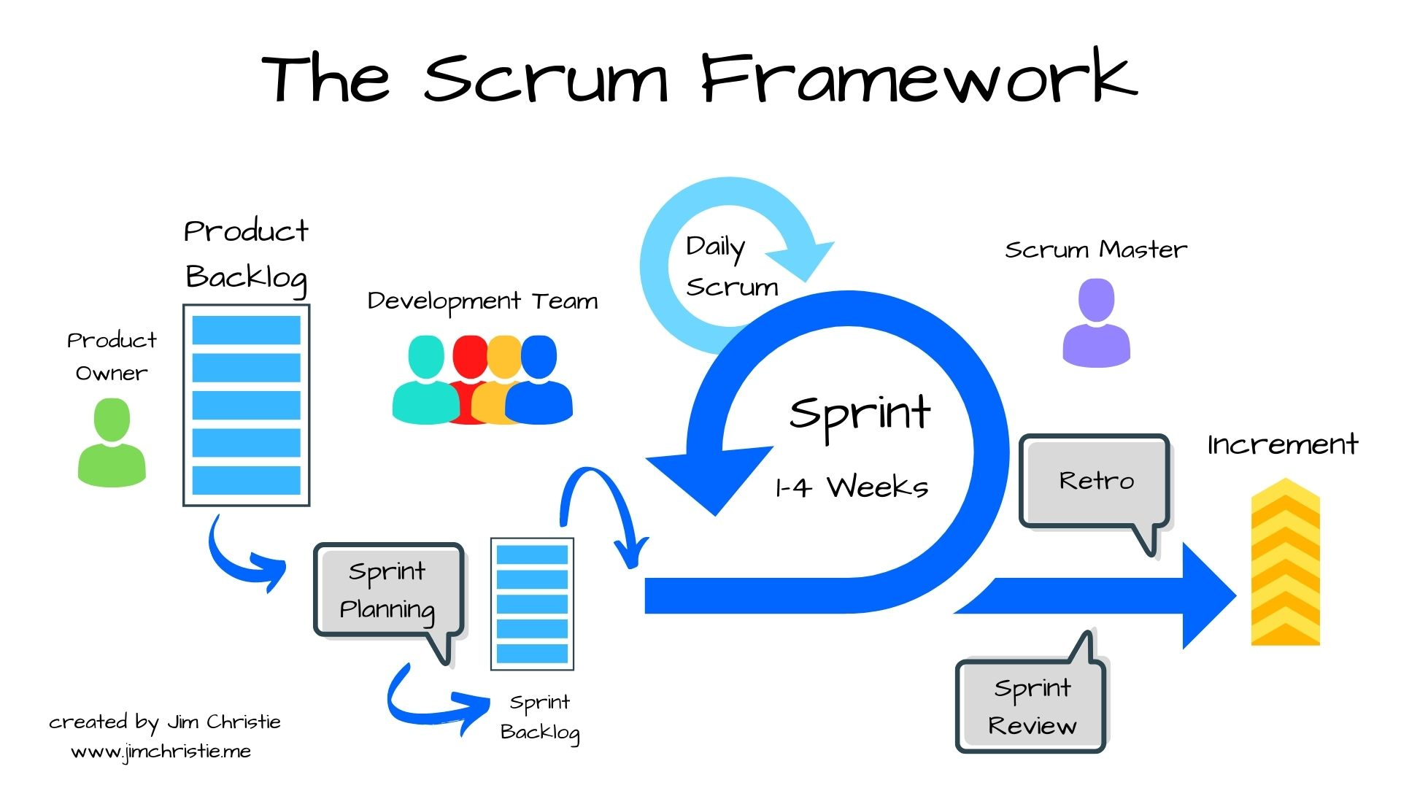

Slide 98
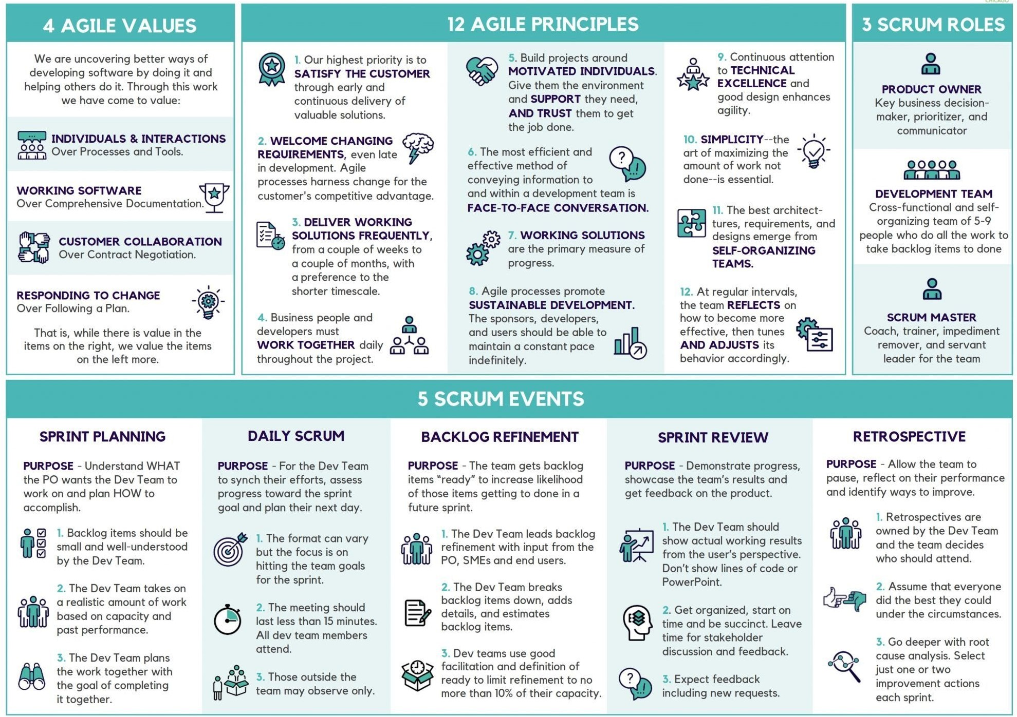

Slide 99
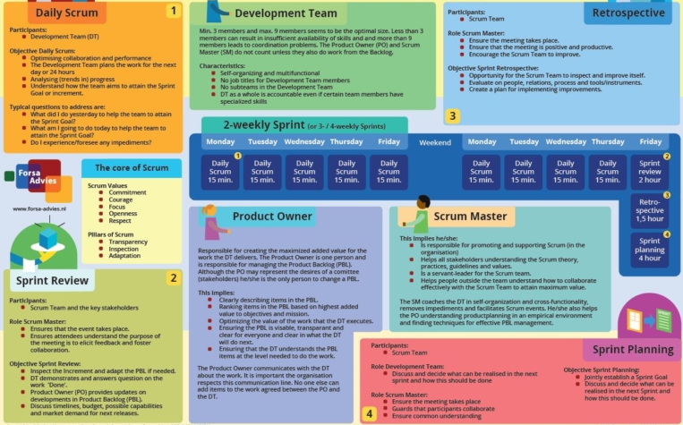

Slide 100
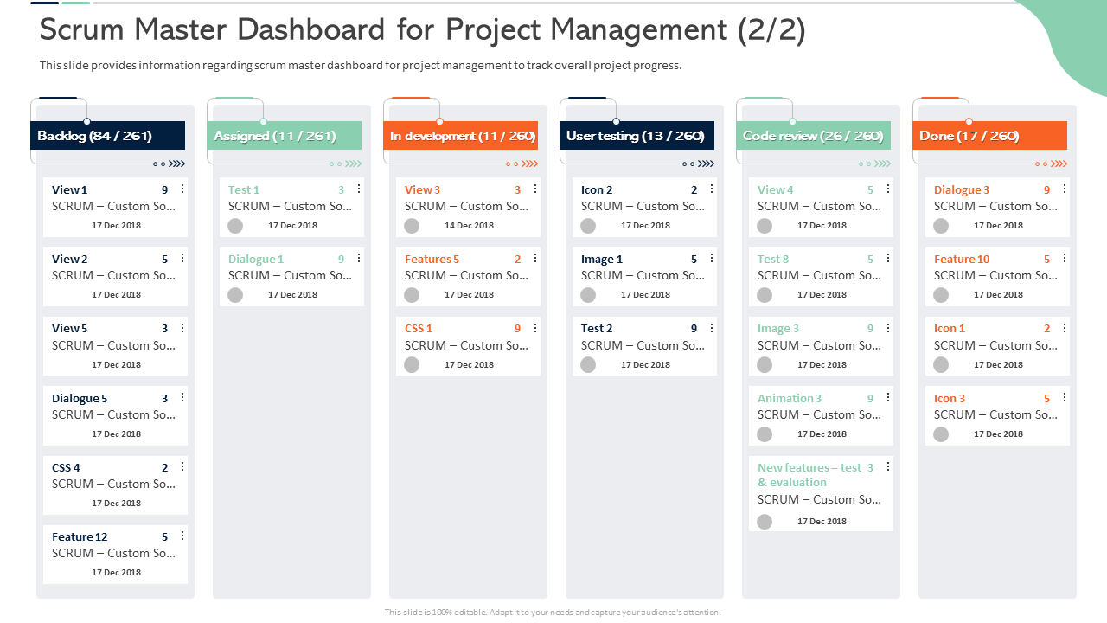

Slide 101
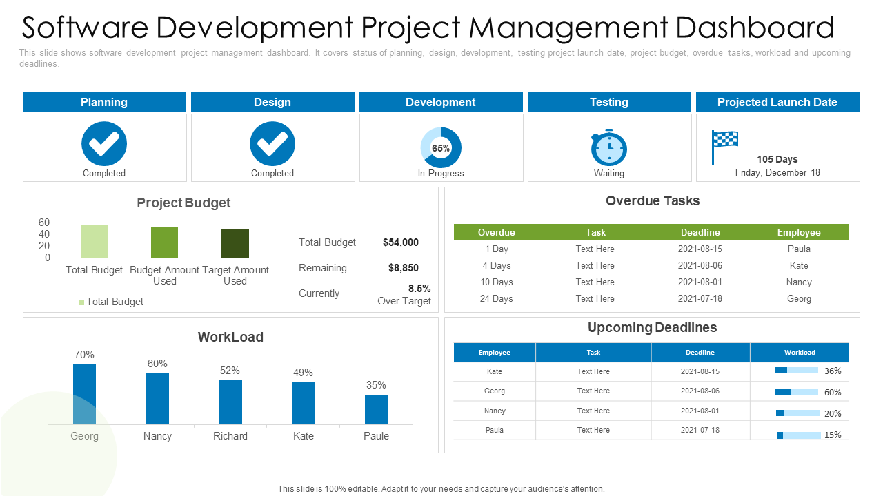

Slide 102
ALIGNING WITH KEY STAKEHOLDERS (CLIENTS + INTERNAL TEAMS) TO GATHER PRODUCT REQUIREMENTS
UNDERSTAND THE BUSINESS CONTEXT
HOW TO DO IT:
Research client objectives (brand awareness, performance, ROI uplift).
Study MiQ’s existing solutions and identify where gaps may exist.
Review campaign performance, market insights, and competitor benchmarks.
Pro-tip: In ad-tech, tie every conversation back to how the product helps drive campaign outcomes faster, cheaper, & smarter.
---------------------------------------------------------------------------------------------------------------------------------------------------------------------------------------------
2. BUILD TRUSTED RELATIONSHIPS WITH STAKEHOLDERS
HOW TO DO IT:
Set recurring syncs with internal teams (sales, account managers, traders, analytics).
Meet clients regularly in discovery or QBR-style sessions.
Listen actively and note pain points, not just feature requests.
Pro-tip: Relationship equity matters — don’t only show up when you need requirements; be seen as a partner who understands their business.
---------------------------------------------------------------------------------------------------------------------------------------------------------------------------------------------
3. ELICIT BUSINESS NEEDS (NOT JUST FEATURES)
HOW TO DO IT:
Use structured questioning to uncover the “why”:
“What’s blocking you from hitting your KPIs?”
“If this manual task were automated, what would it free up for you?”
Document needs as problem statements rather than solution asks.
Pro-tip: Translate vague requests like “better reporting” into specific measurable needs (e.g., “reduce report turnaround time from 2 days to 2 hours”).

Slide 103
4. FACILITATE ALIGNMENT SESSIONS ACROSS FUNCTIONS
HOW TO DO IT:
Host workshops bringing together clients (business view) and internal teams (feasibility view).
Use prioritization frameworks (RICE (Reach, Impact, Confidence, and Effort), MoSCoW (Must have, Should have, Could have, and Won't have)) to weigh impact vs. effort.
Leverage visual tools (journey maps, user story maps) to make discussions concrete.
Pro-tip: Keep alignment sessions short, focused, and data-backed — long unfocused workshops lose buy-in quickly.
---------------------------------------------------------------------------------------------------------------------------------------------------------------------------------------------
5. TRANSLATE INTO CLEAR PRODUCT REQUIREMENTS
HOW TO DO IT:
Convert needs into user stories, acceptance criteria, Product Requirements Document (PRD).
Validate these requirements with both business (does it solve the problem?) and tech (is it feasible?).
Pro-tip: Always write requirements in the voice of the end-user (“As a trader, I want to…”), not just in technical terms.
---------------------------------------------------------------------------------------------------------------------------------------------------------------------------------------------
6. CLOSE THE FEEDBACK LOOP
HOW TO DO IT:
Share back a summary of what you captured to confirm mutual understanding.
After development, validate with client pilots or internal users.
Measure adoption and report improvements back to stakeholders.
Pro-tip: Showing measurable progress (“we cut campaign setup time by 40%”) builds long-term trust and strengthens alignment.

Slide 104
PYTHON

Slide 105
TOPIC | KEY CONCEPTS / DEFINITIONS (ELABORATED WITH SUBTYPES)
Python Variables | A variable is a name bound to an object/value. Python is dynamically typed: you don’t declare types; the interpreter figures out type at runtime. Mutability vs Immutability of the object referenced is important (e.g. ints, strings are immutable; lists, dicts are mutable). Variable scope: Global, Local, Enclosing (in nested functions), Built-in. Namespace & lifetime: local variables exist during function execution; global during program run; built-ins persist. - Multiple assignment, tuple unpacking, augmented assignment (e.g. +=) are variations of assignment / variable binding Type hints / annotations (Python 3.x) though not strictly enforced; static analysis uses them.
Python Operators | Operators are special symbols or keywords that carry out operations on values / variables. Subtypes include: Arithmetic Operators: +, -, *, /, %, // (floor division), ** (exponentiation) etc. Assignment Operators: =, +=, -=, *=, /=, //=, **=, bitwise assignment (&=, `
Python Keywords | Keywords are reserved words built into the language; you cannot use them as variable names. Subtypes & examples: - Control Flow Keywords: if, elif, else, for, while, break, continue, pass, return Function / Class Definition Keywords: def, class, lambda (anonymous functions) Exception Handling Keywords: try, except, finally, raise, assert Importing & Module Keywords: import, from, as Boolean / Truth Keywords: True, False, None Scope / Namespace Keywords: global, nonlocal Concurrency / Async Keywords: async, await (in modern Python versions) Other Structural Keywords: with, yield, del Note: The full current list depends on Python version; new keywords may be introduced.

Slide 106
TOPIC | KEY CONCEPTS / DEFINITIONS (ELABORATED WITH SUBTYPES)
Python Data Types | Built-in / standard data types classify what kind of values objects have and what operations are allowed. Subtypes include: Numeric Types: int (integers), float (floating point), complex (complex numbers with real+imaginary parts) Boolean Type: bool (subclass of int, with only True / False) Sequence Types: str (string of Unicode characters), list (mutable ordered sequence), tuple (immutable ordered sequence), range (immutable sequence of numbers, often used for iterations) Mapping Type: dict (key‐value mapping, keys must be hashable) Set Types: set (mutable unordered collection of unique elements), frozenset (immutable version) Binary Types: bytes (immutable byte sequences), bytearray (mutable), memoryview (view on buffer / binary data) NoneType: the type of None, signifies absence of value Other Concepts: Type conversion (implicit & explicit), checking types (type(), isinstance()), primitive vs non-primitive types (mutability, simplicity)
Python Conditional Statements | Used to make decisions in code, controlling which code block runs based on conditions. Subtypes & variations: Simple if statements: if condition: if-else: if … else … if-elif-else chains to test multiple conditions Nested conditionals: conditionals inside other conditionals Conditional Expressions / Ternary Operator: value_if_true if condition else value_if_false Truthy / Falsy testing: many types have truth value (empty sequences, zero, None → False; non-empty etc → True) Short-circuiting: in logical combinations (e.g. and, or) some parts may not be evaluated Comparison chaining: e.g. a < b < c Use of pass to define empty conditional branch Edge cases: comparisons vs identity vs issues with floating point or None etc.

Slide 107
TOPIC | KEY CONCEPTS / DEFINITIONS (ELABORATED WITH SUBTYPES)
Python Loops | Loops let you repeat code. Subtypes & patterns: for loops: iterate over sequence (list, tuple, string, dict keys, values, etc.), over range object while loops: repeat until condition becomes False Nested loops: loops inside loops Loop control statements: break (exit loop), continue (skip to next iteration), else in loops (runs if loop didn’t break) Iterators & Generators: ability to iterate via iterator protocol (__iter__, __next__) and generate values on the fly - Comprehensions (list / set / dict) as compact loop Performance considerations: avoid heavy nested loops, prefer comprehension/generator when possible Edge cases: infinite loops (mis-written while), modifying collections during iteration.
Python Functions | Encapsulating reusable code. Subtypes and details: Defining functions with def including parameters and return values Parameter types: positional, keyword arguments, default arguments, variable positional (*args), variable keyword (**kwargs), keyword-only args (after *) Anonymous functions via lambda (single expression) Function scope: local variables; global; closure; nonlocal keyword for nested functions Returning values: explicit return; if no return → returns None Docstrings: for documentation Higher-order functions: passing functions as arguments, returning functions Decorators, nested/inner functions Recursion (overlaps with topic H) Side effects vs purity; idempotence; function side behaviour.

Slide 108
TOPIC | KEY CONCEPTS / DEFINITIONS (ELABORATED WITH SUBTYPES)
Python Recursion | Calling a function from itself. Subtypes / concerns: Base case vs recursive case: base case to stop recursion or infinite recursion results Direct recursion vs indirect recursion (function A calls B, B calls A) Tail recursion: a style where recursive call is last action – note: Python does not optimize tail recursion by default – Working with recursion for factorial, Fibonacci, tree traversals, backtracking etc. Stack depth limit: Python has maximum recursion depth; too deep causes RecursionError Performance: many recursive algorithms are expensive (exponential) if overlapping subproblems – can be optimized using memoization or converting to iteration Memory overhead of call stack.
Python Lambda | Anonymous function expression. Subtypes / constraints: Defined using keyword lambda, syntax lambda args: expression Only a single expression allowed, no statements Useful for small, throw-away functions often passed to map, filter, sorted(key=…), etc. Can take multiple arguments, including default values, but complex logic is discouraged Return value is the expression result Readability issues; debugging harder Comparison with def functions: lambdas are limited; def can include multi-line code and statements; lambdas are objects too; scope rules apply.
Python Strings | Immutable sequences of Unicode characters. Subtypes / operations: Literal definitions: single quotes '…', double quotes "…", triple quotes '''…''' or """…""" (multi-line strings) Escape sequences (e.g. \n, \t, \\) and raw strings (r"…") String methods: lower, upper, strip, replace, find, split, join, format, f-strings (modern), .startswith(), .endswith(), etc Slicing and indexing; immutable so slicing returns new string Concatenation (using +) and repetition (using *) Immutability means modifying a character is not possible you create new strings - Encoding / decoding: encode(), decode(), Unicode, bytes conversion Edge cases: Unicode combining characters, surrogate pairs, normalization.

Slide 109
TOPIC | KEY CONCEPTS / DEFINITIONS (ELABORATED WITH SUBTYPES)
Python Lists | Mutable ordered sequence container. Subtypes / operations: Creation: literal [ ], list constructor list(…) Access: indexing, slicing - Adding / deleting: append(), extend(), insert(), remove(), pop(), clear() Other list methods: sort(), reverse(), count(), index() Nested lists (list of lists) Copying: shallow copy vs deep copy Iteration: simple loops, comprehensions, enumerate() Use in stack or queue patterns Performance: random access O(1), insertion/deletion at end O(1), in middle O(n) etc. Memory overlap if aliasing (two variables refer to same list).
Python Tuples | Immutable ordered sequence. Subtypes / operations: Creation: literal ( … ), single-element tuple needs trailing comma (x,) Access via indexing, slicing - Unlike list, no append or remove (immutable) Can contain heterogeneous types; can nest other tuples or mutable objects Useful for fixed collections of data, multiple return values from functions Tuples can be used as keys in dicts if all elements are hashable Memory and performance: smaller than lists generally; safer when no modifications needed.
Python Dictionaries | Key-value mapping type. Subtypes / important details: Keys: must be hashable types (immutable types, e.g. strings, numbers, tuples of immutables) Values: any type Creation: literal {key: val, …}, dict() constructor, comprehension {k: v for ...} Access: indexing via dict[key], or .get(key, default) Modifying: add/update via dict[key] = val, delete via del, .pop(), .clear() Iteration: .keys(), .values(), .items() Order: insertion order preserved in Python 3.7+; older versions did not guarantee this Use cases: lookups, grouping, JSON data, frequency counting Memory & performance: average O(1) lookup times; large dictionaries have overhead.

Slide 110
TOPIC | KEY CONCEPTS / DEFINITIONS (ELABORATED WITH SUBTYPES)
Python Sets | Unordered collection of unique elements. Subtypes / variations: Mutable set, immutable frozenset Creation: literal {…}, set(iterable), frozenset(iterable) Operations: membership testing, addition (.add()), removal (.remove(), .discard()), set arithmetic: union (`
Python Arrays | “Array” meaning different things depending on context in Python. Subtypes / differences: Built-in list often used like arrays (dynamic, heterogeneous) array module: typed arrays (elements of same numeric type), more efficient for large number of numeric elements Third-party libraries: e.g. NumPy arrays with fixed size, homogeneous type, vectorized operations Memory views / buffers when dealing with binary data Use cases: performance-sensitive numeric computations, large datasets Differences: list operations vs array operations; broadcasting etc in NumPy; trade off flexibility vs speed.
Python List Comprehension | Compact syntax to generate new lists. Key subtypes / variations: Basic comprehension: [ expression for item in iterable ] With condition / filter: [ expression for item in iterable if condition ] Nested comprehensions: comprehension inside comprehension (e.g. flattening nested lists) Using multiple iterables: [ f(x, y) for x in list1 for y in list2 ] Comprehension vs map/filter vs loop: readability, performance trade-offs Other comprehension types: set comprehensions { … }, dict comprehensions {key_expr: value_expr for …}, generator expressions ( … ) (similar syntax but lazy evaluation) Side effects discouraged inside comprehensions; best for pure expressions Memory usage: comprehension builds full list; generator expression or iterators may help for large sizes.

Slide 111
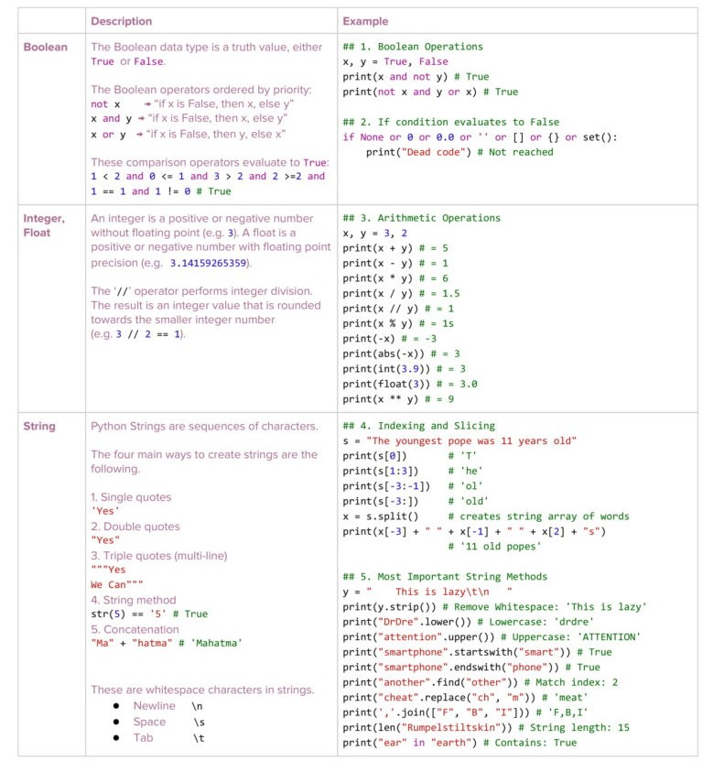

Slide 112
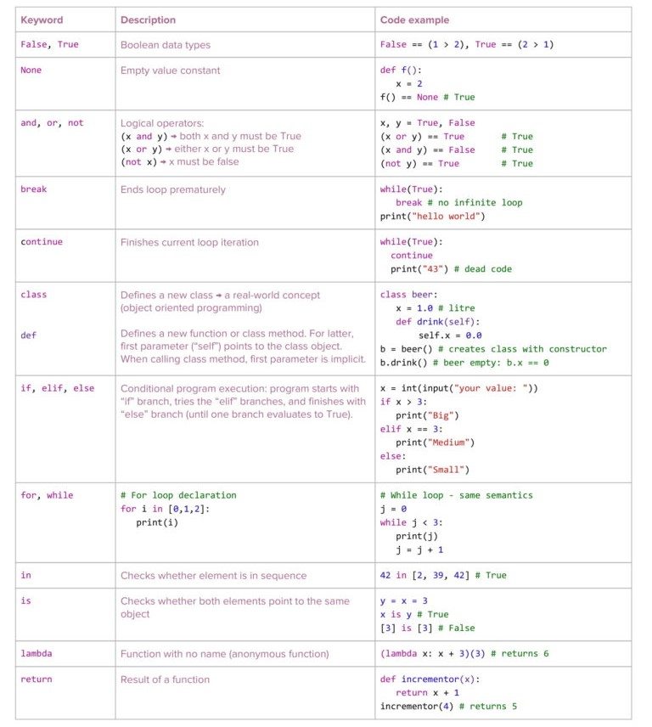

Slide 114
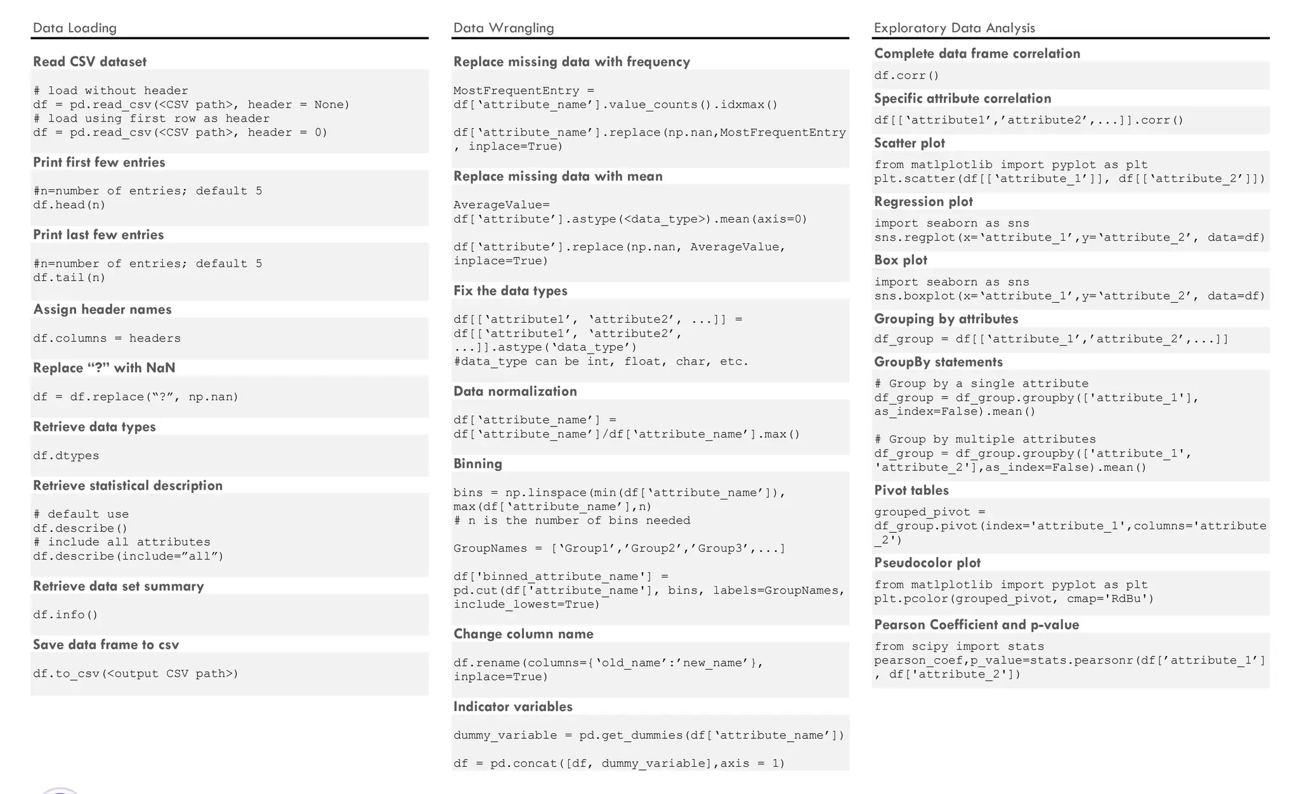

Slide 115
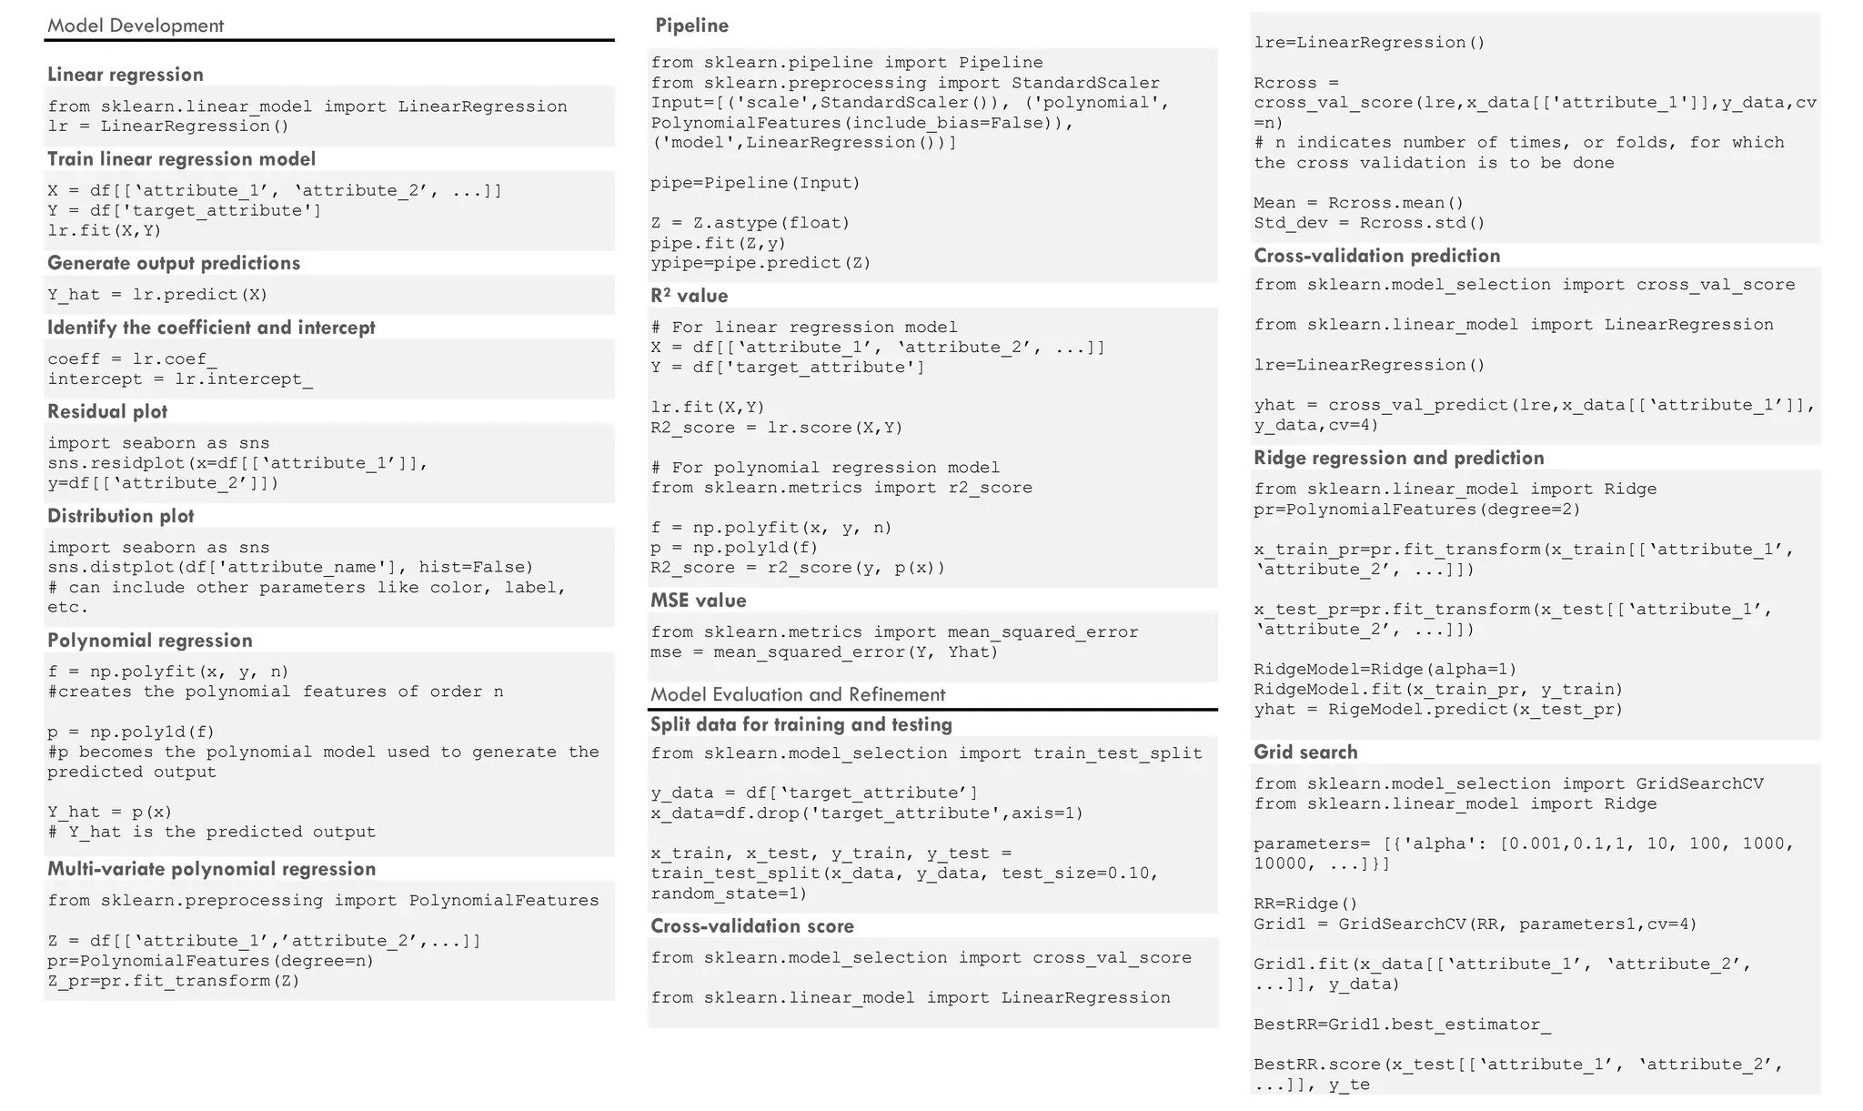

Slide 116
LIBRARIES (1/2)
LIBRARY | DESCRIPTION | TYPICAL USES | EXAMPLE SYNTAX | AI ADVERTISEMENT USE CASES
NumPy | Multi-dimensional arrays; mathematical operations; underpins scientific computing | Data preprocessing, batch data operations, numeric analytics | import numpy as np arr = np.array([1,2,3]) | Fast processing of clickstream and impression logs; feature extraction for ad targeting
Pandas | Data manipulation & analysis, structured data (DataFrames) | ETL, reporting, KPI dashboards | import pandas as pd df = pd.read_csv('ad_data.csv') | Audience segmentation; user/event logs processing; joining anonymized datasets
Matplotlib | Plotting library for static/animated visualizations | Charts, data exploration, analytic reports | import matplotlib.pyplot as plt plt.plot(x, y) | Visualizing campaign performance (CTR, spend, conversions); model performance metrics
Seaborn | High-level interface for statistical data visualization (built on Matplotlib) | Statistical analysis, pattern discovery | import seaborn as sns sns.barplot(x, y) | Heatmaps of ad engagement by demographic/region; funnel visualization
SciPy | Advanced scientific and technical computing | Optimization, signal processing, statistics | from scipy import stats stats.ttest_ind(a, b) | A/B test analytics for creatives; conversion rate experiment analysis
Scikit-learn | Machine learning algorithms for classification, regression, clustering | Model training, evaluation, and feature engineering | from sklearn.ensemble import RandomForestClassifier clf = RandomForestClassifier() | Predicting click-through or conversion rates; lookalike modeling for targeting

Slide 117
LIBRARIES (2/3)
LIBRARY | DESCRIPTION | TYPICAL USES | EXAMPLE SYNTAX | AI ADVERTISEMENT USE CASES
TensorFlow | Deep learning, neural networks, and distributed ML | High-performance AI model building | import tensorflow as tf model = tf.keras.Sequential([...]) | Large-scale behavioral prediction; real-time bidding optimization; personalization models
PyTorch | Flexible, dynamic deep learning; research and production | Neural network experiments, rapid prototyping | import torch x = torch.tensor([1.,2.,3.]) | Natural Language Processing for ad creatives; deep CTR prediction
Keras | High-level neural networks API (runs on TensorFlow) | Prototyping deep learning models, rapid iteration | from tensorflow import keras keras.Sequential([...]) | Quick iterative model building for creative optimization or personalization
Flask | Lightweight web application framework | APIs, web dashboards, deployment of models | from flask import Flask app = Flask(__name__) | Deploying real-time inferencing services for ad decisioning; campaign performance dashboards
Django | Full-stack web framework; "batteries-included" | Scalable web and app backend development | import django django-admin startproject myproject | Building ad tech platforms, analytics portals, and campaign management UIs

Slide 118
LIBRARIES (3/3)
LIBRARY | DESCRIPTION | TYPICAL USES | EXAMPLE SYNTAX | AI ADVERTISEMENT USE CASES
Requests | Simple HTTP requests and API consumption | Fetching data, integrating third-party data | import requests response = requests.get(url) | Retrieving campaign stats from ad exchanges; accessing external targeting data
BeautifulSoup | HTML/XML parsing and web scraping | Data acquisition from web, link extraction | from bs4 import BeautifulSoup as bs bs(html, 'html.parser') | Scraping competitor ad placements or campaign listings
OpenCV | Computer vision: image/video processing | Object detection, image analytics, video analysis | import cv2 img = cv2.imread('ad.jpg') | Creative quality control, brand safety monitoring, visual content classification
Selenium | Automated browser control for testing/scraping | Web automation, end-to-end tests | from selenium import webdriver driver = webdriver.Chrome() | Automated creative QA, landing page checks, programmatic ad validation
Scrapy | Advanced web scraping framework | Scalable web gathering, pipelines | import scrapy class AdSpider(scrapy.Spider): ... | Gathering ad intelligence, competitor pricing, large-scale data extraction

Slide 119
AI & ML

Slide 120
Artificial Intelligence
Machine Learning → Statistics, Algorithms, & Data
Deep Learning → Image Recognition, Speech Recognition
---------------------------------------------------------------------------------------------------------------------------------------------------------------------------------------------
Deep Leaning is classified into:
Artificial Neural Networks: Parts of a deep learning neural networks
Layers: Input Layer, Hidden Layer, Output Layer
Famously known popular structures of Deep Learning Neural Networks:
Convolutional Neural Networks: Commonly used in image recognition
Recurrent Neural Networks: Commonly used in text to speech applications
---------------------------------------------------------------------------------------------------------------------------------------------------------------------------------------------
Supervised Learning: Involves learning from labeled data, where the model is trained on input-output pairs. Common tasks include regression and classification.
Unsupervised Learning: Focuses on discovering patterns in unlabeled data. The model identifies relationships and structures without prior knowledge of the outcomes. Common tasks include clustering and association.
Reinforcement Learning: Involves learning through interactions with an environment, where the model receives rewards or penalties based on its actions. This approach is often used in scenarios requiring decision-making.

Slide 121
GEN AI VS AGENTIC AI VS AI AGENTS
ASPECT | GENERATIVE AI (GEN AI) | AGENTIC AI | AI AGENTS
Core Function | Creates new content (text, images, code, music) by learning patterns from data. | Combines reasoning, planning, memory, and action to autonomously pursue goals (beyond simple content generation). | Software entities designed to act on behalf of a user/system, performing tasks based on triggers or instructions.
Autonomy Level | Low – responds to prompts but does not self-initiate tasks. | High – capable of self-initiating tasks, making decisions, and adapting strategies. | Medium – can execute pre-programmed or learned tasks; autonomy depends on design.
Example Use Cases | Text summarization, code generation, image synthesis. | Multi-step problem solving, workflow orchestration, autonomous research agents. | Customer service bots, RPA bots, virtual assistants executing commands.
Memory & Planning | Typically stateless; no persistent memory unless explicitly built. | Uses long-term memory, reasoning, and planning to achieve objectives. | May have short-term or task-specific memory but usually limited strategic planning.
Output vs Action Orientation | Output-oriented (creates artifacts). | Goal-oriented (plans and executes actions to reach an outcome). | Task-oriented (executes discrete tasks or actions within set boundaries).
Adaptability | Limited – adapts only through retraining or fine-tuning. | High – adapts dynamically to new contexts, feedback, and changing goals. | Moderate – adapts within its programmed rules or ML model but not fully self-improving.
Human Involvement | High – requires human prompts to generate outputs. | Low – can operate semi- or fully autonomously with minimal supervision. | Medium – often triggered by user input or system events.
Integration Scope | Usually, a standalone model integrated into apps for content generation. | Acts as an orchestrator across multiple systems, tools, and data sources. | Typically bound to a single application or workflow but can be networked.

Slide 122
Criteria | Supervised Learning | Unsupervised Learning | Reinforcement Learning
Definition | Learns from labeled data | Identifies patterns in unlabeled data | Learns through interaction with environment
Type of Data | Labelled data | Unlabelled data | No predefined data learn from environment
Type of Problems | Classification, Regression | Clustering, Association | Sequential decision-making
Supervision | Requires external supervision | No supervision | No supervision, learns from feedback
Algorithms | SVM, Decision Trees, Neural Networks | K-Means, PCA, Autoencoders | Q-learning, DQN, SARSA
Goal | Predict outcomes accurately | Discover hidden patterns | Optimize actions for maximum rewards
Applications | Medical diagnosis, fraud detection | Customer segmentation, anomaly detection | Self-driving cars, robotics, gaming
Machine Learning | Domain | Examples
Supervised Learning | Healthcare | Disease diagnosis like cancer detection
 | Finance | Loan approval, credit risk assessment
 | NLP | Sentiment analysis, text classification
Unsupervised Learning | E-commerce | Product recommendation, customer segmentation
 | Cybersecurity | Fraud detection, intrusion detection
 | Biology | Gene classification, dimensionality reduction
Reinforcement Learning | Autonomous Driving | Self-driving cars learning optimal driving behavior
 | Robotics | Training robots for automated assembly tasks
 | Gaming | AI-driven strategy games like AlphaGo

Slide 123
MODELS (1/11)
TYPE | MODEL | DESCRIPTION | USE CASES | PROS | USES | CONS | EXAMPLE
Supervised | Logistic Regression | Estimates the probability of a binary outcome (e.g., click/no-click or user conversion) based on input features such as user attributes, context, and ad characteristics. Yields interpretable probability scores for each class. | Ad click-through rate (CTR) prediction, conversion rate estimation, fraud detection | Simple, interpretable, fast, requires little computing power | Quick scoring in real-time bidding (RTB), CTR, and conversion optimization | Extremely nonlinear or high-dimensional relationships | Predicting likelihood, a user will click on an ad
Supervised | Decision Tree / Random Forest | Decision Tree splits data into branches using feature thresholds, mapping to a classification or regression result. Random Forest combines many such trees to reduce overfitting and improve accuracy, making stable predictions even with data noise and outliers. | User segmentation, churn prediction, multi-faceted audience scoring, ad fraud pattern analysis | Handles diverse feature types, robust to noisy data, provides feature importances | Ad fraud analytics, audience segmentation, campaign performance analysis | May be overfit with small/sample-biased data | Detecting invalid click patterns, ad-view fraud detection

Slide 124
MODELS (2/11)
TYPE | MODEL | DESCRIPTION | USE CASES | PROS | USES | CONS | EXAMPLE
Supervised | Gradient Boosted Trees (e.g., XGBoost, LightGBM) | Builds models in sequential stages where each stage corrects errors from prior models. This ensemble learning approach is highly effective for structured/tabular data and powers many high-stakes bid and targeting systems in AdTech. | Bid price prediction, outcome scoring (e.g., conversion, engagement), audience scoring | High accuracy, works well with missing data, handles non-linearities nicely | Real-time bidding strategies, budget allocation, LTV (lifetime value) prediction | High-latency systems, streaming with strict time budgets | Determining optimal bid price in ad auctions
Supervised | Support Vector Machine (SVM) | Generates hyperplanes in a high-dimensional space that best separate data classes. Kernel tricks allow SVM to model non-linear boundaries, making it useful for text/image categorization or brand safety classification in moderate-sized datasets. | Brand safety filtering, text/image categorization, classifying ad creatives by compliance | Good for high-dimension, can use custom kernels, robust margin | Brand/context safety, compliance, moderate-sized labeled sets | Large datasets, poorly separable classes | Flagging unsafe or non-compliant ad images

Slide 125
MODELS (3/11)
TYPE | MODEL | DESCRIPTION | USE CASES | PROS | USES | CONS | EXAMPLE
Supervised | Multilayer Perceptron (MLP, Neural Network) | A fully connected feedforward neural network with one or more hidden layers. MLP/ANNs approximate complex, non-linear mappings, handling mixed features and interaction terms in AdTech behavioral and performance prediction. | Impression response prediction, dynamic scoring, conversion probability estimation | Captures non-linear relationships, flexible, scalable with data/compute | Complex interaction effects, non-linear user behavior modeling | Small datasets, no non-linearities | Predicting impression-level response for ad campaign analysis
Unsupervised | K-Means / Hierarchical / DBSCAN Clustering | These algorithms group users, events, or creatives by behavior or attributes without labels. K-Means minimizes intra-cluster distance for a set number of clusters. Hierarchical builds tree-structured groupings. DBSCAN finds arbitrarily-shaped clusters from density. | Audience segmentation, traffic clustering, identifying invalid traffic, lookalike modeling | Finds hidden/latent patterns, unsupervised, improves targeting granularity | Audience discovery, lookalike expansion, botnet/event anomaly detection | Data with no distinct groups, high overlap | Constructing lookalike audiences for campaign expansion

Slide 126
MODELS (4/11)
TYPE | MODEL | DESCRIPTION | USE CASES | PROS | USES | CONS | EXAMPLE
Unsupervised | Principal Component Analysis (PCA) / t-SNE / UMAP | Dimensionality reduction algorithms. PCA projects data onto orthogonal axes maximizing variance (linear), useful for compressing features. t-SNE and UMAP provide non-linear embeddings for visualization or clustering by compressing high-dimensional data. | Visualizing audience clusters, feature reduction before model training, creative similarity | Reduces computation, can reveal latent clusters, aids data exploration | Audience exploration, creative content similarity, feature preprocessing | Direct prediction, can lose important factors | Reducing dimensionality for clustering user segments
Deep Learning | Convolutional Neural Network (CNN) | A type of neural network using convolutional layers to process spatial (image/video) data. Automatically detects and learns spatial patterns such as edges, textures, or logos in ad creatives. | Image-based creative QA, visual compliance, detecting inappropriate creative content | Superior performance on image/video, scaleable, recognizes intricate patterns | Creative review, logo/brand presence detection, content safety | Non-visual/tabular data, tiny image data | Automated brand safety: flagging restricted symbols/logos in ads

Slide 127
MODELS (5/11)
TYPE | MODEL | DESCRIPTION | USE CASES | PROS | USES | CONS | EXAMPLE
Deep Learning | Recurrent Neural Network (RNN), Long Short-Term Memory (LSTM), Gated Recurrent Unit (GRU) | Sequence models with memory enabling learning from ordered data such as time series, user paths, or ad exposure logs. LSTM/GRU variants solve vanishing gradient problems for long sequences. | Sequential user activity modeling, engagement prediction, optimizing impression sequencing | Captures context over time, models trends, fits session/user journey data | Session-level prediction, user-path optimization, funnel analysis | Static data, lacks time ordered features | Predicting user ad exposure sequences to maximize engagement
Deep Learning | Transformer Architectures (e.g., BERT, GPT) | Attention-driven neural models that encode sequential data in parallel, learning long-range context. In AdTech, used for content/context understanding, semantic modeling, and generation of textual ad assets. | Contextual ad matching, sentiment analysis, real-time content summarization, ad copy generation | Best-in-class for NLP/NLU, context-aware, supports transfer learning | Content/context matching, creative personalization, large-scale ad copy generation | Limited by small labeled sets, high compute cost | Summarizing web pages to match brand campaigns to individualized ads

Slide 128
MODELS (6/11)
TYPE | MODEL | DESCRIPTION | USE CASES | PROS | USES | CONS | EXAMPLE
Unsupervised | Principal Component Analysis (PCA) / t-SNE / UMAP | Dimensionality reduction algorithms. PCA projects data onto orthogonal axes maximizing variance (linear), useful for compressing features. t-SNE and UMAP provide non-linear embeddings for visualization or clustering by compressing high-dimensional data. | Visualizing audience clusters, feature reduction before model training, creative similarity | Reduces computation, can reveal latent clusters, aids data exploration | Audience exploration, creative content similarity, feature preprocessing | Direct prediction, can lose important factors | Reducing dimensionality for clustering user segments
Deep Learning | Convolutional Neural Network (CNN) | A type of neural network using convolutional layers to process spatial (image/video) data. Automatically detects and learns spatial patterns such as edges, textures, or logos in ad creatives. | Image-based creative QA, visual compliance, detecting inappropriate creative content | Superior performance on image/video, scaleable, recognizes intricate patterns | Creative review, logo/brand presence detection, content safety | Non-visual/tabular data, tiny image data | Automated brand safety: flagging restricted symbols/logos in ads

Slide 129
MODELS (7/11)
TYPE | MODEL | DESCRIPTION | USE CASES | PROS | USES | CONS | EXAMPLE
Deep Learning | Recurrent Neural Network (RNN), Long Short-Term Memory (LSTM), Gated Recurrent Unit (GRU) | Sequence models with memory enabling learning from ordered data such as time series, user paths, or ad exposure logs. LSTM/GRU variants solve vanishing gradient problems for long sequences. | Sequential user activity modeling, engagement prediction, optimizing impression sequencing | Captures context over time, models trends, fits session/user journey data | Session-level prediction, user-path optimization, funnel analysis | Static data, lacks time ordered features | Predicting user ad exposure sequences to maximize engagement
Deep Learning | Transformer Architectures (e.g., BERT, GPT) | Attention-driven neural models that encode sequential data in parallel, learning long-range context. In AdTech, used for content/context understanding, semantic modeling, and generation of textual ad assets. | Contextual ad matching, sentiment analysis, real-time content summarization, ad copy generation | Best-in-class for NLP/NLU, context-aware, supports transfer learning | Content/context matching, creative personalization, large-scale ad copy generation | Limited by small labeled sets, high compute cost | Summarizing web pages to match brand campaigns to individualized ads

Slide 130
MODELS (8/11)
TYPE | MODEL | DESCRIPTION | USE CASES | PROS | USES | CONS | EXAMPLE
Deep Learning | Generative Adversarial Network (GAN) | Comprises two networks: a generator producing synthetic data and a discriminator evaluating authenticity. They are trained in opposition, producing high-quality synthetic images, text, or signals used for ad creative testing and fraud detection. | Creative augmentation/testing, synthetic data, detecting deepfakes/fraudulent content | Enables data augmentation, can reveal synthetic patterns, high quality output | Creative iteration, real-time fraud detection, abuse scenario simulation | Very small data, unsupervised optimization | Generating variants of banners, spotting procedural ad fraud
NLP | Bag-of-Words (BOW), Term Frequency-Inverse Document Frequency (TF-IDF), Word Embeddings (Word2Vec, GloVe) | Classical and embedding-based approaches to represent textual/contextual data numerically. BOW/TF-IDF counts tokens; embeddings yield continuous-valued feature vectors for words. Embeddings preserve semantics, crucial for relevance and targeting. | Contextual matching, creative ranking, relevance scoring, audience interest extraction | Interpretable, fast (BOW/TF-IDF); semantics (embeddings); enables downstream ML/NLP | Contextual targeting, text ad search, interest profiling | Ambiguous / short text, rapidly evolving vocabulary | Scoring relevance between ad content and webpage context

Slide 131
MODELS (9/11)
TYPE | MODEL | DESCRIPTION | USE CASES | PROS | USES | CONS | EXAMPLE
NLP | Named Entity Recognition (NER), Sentiment Analysis | Extracts key elements (e.g., brands, products, locations) from text (NER) and classifies sentiment as positive, negative, or neutral. Used for brand safety, suitability, and compliance in user-generated and publisher content. | UGC brand safety, competitive brand tracking, topical targeting | Enables granular filtering, improves compliance, captures real audience sentiment | Brand monitoring, sentiment-based targeting, negative content exclusion | Unstructured/low signal text | Detecting mentions of restricted or competitor brands in content
Computer Vision | YOLO (You Only Look Once), Faster Regions with Convolutional Neural Networks (Faster-RCNN), Single Shot MultiBox Detector (SSD) | State-of-the-art object detection algorithms that locate and classify multiple objects in images or frames simultaneously, in real time or near real time. | Logo detection, creative QC, competitor analysis, visual ad placement abnormalities | Real-time detection, handles multiple objects, high precision | Automated QC, compliance scanning, logo visibility analysis | Non-visual media, image-poor creative sets | Locating brand or competitor logos in large volume ad images

Slide 132
MODELS (10/11)
TYPE | MODEL | DESCRIPTION | USE CASES | PROS | USES | CONS | EXAMPLE
Computer Vision | Optical Character Recognition (OCR) | Extracts and digitizes textual content embedded in images (e.g., ad banners). Ensures creative compliance by reading text for forbidden phrases, required legal info, or user-generated content. | Regulatory/legal compliance, creative copy analytics, automated creative review | Enables compliance automation, enhances creative search, boosts regulatory adherence | Banners, screenshots, creative labeling, competitor keyword checks | Poor quality/low contrast images | Ensuring legal disclaimers are visible in bank ad banners
Reinforcement | Q-Learning, Deep Q-Network (DQN), Advantage Actor-Critic (A2C/PPO), Multi-Armed Bandit | Q-Learning: finds optimal actions using numerical rewards over time. Deep Q-Networks use deep learning to estimate Q-values in large state/action spaces. Actor-Critic/Proximal Policy Optimization (PPO) blend policy/value learning for stability. Multi-Armed Bandits optimize action selection among choices to maximize reward. | Real-time bid optimization, pacing/budget allocation, multivariate creative testing, sequential campaign adjustments | Self-optimizing, adapts on-the-fly, maximizes campaign outcomes | Dynamic bidding, creative rotation and pacing, campaign A/B/n testing | Needs online environment, slow cold start | Dynamic bid and budget allocation to maximize ad ROI

Slide 133
MODELS (11/11)
TYPE | MODEL | DESCRIPTION | USE CASES | PROS | USES | CONS | EXAMPLE
Ensemble/Hybrid | Bagging, Stacking, Blending | Combines predictions from multiple diverse models to boost overall accuracy and reduce risk. Bagging (bootstrap aggregating) averages multiple models; stacking blends predictions from different model families. | Fraud detection, click and conversion stacking, multi-signal creative scoring | Reduces variance, increases resilience to errors, leverages model strengths | Combined scoring, fraud stack, campaign metric validation | Complex interpretation, higher computational overhead | Ensemble for click/conversion/fraud, cross-validating ad inventory
Anomaly/Fraud | Isolation Forest, Local Outlier Factor (LOF) | Identify abnormal datapoints within large, high-dimensional datasets. Useful in spotting fraudulent activity (bots, click farms, spoof events) that deviate from the norm without explicit labels. | Fraud/invalid traffic detection, bot traffic isolation, ad event outlier scanning | Unsupervised, scalable, excels for rare event detection | Real-time traffic validation, event fraud screening, programmatic exchange monitoring | Outlier detection may flag true rare/legit rare events | Spotting invalid clicks and bot traffic in real-time DSP logs
Probabilistic | Naive Bayes | A classification algorithm based on Bayes’ Theorem assuming feature independence. Calculates class probabilities and selects the highest one. | Spam detection, sentiment analysis, document classification | Fast training and prediction, handles high-dimensional data well | Email filtering, social media sentiment scoring, text categorization | Assumes feature independence, struggles with correlated features | Classifying emails as spam or not spam based on word frequency

Slide 134
SQL

Slide 135
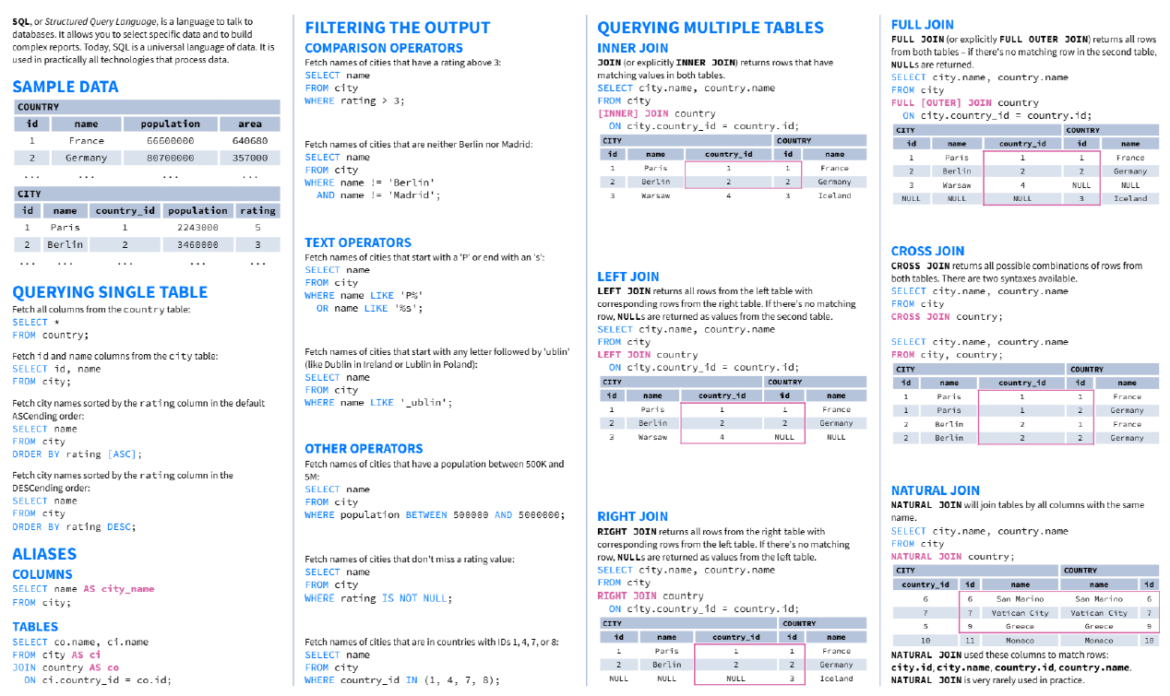

Slide 136
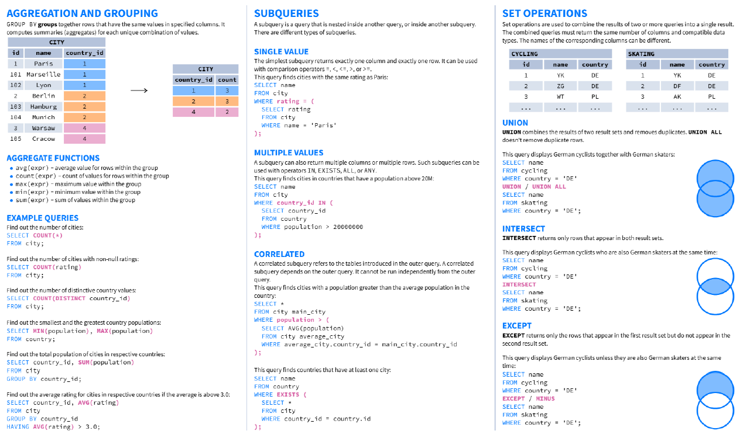

Slide 137
DDL – Data Definition Language:
DDL defines, alters, and deletes database structures.
COMMAND | DESCRIPTION | SYNTAX
CREATE | Create database or its objects (table, index, function, view, stored procedure, trigger). | CREATE TABLE table_name (column1 data_type, column2 data_type, ...);
DROP | Delete objects from the database. | DROP TABLE table_name;
ALTER | Alter the structure of the database. | ALTER TABLE table_name ADD COLUMN column_name data_type;
TRUNCATE | Remove all records from a table; frees space allocated for records. | TRUNCATE TABLE table_name;
COMMENT | Add comments to the data dictionary. | COMMENT ON TABLE table_name IS 'comment_text';
RENAME | Rename an object existing in the database. | RENAME TABLE old_table_name TO new_table_name;
CREATE TABLE employees (
employee_id INT PRIMARY KEY,
first_name VARCHAR(50),
last_name VARCHAR(50),
hire_date DATE);

Slide 138
DQL – Data Query Language
DQL retrieves data. SELECT is the main command; others are clauses.
CLAUSE | DESCRIPTION | SYNTAX
SELECT | Retrieve data from the database. | SELECT column1, column2, ... FROM table_name WHERE condition;
FROM | Indicates the table(s) from which to retrieve data. | SELECT column1 FROM table_name;
WHERE | Filters rows before any grouping or aggregation. | SELECT column1 FROM table_name WHERE condition;
GROUP BY | Groups rows having the same values in specified columns. | SELECT column1, AVG(column2) FROM table_name GROUP BY column1;
HAVING | Filters the results of GROUP BY. | SELECT column1, AVG(column2) FROM table_name GROUP BY column1 HAVING condition;
DISTINCT | Removes duplicate rows from the result set. | SELECT DISTINCT column1, column2 FROM table_name;
ORDER BY | Sorts the result set by one or more columns. | `SELECT column1 FROM table_name ORDER BY column1 [ASC
LIMIT | Restricts number of rows returned. (Default sort ascending unless DESC specified.) | SELECT * FROM table_name LIMIT number;
SELECT first_name, last_name, hire_date
FROM employees
WHERE department = 'Sales'
ORDER BY hire_date DESC;

Slide 139
DML – Data Manipulation Language
DML manipulates data stored in tables.
COMMAND | DESCRIPTION | SYNTAX
INSERT | Insert data into a table. | INSERT INTO table_name (column1, column2, ...) VALUES (value1, value2, ...);
UPDATE | Update existing data within a table. | UPDATE table_name SET column1 = value1, column2 = value2 WHERE condition;
DELETE | Delete records from a database table. | DELETE FROM table_name WHERE condition;
INSERT INTO employees (first_name, last_name, department)
VALUES ('Jane', 'Smith', 'HR');

Slide 140
DCL – Data Control Language
DCL controls permissions and access.
COMMAND | DESCRIPTION | SYNTAX
GRANT | Assign new privileges to a user account. | GRANT privilege_type [(column_list)] ON [object_type] object_name TO user [WITH GRANT OPTION];
REVOKE | Remove previously granted privileges. | REVOKE [GRANT OPTION FOR] privilege_type [(column_list)] ON [object_type] object_name FROM user [CASCADE];
GRANT SELECT, UPDATE ON employees TO user_name;

Slide 141
TCL – Transaction Control Language
TCL manages transactions in the database.
COMMAND | DESCRIPTION | SYNTAX
BEGIN TRANSACTION | Starts a new transaction. | BEGIN TRANSACTION [transaction_name];
COMMIT | Saves all changes made during the transaction. | COMMIT;
ROLLBACK | Undoes all changes made during the transaction. | ROLLBACK;
SAVEPOINT | Creates a savepoint within the current transaction. | SAVEPOINT savepoint_name;
BEGIN TRANSACTION;
UPDATE employees SET department = 'Marketing' WHERE department = 'Sales';
SAVEPOINT before_update;
UPDATE employees SET department = 'IT' WHERE department = 'HR';
ROLLBACK TO SAVEPOINT before_update;
COMMIT;

Slide 142
EXTRAS

Slide 143
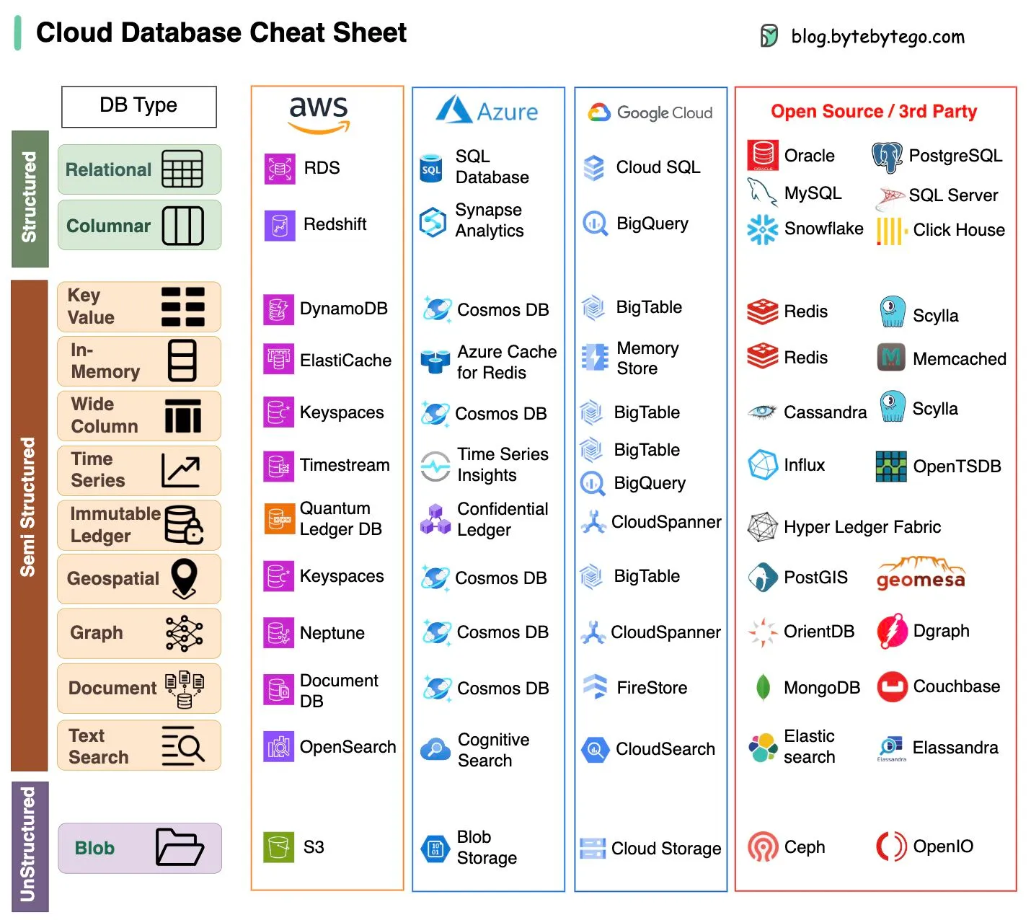

Slide 144
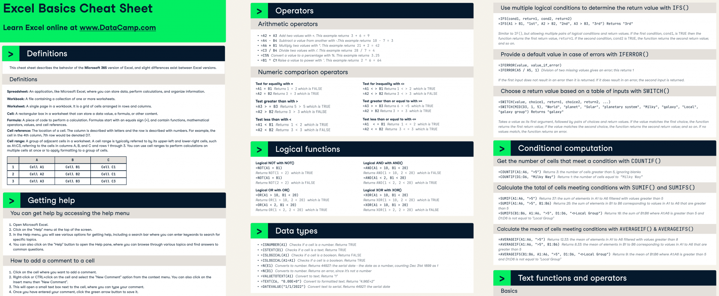
EXCEL BASICS

Slide 145
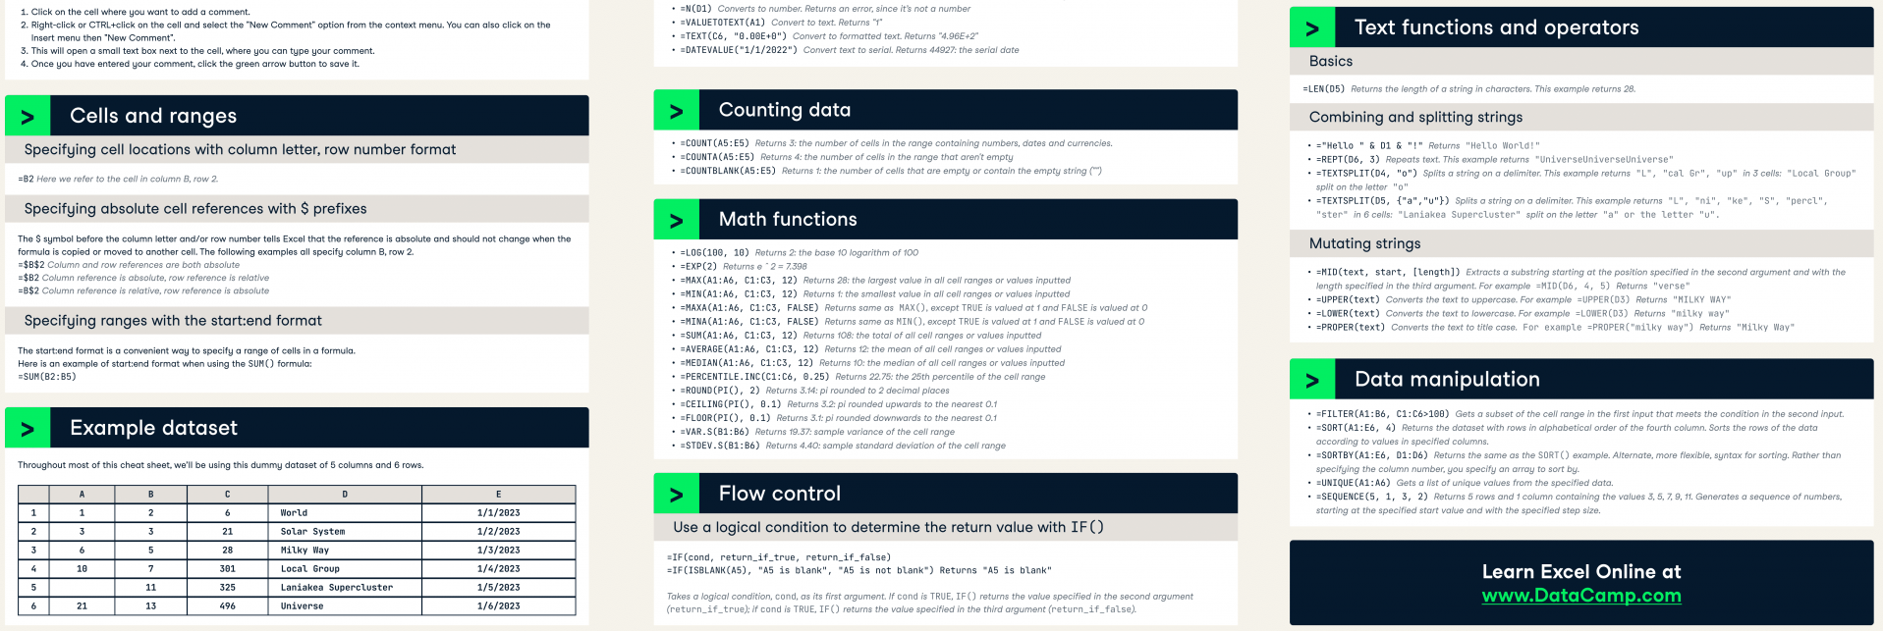
EXCEL BASICS

Slide 146
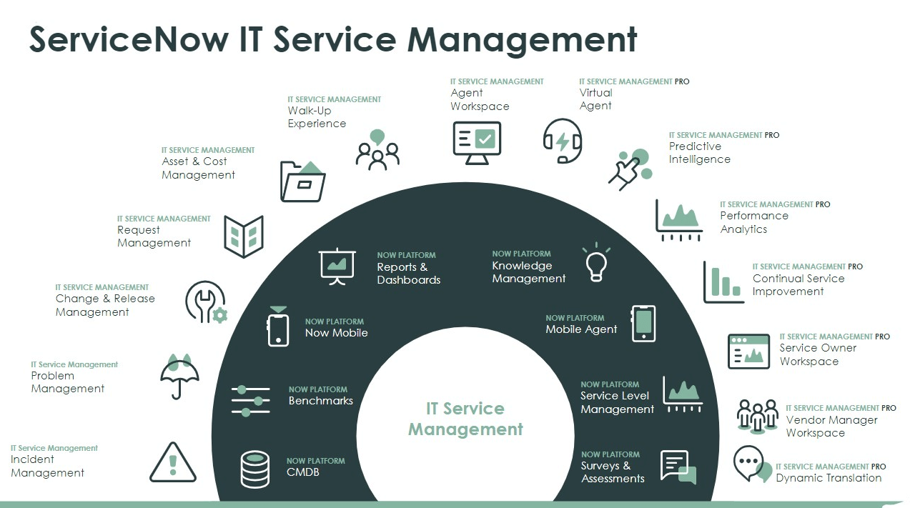

Slide 147
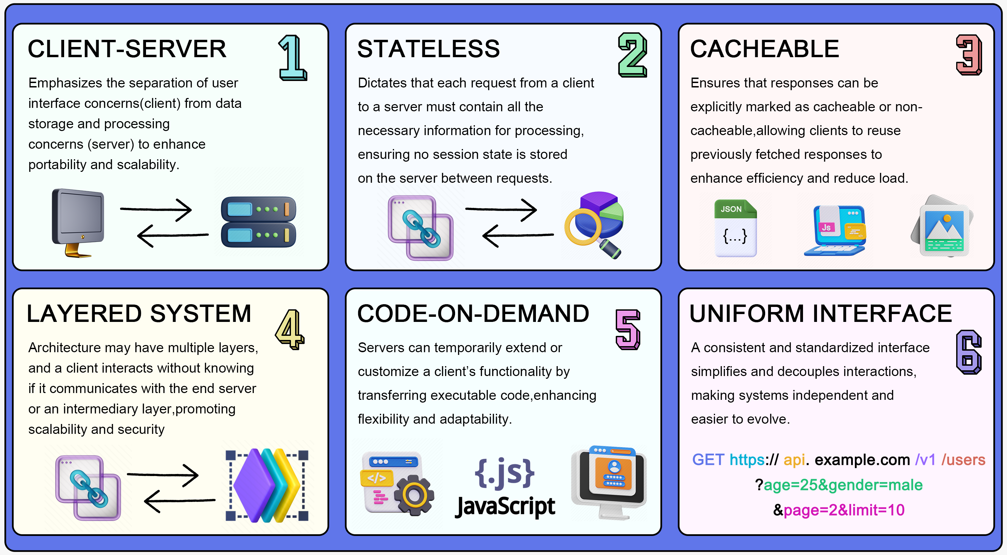
API BASICS

Slide 148
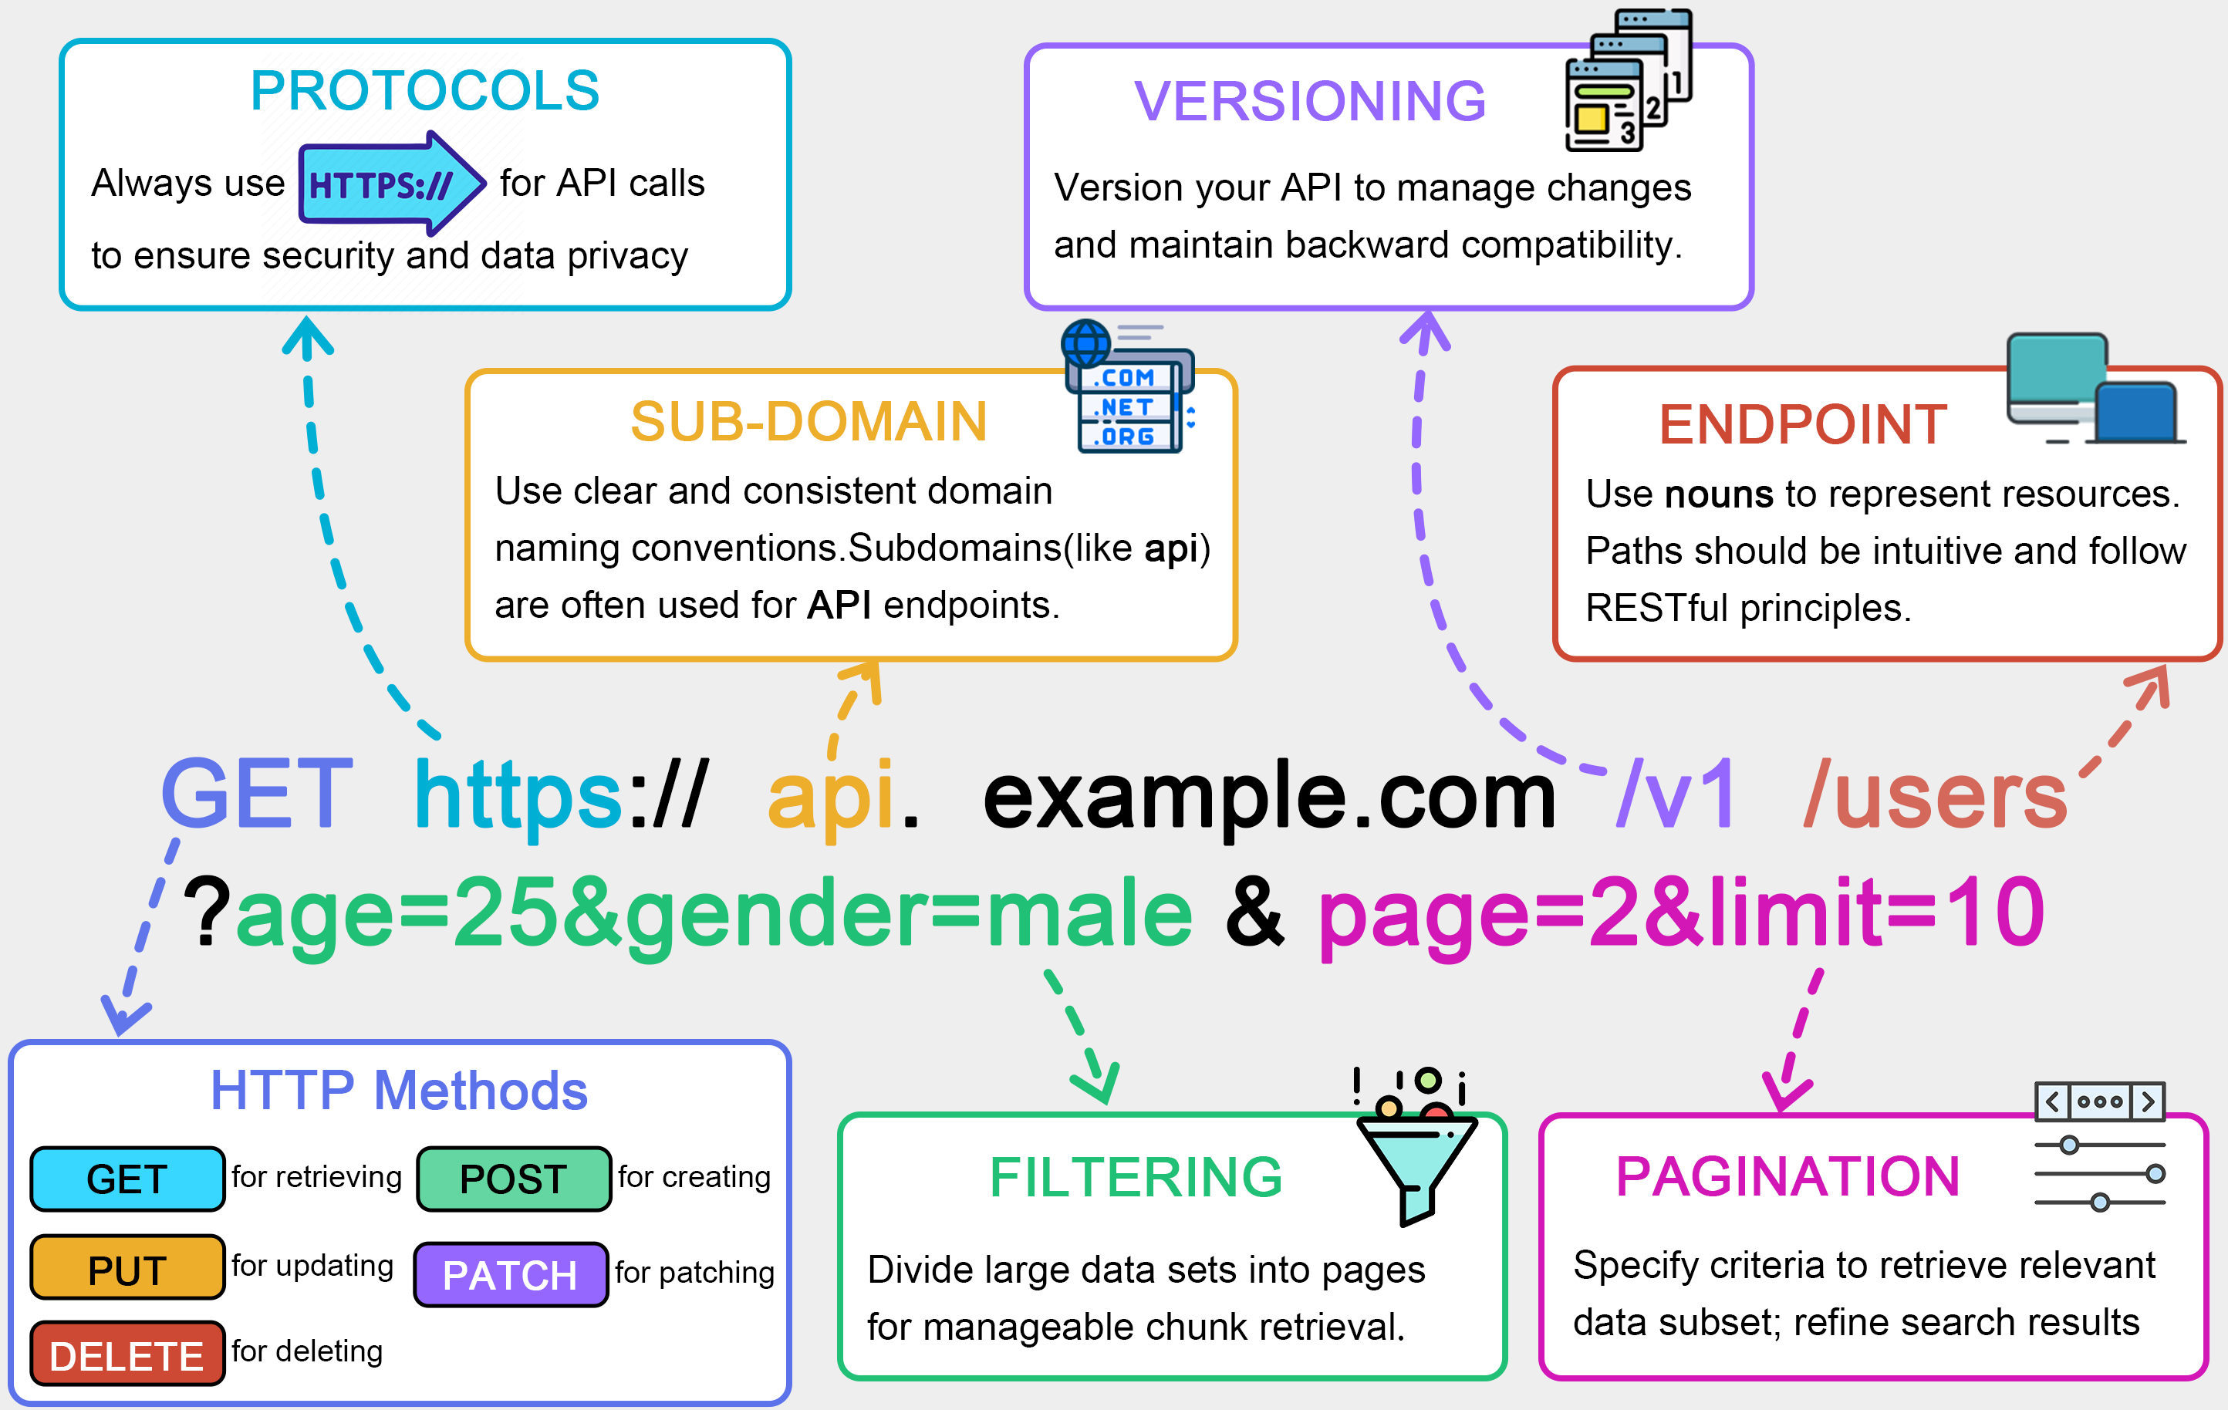
API BASICS

Slide 149
STARTEGIC CONSULTATION

Slide 150

What do management consultants actually do?
Understanding the industry
Identifying Key Questions and Hypothesis
Structuring the problem
Conducting Analysis
Presenting insights
Quickly familiarize with customer’s industry using reports, financial data, press coverage, and expert insights
They breakdown broad challenges into small testable questions. Hypothesis are formed to guide the analysis
Frameworks like Pyramid principle, Value chain analysis, SWOT analysis are used to organise the investigation logically
Gather and analyse data, conduct surveys, research competitors, and seek expert opinions to validate or disapprove their hypothesis
Findings are delivered clearly through actionable reports.
Consulting Process
Problem Structure initial hypothesis & approach
Data Collection (Qualitative & Quantitative)
Client feedback and buy in
Data synthesis and hypothesis development
Future of Consulting 2025+
Outcome-based models
AI-human collaboration
ESG (Environmental, Social, & Governance) & impact-driven focus
Preliminary findings
This is where you need to spend most of your time as a consultant
Recommendations and implementation plan

Slide 151
New Associate Consultant Role
Value addition: Build Trust Through Analytical Integrity
Communication: Show Professionalism from Day One
Extraordinary Teams: Be a collective, reliable teammate
Deliver reliable and accurate analysis – every time
Treat every deliverable as if it’s going to the CEO
Gather data effectively and creatively (Industry reports, site visits, social media trends)
Strive for Zero-defect analysis:
Check your logic, calculations, and sources
Document assumptions and methodologies with clear audit trails
Organize and format all materials in a clear, consistent style.
Listen actively:
Capture both what is said and what is implied
Ask thoughtful, clarifying questions.
Take a clear, structured notes that reflect the nuance of the conversation
Be punctual, responsive, and dependable
Respect your teammate's time – come prepared and proactive
Uphold the firm’s standards of quality and conduct in everything you do.
New Manager Role
Value addition at this level
Communication: Show Professionalism from Day One
Extraordinary Teams: Be a collective, reliable teammate
Take full ownership of the case team's overall value creation and project success.
Provide intellectual leadership by framing the client’s business issues creatively & prioritizing what matters most.
Set and enforce high standards of analytical rigor and quality throughout the team’s work.
Tailor communication formats to clearly convey insights & influence customer decision-making.
Codify key learnings & value delivered to strengthen internal knowledge and best practices.
Independently craft clear, logically strutted, management-consulting-style presentations that drive action.
Align with clients on project goals, analytical approach, and implications to build shared ownership.
Establish credibility with senior executives by demonstrating deep understanding and innovative thinking.
Cultivate ongoing customer engagement and identify opportunities for future firm’s involvement.
Actively manage team members professional development through skill planning, coaching, and timely feedback.
Balance case goals with individual growth, engagement, and satisfaction.
Proactively engage supervisors with focused questions and timely updates to drive better outcomes.
Foster a culture of collaboration, enthusiasm, and commitment to team, client, and form success.
Step up for non-client initiatives and contribute positively to overall office morale.

Slide 152
5 Step Approach to solve a business case
Understand & Analyze the case facts
Identify the key issue(s)
Outline Realistic Alternatives
Evaluate Each Option
Deliver a clear recommendation
Carefully read and re-read the case to grasp all details.
Highlight key facts, interpret charts, and question assumptions.
Treat all facts as true, but assess opinions critically.
Develop thoughtful questions to uncover cores issues.
Use the facts to uncover the main challenges.
Go beyond surface-level problems to find root cause.
Consider strategic, operational, and market-related factors.
Develop context-appropriate, feasible options.
Align ideas with the company’s size, goals, and constraints.
Consider market conditions, customer needs, and competitive pressures.
Weigh pros and cons using strategic frameworks.
Acknowledge risks, data gaps, and resource limitations.
Use consistent criteria to assess implications and trade-offs
Present a well justified, realistic course of action.
Demonstrate commercial awareness and logical reasoning.
Be a part to explain how you reached your conclusion
BUSINESS CASE
Profitability
Industry Analysis
Marlet entry
Capacity expansion
Merge and acquisition
Investments
Organizational behaviours
BRAINSTORMING
Define a problem
Build a decision tree
Create a hypothesis
Test a hypothesis
Generate solutions
Implement an idea
ESTIMATION
Clarify the scope
Structure the problem
Create assumptions
Calculation
Sanity check

Slide 153
How to succeed in case interviews
Tailor your approach
Demonstrate Curiosity
Show Business Acumen
Stay calm under pressure
Passion for problem solving
Final Thought
Craft your own problem-solving strategy – don’t rely solely on frameworks.
Use tools like porter’s 5 focus, Three C’s, or IVK systems to guide, not dictate.
Show you’re intellectually curious and enjoy the challenge.
If you’re not enjoying case prep, it may be a sign consulting isn’t the right path.
No business degree? No problem-just to do your homework.
Read widely.
The financial times, Bloomberg, Reuters, The Economist.
Interviewers will apply pressure-grace under fine counts.
You’re judged more on how you think than what you know.
Be genuinely excited about cracking the case.
Ask meaningful questions, like:
“Was this based on real project? What was the outcome?
The top candidates bring more than frameworks-they bring energy, insights, and real curiosity.
Be that person, and you’re already halfway there.
Understanding Competitive Strategy
Bargaining power of suppliers
Two foundational Questions drive strategy
5 forces framework shapes industry profitability
How attractive is the industry you compete in?
What is your position within that industry?
Rivalry among existing competitors
Threat of new entrants
Bargaining power of buyers
Bargaining power of suppliers
Threat of substitutes
Threat of new entrants
Existing Industry Rivalry
Threat of substitute products
Industry Examples
Pharmaceuticals: A 5 star industry with high barriers, low price sensitivity, and minimal substitutes
Airlines: Post-deregulation, a low profit industry marked by intensive rivalry and price sensitivity
Bargaining power of Buyers

Slide 154
Mastering Industry and Market Analysis
Step 1: Define the Market
Step 2: Identify Size and Growth
Step 3: Determine Attractiveness
Step 4: Analyse Trends
What market/industry are we looking at?
Are we being too parochial?
Do we need to change our focus?
Do we need to be more creative in our definition of the market?
What is the size / growth?
Is the market big enough?
Is growth fast enough?
Do we need to look elsewhere for growth potential?
Is this the market for me?
How competitive is the market?
What is the threat of entry/substitution?
How easy is it to create competitive advantage?
How well am I positioned compared to competitors?
What’s going on?
Are there broader trends we should be aware of?
What impact is technology having on the market?
Strategic Differentiation
FORCES | COST LEADERSHIP | DIFFERENTIATION | FOCUS
Threat of New Entrants | Use cost advantages to deter new entrants | Create unique products to increase entry barriers | Serve niche markets with specialized knowledge
Bargaining Power of Suppliers | Leverage higher volumes to negotiate better deals | Establish strong supplier relationships with unique products | Build close relationships in niche markets for favorable terms
Bargaining Power of Buyers | Offer lower prices to attract price-sensitive customers | Provide unique products that justify higher prices | Serve specific customer needs effectively, creating loyalty
Threat of Substitutes | Use cost advantages to make substitutes less attractive; compete on price | Develop distinctive products with few substitutes | Focus on specialized products for niche markets
Industry Rivalry | Achieve cost efficiency to outperform competitors on price | Differentiate products to reduce direct competition | Concentrate on a specific market segment to reduce competition

Slide 155
How Modern Firms Create and Sustain Competitive Advantage Beyond Cost – Strategic Differentiation
Why Great Industry Analysis starts with “Why” and “So What”
From Surface-Level Questions to strategic intelligence
Perceived Value > Functional Value
Customers buy what they believe is better, not just what is better. Winning brands shape perception through trust, design, and experience.
What is the size of the market?
How quickly is the market growing?
What is the market value chain?
Focus Wins
Firms that succeed don’t try to be good at everything. They double down on one thing their core customers care most about - and do it better than anyone.
How profitable is the industry?
Conducting an
industry analysis
Who are the key players?
Differentiation Requires Trade-Offs
Saying no is strategic. Great companies protect their uniqueness by avoiding distractions and resisting the urge to imitate rivals.
What are the customers demands?
What is the concentration in the market?
Execution is the Moat
It’s not just what you promise—it’s how consistently you deliver. Operational excellence turns strategy into reality.
What are the competitive dynamics?
What are the main industry trends?
What are the glaring issues in the market?
Being Different Isn’t Enough - Be Believable
Clear, credible communication is essential. If customers can’t see or understand your differentiation, it doesn’t count.
Remember: Always ask why? and so what? to move from analysis to insights

Slide 156
From Benchmarking to Strategy-Shaping Insights
Understanding Client Context Through Market Analysis
Understanding industry structure, cost dynamics, & strategic positioning… a frame of insights beyond just market definition (1/1)
Typical Insights created by industry and market analysis
Value chain analysis identifies areas of competitive advantage or disadvantage along 2 lines:
How firms are creating value.
Who is successful/unsuccessful, and why.
What our clients’ situation is compared with what it believes its situation to be.
Whether the business or segments are attractive.
Whether any competitors dominate the value chain.
Relative power at key stages within the industry.
The firm may be able to control its cost drivers better than competitors (“internally focused - - cost containment”)
The firm may be able to reconfigure the value chain to capitalize on its strengths (“externally” focused - - revenue enhancement)
Understanding Client Context Through Market Analysis
Understanding industry structure, cost dynamics, & strategic positioning… a frame of insights beyond just market definition (1/2)
Typical questions we are trying to answer through industry and market analysis
Value chain analysis drives strategic hypothesis to answer several questions:
Is our client’s performance good or bad relative to competitors?
Is our client’s growth rate fast or slow relative to the market?
What are the trends that may impact performance in the future?
Are they within our control?
How is value added in the client’s industry?
Are they playing in the optimal place in the value chain?
Is our client’s market fundamentally attractive, or not?
How does this influence what we should do?
Where are we, and our competitors, earning money? Why?
Do competitors financials differ according to how they are structured and where they play along the value chain?
Should we forward or backward integrate?
Should we outsource or spin-off value activities (i.e., business processes)?
What are the industry critical success factors?
What are our managerial action plans to control costs, improve service and increases delivered value?

Slide 157
Return on Assets
Company | Net Income After Taxes | Revenues | Assets | Liabilities | Equity
Company A | 254B | 2.6B | 2.8B | 1B | 1.8B
Company B | 7B | 77B | 1.121T | 1.085T | 35B
Company C | 11B | 348B | 151B | 89B | 61B
Return on assets is an indicator of how profitable a company is relative to its total assets
Return on assets =
Net Income/Total Assets
 | Assets | Returns | ROA
Spartan Sam | 1500 | 150 | 10%
Fancy Fran | 15000 | 1200 | 8%
Return on Equity
Return on Equity =
Net Income/Shareholder’s Equity
 | ROE
TechCo | 18%
Industry peers | 15%
Acceptable long term average of ROE | 14%
Poor long term average of ROE | 10%
Return on Equity is considered a measure of how effectively management is using a com[any’s assets to create profits
Net Profit Margin
Net Profit Margin =
{(R – COGS – E – I – T)/R}*100 =
(Net Income/R)*100
Where:
R = Revenue
COGS = The Cost of goods sold
E = Operating and Other expenses
I – Interest
T = Taxes
The Net profit margin illustrates how much of each dollar in revenue collected by a company translates into profit

Slide 158
Debt to Assets: The Debt to Assets ratio indicates the proportion of a company’s assets that are being financed with debut, rather than equity. The ratio is used to determine the financial risk of a business.
Debt to Equity: The debt to equity ratio is similar ratio indicating the relative proportion of shareholders’ equity and debt used to finance a company’s assets. The ratio is used to evaluate a company’s financial leverage.
Company | Net Income After Taxes | Revenues | Assets | Liabilities | Equity
Company A | 254B | 2.6B | 2.8B | 1B | 1.8B
Company B | 7B | 77B | 1.121T | 1.085T | 35B
Company C | 11B | 348B | 151B | 89B | 61B
Calculation
Company | ROA | ROE | Net Profit Margin | Debt to Assets | Debt to Equity
Company A | 254B/2.28B = 9% | 254B/1.8B = 14% | 254B/2.6B = 10% | 1B/2.8B = 36% | 1B/1.8B = 56%
Company B | 7B/1121B = 1% | 7B/35B = 20% | 7B/77B = 9% | 1085B/1121B = 97% | 1085B/35B = 3103%
Company C | 11B/151B = 7% | 11B/61B = 18% | 11B/348B = 3% | 89B/151B = 60% | 89B/61B = 148%
Company | ROA | ROE | Net Profit Margin | Debt to Assets | Debt to Equity
Company A | 9% | 14% | 10% | 36% | 56%
Company B | 1% | 20% | 9% | 97% | 3103%
Company C | 7% | 18% | 3% | 60% | 148%

Slide 159
MARKETING
MERGERS & ACQUISITIONS
Marketing costs vary from business to business, industry to industry. Marketing budgets can be as low as 1% of sales but can exceed 30%. When a company starts, it has been known for them to spend as much as 50% of sales on introductory marketing programs during their first year.
A merger is an agreement that unites two existing companies into one new company. Mergers and acquisitions (M&A) are business transactions in which the ownership of companies, business organizations, or their operating units are transferred to or consolidated with another company or business organization. Mergers and acquisitions are commonly done to expand a company’s reach, expand into new segments, or gain market share, all of which are done to increase shareholder value.
RULES FOR COMMODITIES
VARIETIES OF MERGERS
FACTORS CONSIDERED WHILE M&A
When you compare the output of one facilities and the output of another facility, you can’t make up any difference. The output must be elastic. Increasing volume is capital intensive and time intensive.
Horizontal Merger
Vertical Merger
Market-extension Merger
Product- extension Merger
Conglomeration
Purchase Mergers
Consolidation Mergers
Check on the company's liquidity and financial well being
Prepare the business team for the merger or acquisition
Engage in pre-merger/acquisition planning by defining the post-merger/acquisition goals & objectives.
Exercise Due diligence
Create a dedicated M&A transition team
Plan ahead as you make your business transition.
DISCOUNTED CASH FLOW
DCF analysis uses future free cash flow projections and then discounts them to arrive at a present value estimators. This is present value estimate is used to evaluate the potential of the investment
Formula:
DCF = CF / (1 + r)^n
The Discounted Cash Flow (DCF) formula is used to estimate the value of an investment based on its expected future cash flows. The formula is expressed as where:
CF = Cash Flow in the period
r = Discount rate (often the Weighted Average Cost of Capital, WACC)
n = Period number
KEY VALUATION METHODS
Discounted Cash Flow (DCF)
Comparables (Comps)
Multiples (P/E, EV/EBITDA)
P/E – Price or Earnings Multiples;
EV/EBITDA – Enterprise Value/Earnings Before Interest, Taxes, Depreciation, and Amortization

Slide 160
More Customers
Better market coverage
Revenue Synergies
Increased pricing power
Higher average spend per customer
Cross sales from different product types
Synergies: profit difference from combined company Vs sum of separated companies
Infrastructure
Direct costs
Maintenance
Installation
Cost Synergies
Sales
Indirect costs
Marketing
Call Centre

Slide 161
Logistics
Operations
Primary
Activities
Market & Sales
Services
How to measure my division’s operating efficiency?
Procurement
Technology
Support
Activities
Prioritized
Branch
Human Resource
Firm Infrastructure

Slide 162
BRD Vs FRD Vs PRD Vs SRS
DOCUMENT | PURPOSE | FOCUS | AUDIENCE | EXAMPLE CONTENTS
BRD(Business Requirements Document) | Defines high-level business goals, needs, and objectives for a project or product. | "What" the business wants to achieve and "why"; strategic value and outcomes. | Business stakeholders, project managers, business analysts. | Business problem/opportunity, objectives, scope, business requirements, stakeholders, success metrics.
FRD/FRS(Functional Requirements Document/Specification) | Details the system's functions to meet business needs. | "How" the system/product should function; describes behaviors, logic, and features. | System analysts, developers, testers, project teams. | Functional requirements, user stories/use cases, data flows, UI wireframes, system interactions, validation rules.
PRD(Product Requirements Document) | Specifies product-level features, requirements, and roadmaps (often for market-facing products). | "What" the product should do—combines elements of business, functional, and sometimes non-functional requirements tailored to product management. | Product managers, engineers, design, marketing. | Product vision, user needs, prioritized features, user stories, acceptance criteria, release plans.
SRS(Software Requirements Specification) | Formal, comprehensive documentation of both functional and non-functional requirements necessary for software development. | Complete software specifications for "how" the solution is to be technically realized; includes detailed technical and operational expectations. | Developers, testers, technical leads, architects. | Scope, overall description, system features, data requirements, interfaces, performance, security, compliance, constraints.
Key Differences
BRD: Business-centric, why/what, strategic goals. Used at the project initiation phase to describe what needs to be solved from a business angle.
FRD: Functional logic, how, feature-level details. Specifies how the business requirements will be fulfilled and is mainly for solution design.
PRD: Product manager’s actionable doc combining business and user needs with feature-level requirements for building market-facing products.
SRS: Technical, software-focused, both functional and non-functional requirements for developers—blueprint for the final system.

Slide 163
From a Product Manager’s perspective, managing end-to-end SaaS product development involves overseeing specific tools and infrastructure needs aligned with each critical stage of the product lifecycle. Here’s a clear breakdown: (1/3)
1. Ideation and Market Validation
Use market research and competitor analysis tools (e.g., Google Analytics, SEMrush) to validate the problem and product fit.
Employ collaboration tools (e.g., Jira, Confluence) to align stakeholders and document product vision, goals, and user personas.
Engage with customers through surveys and feedback platforms to gather early requirements.
2. Defining Product Requirements
Work with UX designers using wireframing and prototyping tools (e.g., Figma, Adobe XD) to shape the user experience.
Translate insights into clear user stories and acceptance criteria managed in product management systems (e.g., Jira, Azure DevOps).
Prioritize features using frameworks like MoSCoW and communicate roadmaps and timelines with tools like Aha! or Product board.
3. Development Coordination
Collaborate with engineering to select appropriate tech stack and infrastructure (cloud providers like AWS, Azure, containerization through Docker/Kubernetes) ensuring scalability and reliability.
Use version control and CI/CD pipeline tools (GitHub, Jenkins) for smooth code integration and deployment.
Monitor sprint progress and team velocity through Agile tools (Jira, Rally).

Slide 164
From a Product Manager’s perspective, managing end-to-end SaaS product development involves overseeing specific tools and infrastructure needs aligned with each critical stage of the product lifecycle. Here’s a clear breakdown: (2/3)
4. Testing and Quality Assurance
Ensure integration of testing processes using automation tools (Selenium, Jest) and coordinate bug tracking.
Oversee performance and security assessments to meet compliance needs and deliver a robust product.
5. Launch and Deployment
Plan and coordinate product rollout using cloud hosting and deployment infrastructure.
Use monitoring tools (Datadog, Grafana) to track launch health metrics and user feedback channels for quick issue resolution.
Partner with marketing for feature announcements and support materials.
6. Post-Launch Maintenance and Growth
Analyze user analytics to drive continuous improvements and prioritize feature enhancements.
Manage scaling infrastructure needs with DevOps and cloud automation support.
Ensure ongoing security, compliance, and operational uptime.

Slide 165
From a Product Manager’s perspective, managing end-to-end SaaS product development involves overseeing specific tools and infrastructure needs aligned with each critical stage of the product lifecycle. Here’s a clear breakdown: (3/3)
STAGE | FOCUS | TOOLS/INFRA EXAMPLES | KEY LANGUAGES/TECH
Ideation & Validation | Market research, documentation | Google Analytics, SEMrush, Jira | None
Requirement & Design | Prototyping, story mapping | Figma, Adobe XD, Jira | HTML, CSS, JavaScript (React.js, Vue.js)
Development | Frontend, backend, API | GitHub, Jenkins, Docker, AWS | JS/TS (React, Angular), Python, Java, Node.js, Ruby, Go, SQL/NoSQL
Testing | Automated/manual testing | Selenium, Jest, JMeter, OWASP ZAP | JS/TS, Python, Java
Deployment & Monitoring | IaC, deployment, telemetry | Terraform, Kubernetes, Datadog | YAML, Bash, Python
Maintenance & Scaling | Updates, autoscaling | Cloud autoscaling, CI/CD | Same as development stack

